Slide 1
Reference Points and the Sustainable Management of Diseased Populations
The oyster as an example;
with a focus on sustainability of stock and habitat

Slide 2
Agenda
What are reference points?
What models are applicable to reference point-based management?
What models and reference points have been used; which are being used now?
Should we use MPAs?
The msy challenge and “modern” Magnuson-Stevens reference points: how dangerous is the federal management system?

Slide 3
What is a reference point?
A reference point is a management goal
Reference points are often determined based on population dynamics at carrying capacity and the Schaefer model
Reference points are of two types: biomass/abundance and fishing mortality
  Abundance/biomass reference points are a desired population abundance/biomass with which current stock status can be compared: B_{msy}
  Fishing mortality reference points are the F that returns that desired abundance/biomass at B_{msy}: F_{msy}, or proxies: e.g., F_{%msp}
  Note: overfished = B < B_{msy}; overfishing = F > F_{msy}

Slide 4
What is the Schaefer Model?
Y = rB (1 – B/K)
Where Y is surplus production or yield; r is the intrinsic rate of natural increase, and K is carrying capacity.
Note that if B = K, then Y = 0
Note that Y_{max} occurs at B = 0.5K
Thus, typically: B_{msy} = K/2
Derived from the logistic model:
dN/dt = rN (1 – N/K)
Note that the logistic model contains natural mortality implicitly

Slide 5
Management Has Two Options
Manage the disease?
  Options to reduce transmission may be incompatible with msy-based “sustainability” reference points
  The potential for genetic manipulation for disease resistance is poorly known
Manage the diseased stock?
  Implement reference points consistent with “disease-normal” population dynamics
  Area management to balance population dynamics to local environmental drivers and fishing proclivities

Slide 6
Models that do not yield reference points
Forward-predicting environment-dependent population dynamics models
  These require environmental time series such as temperature and salinity
  Populations are developed by means of standard metabolic energetics and population dynamics processes such as ingestion, assimilation, growth, etc.
  Cohort variability can be added by genetics or pseudo-genetics
Note that these models actually can be used for reference points, but easy mathematical solutions are not possible – Management strategy evaluations would be necessary

Slide 7
Reference Point Models
Constancy models vs. goal-directed models
Magnuson-Stevens requires goal-dependent models (B_{msy}, F_{msy})
Quotas can be set to achieve a desired reference point using a one-year forward prediction of either model type
Stock rebuilding can only be achieved with a rebuilding trajectory based on a goal-directed model

Slide 8
Constancy Models
Models without rebuilding plans
No-net-change reference points
Surplus production models: Constant market-size abundance
Surplus production and carbonate budget models: Constant market-size abundance + constant cultch
Exploitation rate models

Slide 9
How is Disease included?
Disease is included implicitly in the natural mortality rate: thus Z = (M+D) + F
Disease is included implicitly in the biomass or abundance index: thus B_{Z=M+D} < B_{Z=M}
So, we do not care about prevalence or infection intensity; only BIOMASS and DEATH
Note that disease mortality can be compensatory; thus Z = (M+D(F)) +F
Critical concept: disease competes with the fishery for deaths
Classic Cases:
  Rule of Thumb F
  Klinck et al. model
  Soniat et al. model

Slide 10
Fishing Mortality Rate
Rule of thumb: F = M if no disease
For oysters in the Mid-Atlantic, M ~ 0.1 (about 10% per year) without disease
Thus 0.1 is an upper bound for F
Note that at low mortality rates, 1. - e^{-M} ~ M; that is, 10% of the stock dying each year is about the same as M = 0.1

Slide 11
Example: Delaware Bay
M without disease ~ 10-12%
F without disease ~ 10-12%
Z = M + F without disease ~ 20-24%
Dermo mortality rate D (circa 2010) ~ 7-15%: note that this is a total adult mortality of 17-25%
F with Dermo = Z-M-D = 22-11-7(or 15) = ≤4%
Thus, Dermo requires a de minimus fishery

Slide 12
The Klinck et al. Model
Objective: no net change in market-size abundance.
dN/dt = -(M(t) + D(t) + F(t))N + R(N)
  Where dN/dt is a balance between natural mortality M, disease mortality D, fishing mortality F, and recruitment R (R is recruitment into the fishery)
Thus:
  Mark_{t+1} = Mark_{t} e^{-(M+D)t} + SMark_{t} e^{-(M+D)t} – C = Mark_{t}
  Where C = catch and SMark is the number of animals that will grow to market size in one year
  To limit overfishing, assume D at epizootic levels (75% percentile mortality rate)
  Requires good knowledge of growth rate and mortality rate

Slide 13
The Soniat et al. Model
OYSTERS MAKE THE SUBSTRATE UPON WHICH THEY DEPEND
dS/dt = (b-λ)S
where dS/dt is a balance between shell addition b and shell loss λ: note that b = f(M,D,N)
Under the reference point constraints!
dN/dt ≥ 0 where N=market-size abundance (see Klinck et al. model)
dS/dt ≥ 0 where S=surficial shell
S_{t+1} = [1-e^{-(M+D)t}(N-C)]ξ + e^{-λt}S_{t} = S_{t}
Note the dependency on M, F, R, N, S and implicitly on growth rate
Critical concept: Disease increases the number of deaths under a given N, but also decreases shell input because N declines

Slide 14
Goal-directed models
Models with rebuilding plans
Surplus production estimate of B_{msy}
  Establishes desired abundance
  Provides F estimates
  Requires extensive time series of population characteristics
Habitat Models of Reef accretion/loss
SCAA (e.g., ASAP, Stock Synthesis) or SCALE models untested

Slide 15
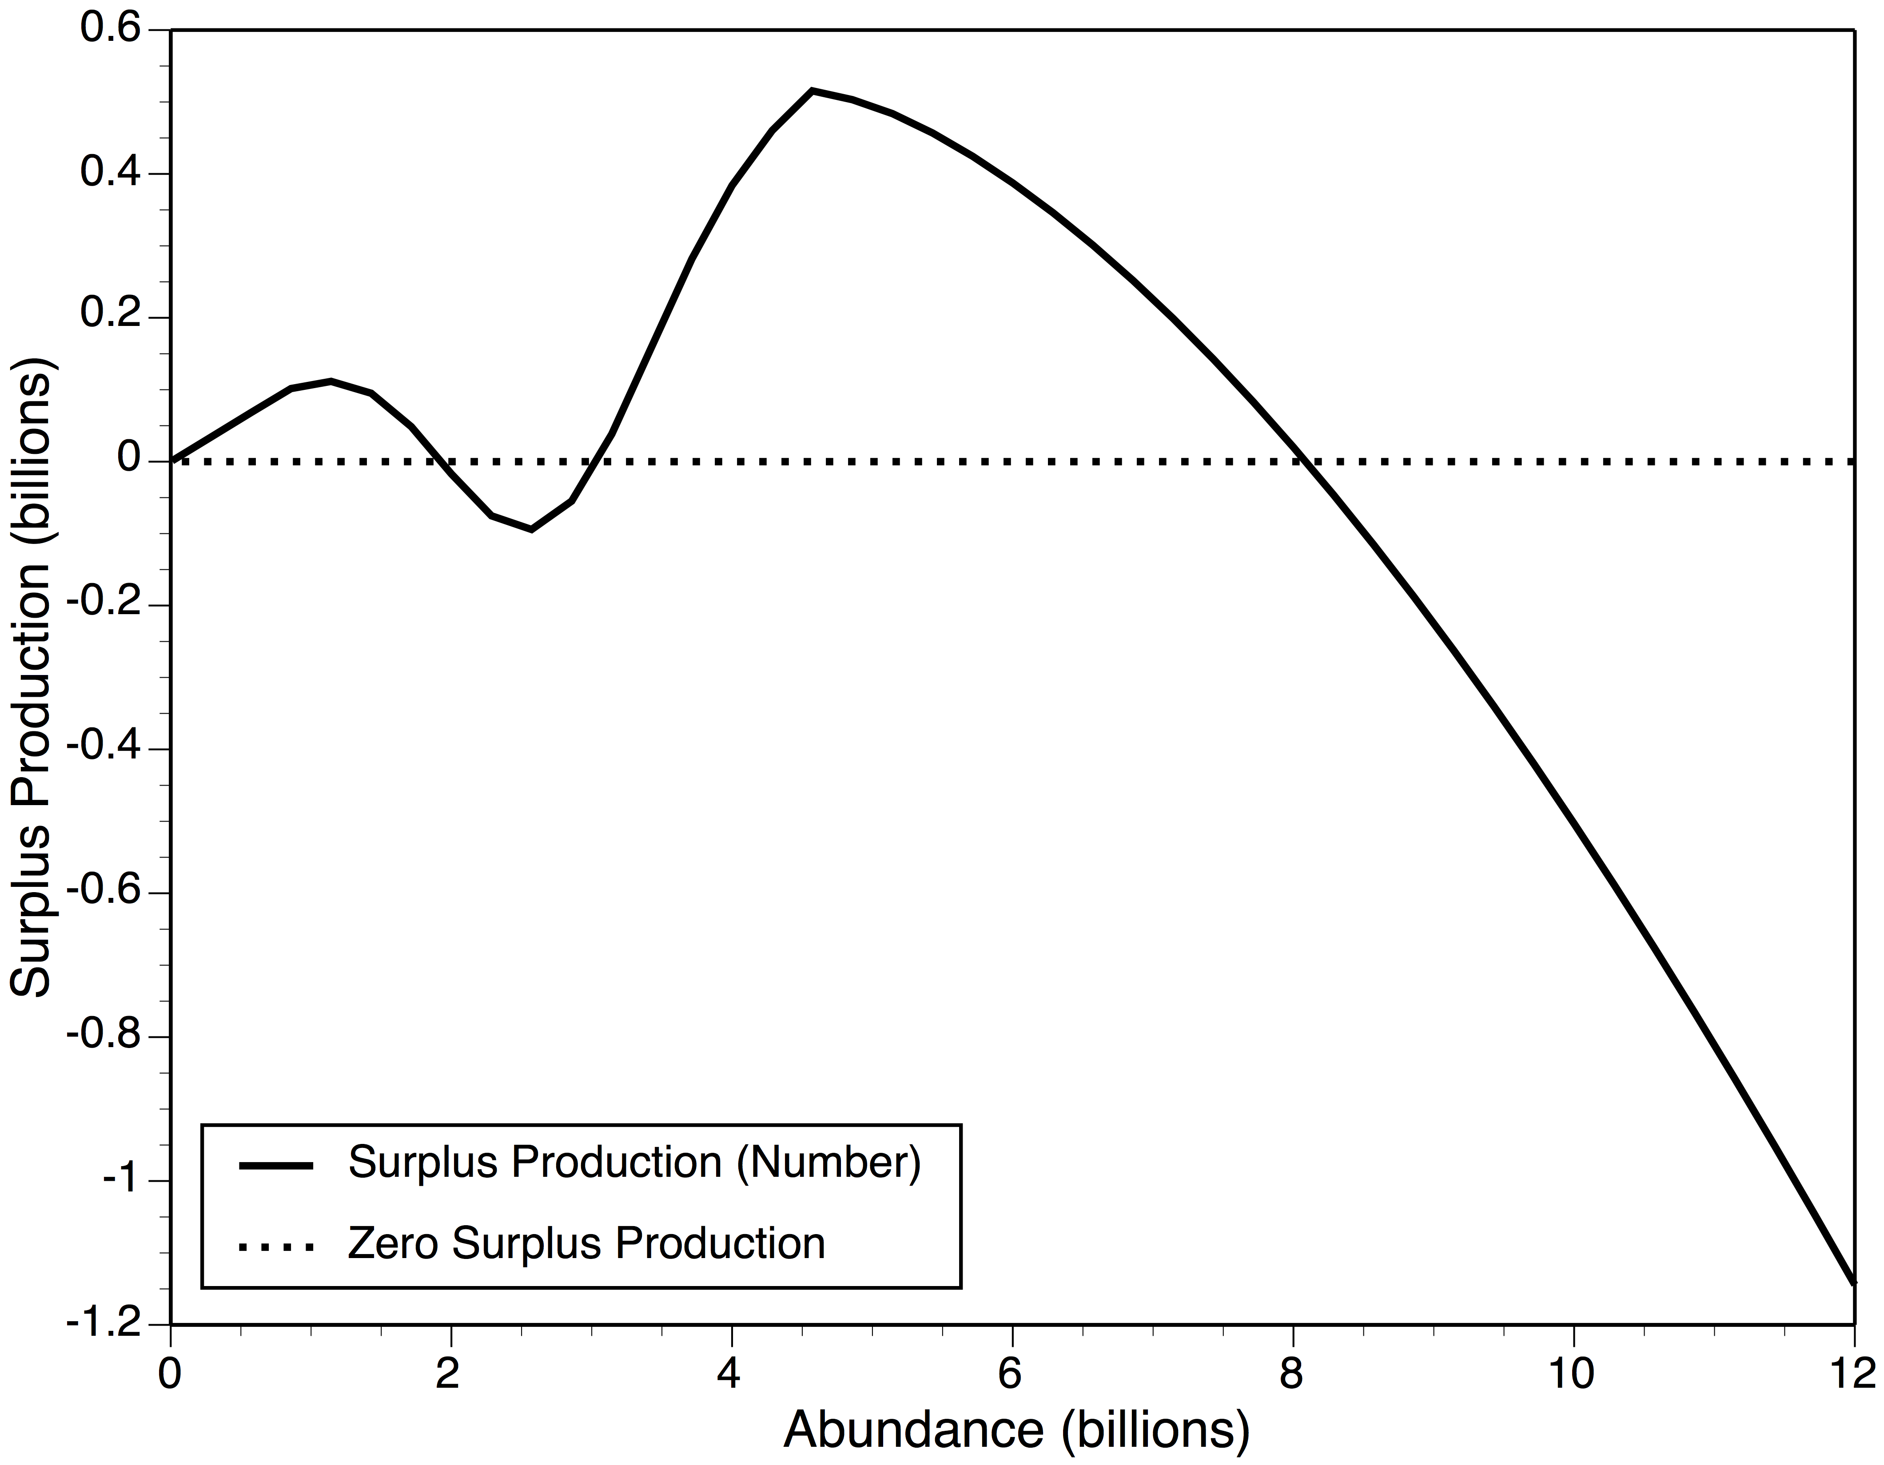
Surplus Production - Schaefer Style
Schaefer Model
High abundance-no disease
Carrying capacity
Two carrying capacities: S = 0
A minor and a major point of maximum surplus production: S> 0
A single surplus production minimum: but in this case S < 0
A point-of-no-return: S=0
Point-of-no-return
Surplus production minimum
msy

Slide 16
Reference Point Types
Type I: Carrying capacity: S = 0
Type II: Surplus production maxima (msy): S > 0
Type III: Surplus production minima: S <, =, or > 0
Type IV: Point-of-no-return: S = 0

Slide 17
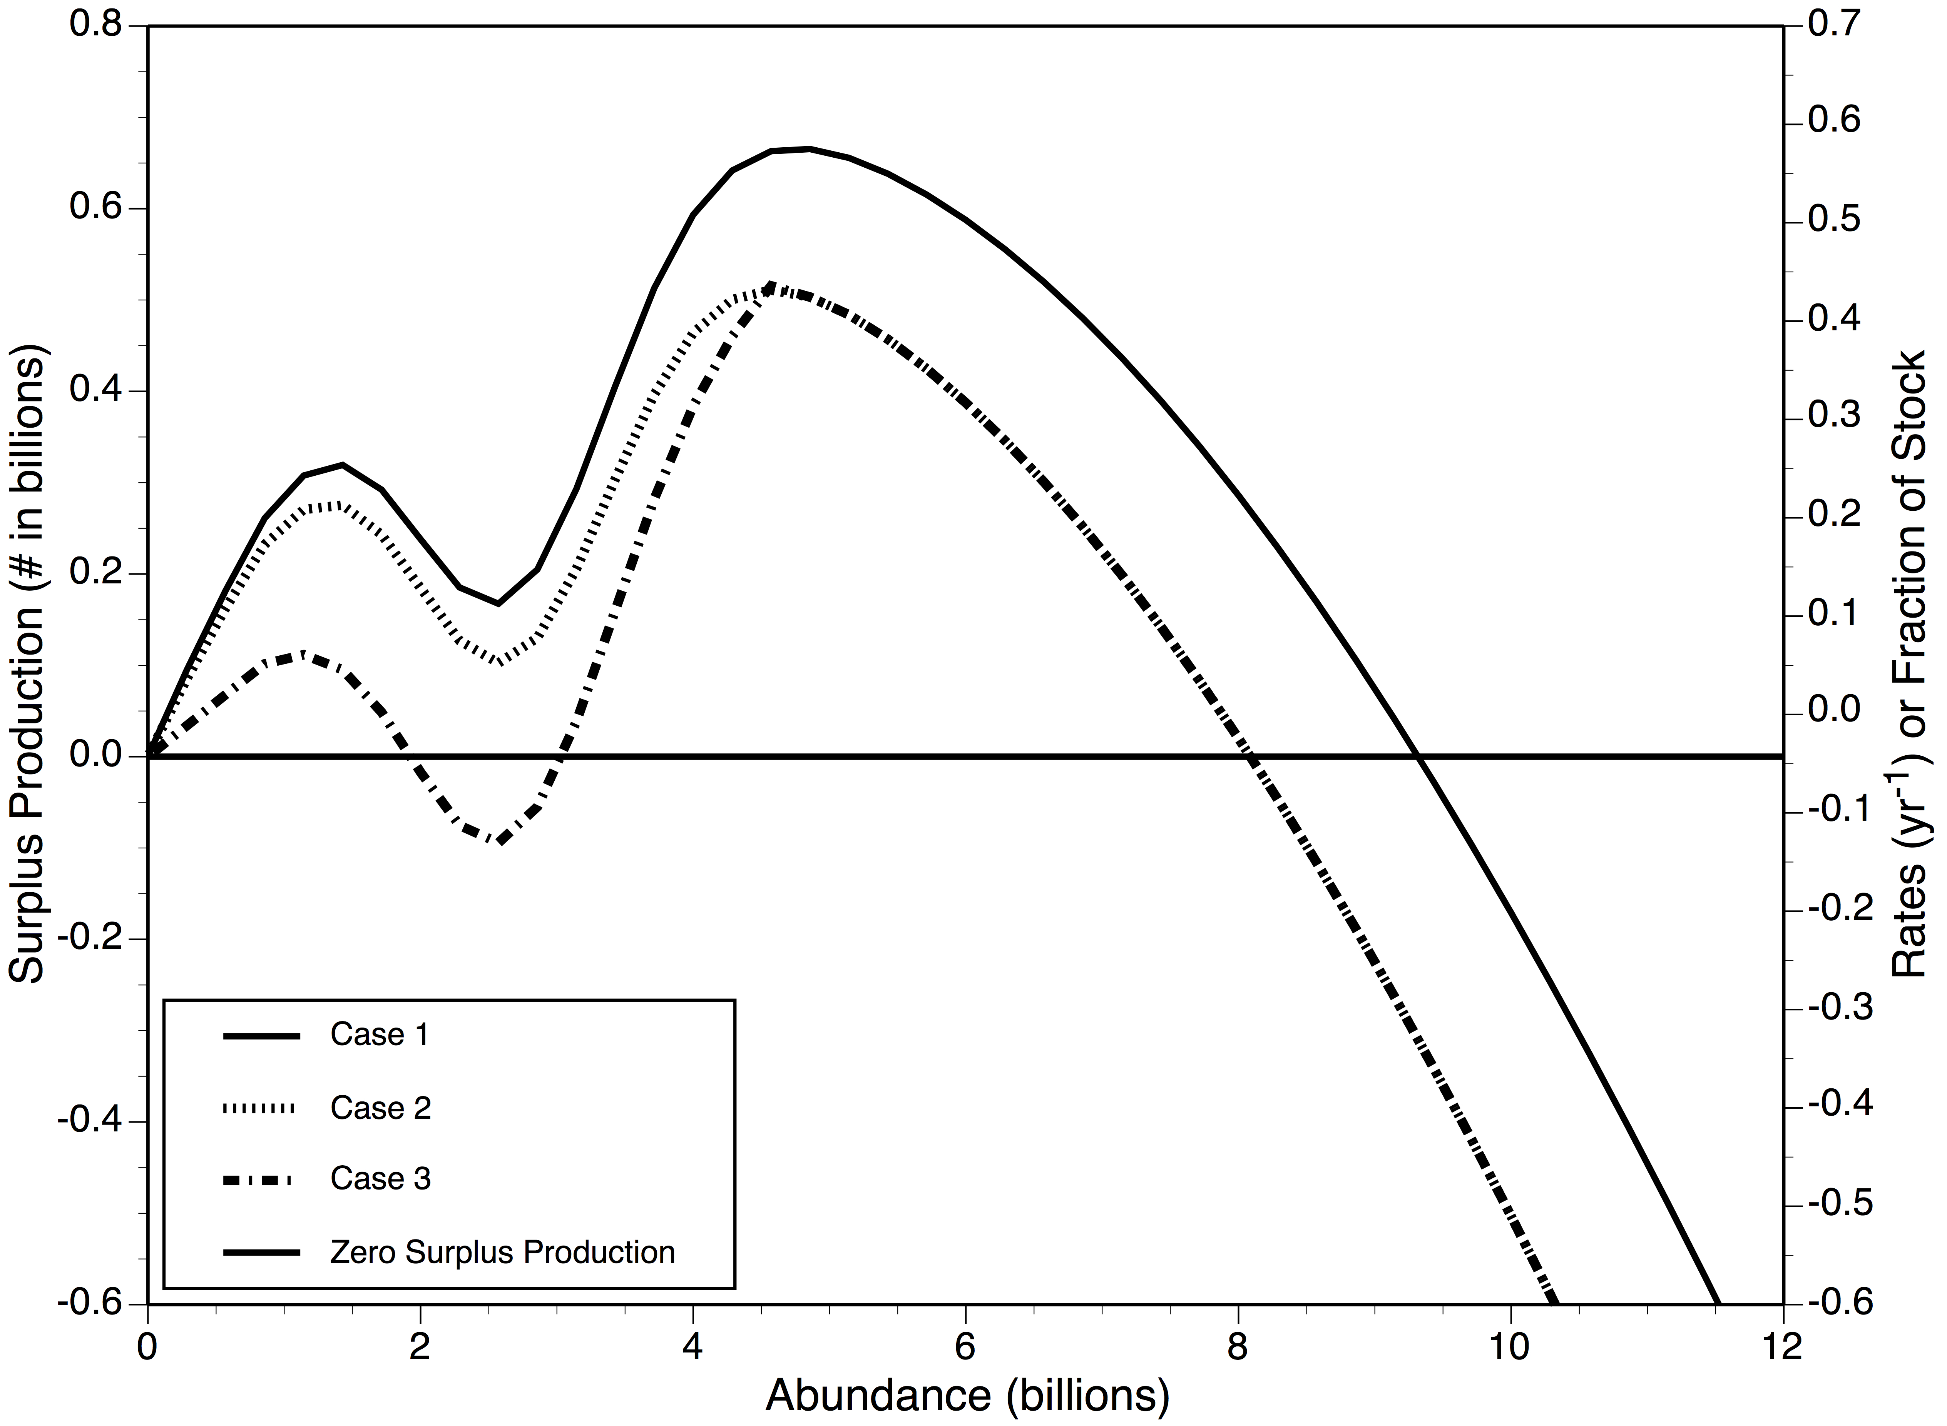
Surplus Production Trajectory Comparison
What is certain: Abundance is stable regardless of assumptions
What is uncertain: Surplus production is uncertain -- assumption-dependent
Type II
F ~ 0.17
Type II
Type III
F ~ 0.055

Slide 18
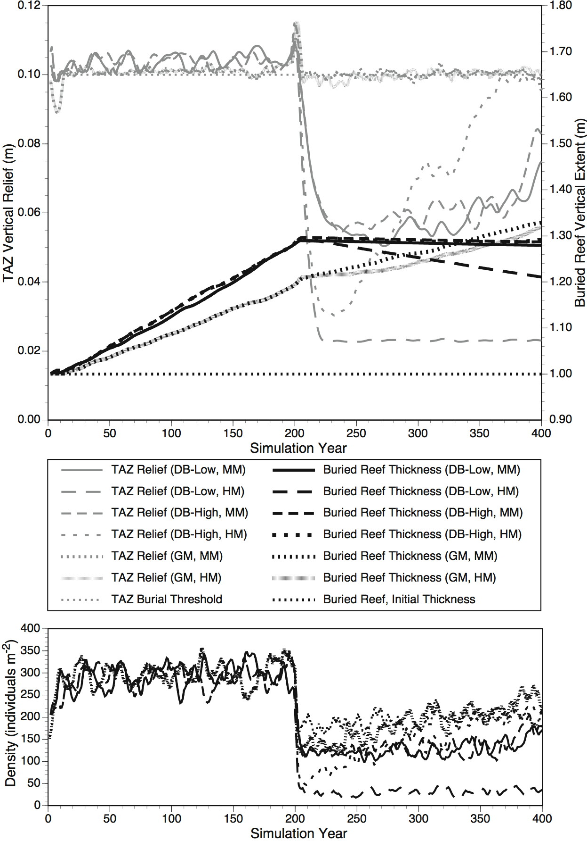
Can reefs accrete with Dermo?
TAZ shell rich
Genetic adaptation
Not likely!
Abundance declines!
Shell input declines!
Reef recession occurs!
TAZ shell poor
Stasis
Recession
Dermo onset

Slide 19
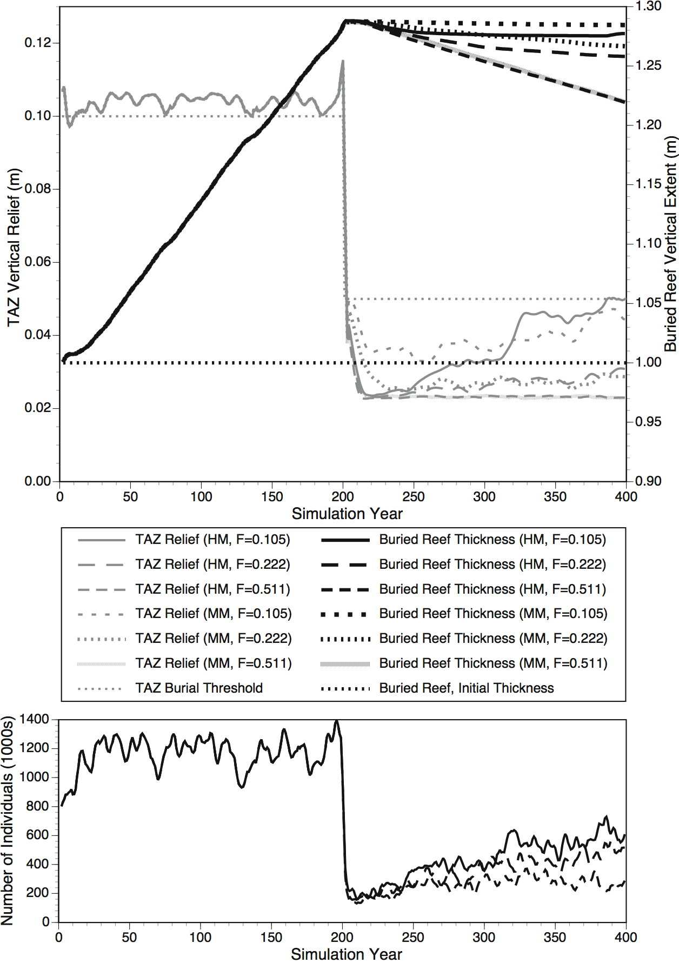
Can reefs accrete with Dermo and fishing?
Stasis
TAZ shell rich
Recession
TAZ shell poor
Very unlikely!
Abundance declines!
Shell input declines!
Reef recession occurs!
Fishing and Dermo onset

Slide 20
The Issue with MPAs
Protection of disease
Protection of susceptible genotypes
versus
Protection of undiseased stocks
Protection of resistant genotypes
Why are there so few diseases in federally managed fisheries?
Is it because (over)fished densities are below R₀ = 1? Is B_{msy} < B(R₀=1)? Is the correct goal B = B_{msy}?
Do we want to risk raising local densities to carrying capacity levels using MPAs?

Slide 21
Area Management
What do we use it for now (in the disease context)
Modulate F relative to D
Subsidize surplus production to sustain higher F
Increase steepness (overcoming Allee effects)
What might we use area management for?
Move disease resistant alleles around
Overfish highly diseased subpopulations

Slide 22
The Danger of “Modern” Magnuson-Stevens Reference Points
The surplus production model
dB/dt = (αB/(1+βB)) – (M+F)B
This is Beverton-Holt recruitment and density-independent (constant) mortality
Here is the first part of the problem!
K=1/β (α/M – 1)
That is: carrying capacity and by extension surplus production are intimately related to M and the Beverton-Holt parameters

Slide 23
And
Fmsy/M = (α/M)^{.5} – 1
Note that: F_{msy} = M^{.5} (α^{.5} – M^{.5})
Critical concept: F_{msy} scales positively with M
This is inherent in the Schaefer model which implicitly assumes that as M increases, the intrinsic rate of natural increase (implicit in the Beverton-Holt α) increases for a given K

Slide 24
Here is the danger
First, introduce steepness: a surrogate for the intrinsic rate of natural increase
Steepness (h) is defined as the recruitment (as a fraction of the recruitment at K) that results when SSB is 20% of its unexploited level
Steepness h = (α/M)/(4 + α/M)
or
Fmsy/M = (4h/(1-h))^{.5} -1

Slide 25
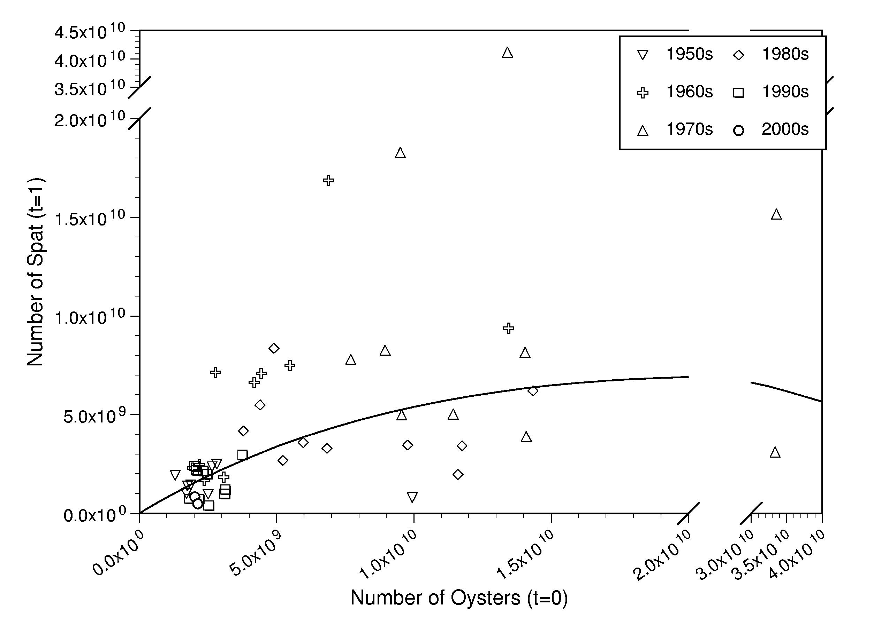
Broodstock-Recruitment: Delaware Bay
h ~ 0.5

Slide 26
Take Home Message
Critical concept: Disease changes mortality rate, but not steepness!
For oysters: with M = 0.10; F_{msy} = .246
But with epizootic M = 0.25; F_{msy} = .616
Note that M=F_{msy}=0.1 implies h ~ 0.55
But what if Z increases due to a disease: that is, what if Z > M? We assume implicitly than M=Z if F=0

Slide 27
What Does This Mean?
Disease mortality must be treated like fishing mortality:
F_{total} = F_{msy}+D
And
D must be known
Critical concept: An unrecognized disease event would easily provide the basis for a stock collapse under present-day Magnuson-style reference points

Slide 28
And
Oysters are like west-coast rockfish. They have low resiliency to increased mortality: that is, they have a low value of h
And we know this because increased mortality from Dermo rapidly reduces biomass: there is little surplus production in the stock to absorb a higher mortality rate

