Slide 1
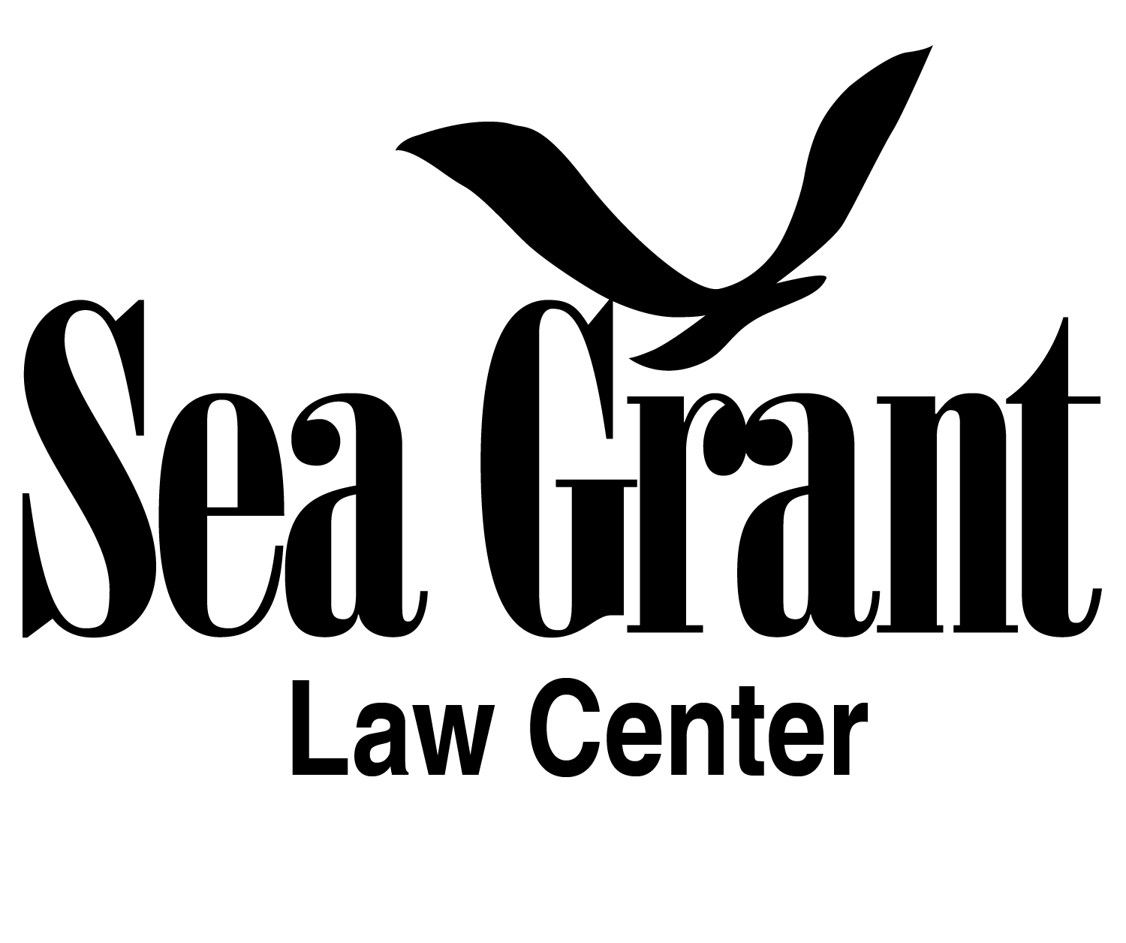
What does the Law Have to Say About Marine Diseases?
Honestly, Not Much!!
Stephanie Otts
Director, National Sea Grant Law Center
RCN Disease Modeling Workshop
Norfolk, VA
May 14, 2015

Slide 2

General Approach
Law usually doesn’t address wildlife diseases, terrestrial or marine, unless it poses a threat to:
Human Health
Livestock
Aquaculture
Image courtesy of http://www.keepcalm-o-matic.co.uk/

Slide 3
Law is Reactive
No general legislative or regulatory authority to address marine diseases.
No prescribe federal responses for aquatic animal pathogens.
What is on the books? – Trade/Movement Restrictions
  Salmonid Fish – “Injurious Species” under Lacey Act
    Entry prohibited unless certified free of listed viruses, including VHS.
  California restrictions on out-planting of abalone from culture facilities that haven’t meet certain standards.

Slide 4
Marine Disease Emergency Act of 2015 (H.R. 936)
Authorize NOAA to declare a marine disease emergency, designate coordinator, and take appropriate action (awarding grants, contracts).
NOAA would be required to develop a written response plan within 21 days of emergency declaration.
  Assessment of potential effects on marine populations.
  Strategies to minimize morbidity and mortality and transmission.
Declaration shall terminate when emergency no longer exists or upon expiration of 120-day period (whichever comes first).
Establish a federal “Marine Disease Emergency Working Group” and national data repository.
GovTrack Prognosis – 1% chance of enactment.

Slide 5
Round Pegs, Square Holes
Case in Point – Endangered Species Act
  Purpose is to protect species at risk of extinction and protect habitat. Prohibits “take” of listed species and “modification” of critical habitat.
  ESA is most effective when species are directly threatened by human action (i.e., dam construction, DDT spraying)
Black abalone listed in 2009. Withering syndrome cited as primary threat contributing to species’ decline.
  No broad management options discussed in listing documents.
  Not much help when threats are indirect.

Slide 6
Should Managers Intervene?
Computer models can be helpful in guiding management responses. Can anything be done? Should anything be done?
Understanding initial impact of disease on population
  If pathogen introduced, what’s the survival rate?
  When the disease has run its course, are there enough animals left to repopulate?
  Are the survivors naturally immune or at risk of re-infection?
Understanding transmission mechanisms and pathogen loading
  How far can pathogen travel in water?
  Are some animals more infectious?
  Do hatcheries concentrate pathogen?

Slide 7

Management Challenge: Navigating Regulatory Maze
20 federal agencies (administrating over 140 laws) with some authority over ocean waters or resources.
23 coastal states (ocean/gulf) with authority out to 3 nm (or 9 in TX and FL GOM)

Slide 8
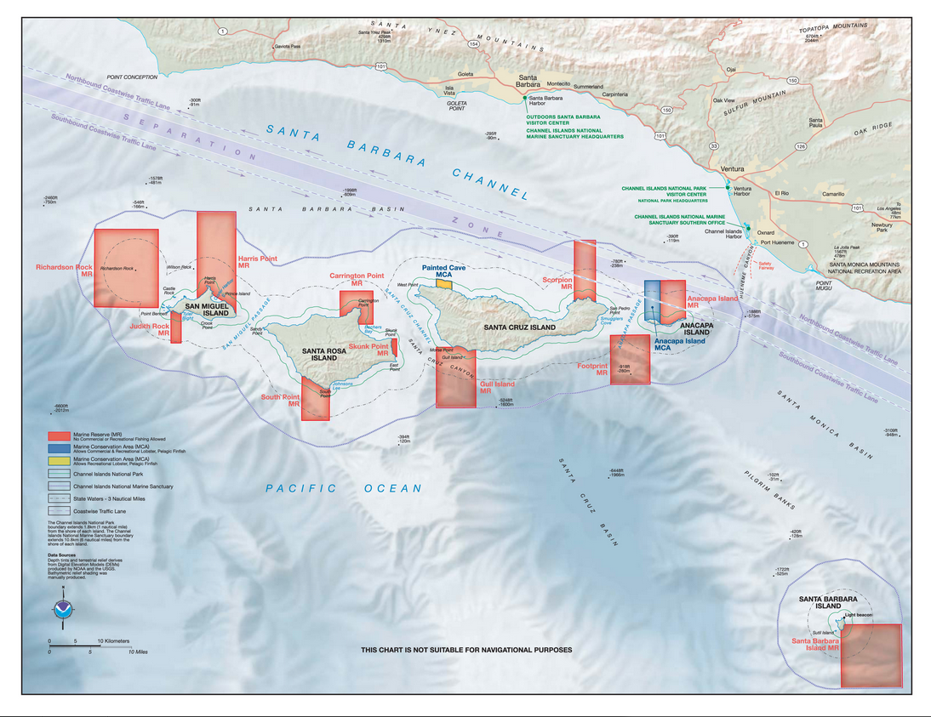

Slide 9
Management Response: Culling?
Is it a commercially harvested species?
  Magnuson-Stevens Fishery Conservation and Management Act prohibits overfishing. Stocks are managed for Maximum Sustainable Yield.
Where is the species located?
  National Marine Sanctuaries Act prohibits destroying or injuring sanctuary resources.
Is the species federally protected?
  Endangered Species Act prohibits take.

Slide 10
Management Response: Treatment?
Use of drugs to treat marine diseases might need approvals from the FDA. Definitely if used in aquaculture operations.
Fish and other aquatic animals are classified as “minor species.” Regulations are a little less restrictive because of the lack of approved drugs for aquatic animals.
Has been some experimental use of oxytetracycline for treatment of abalone.

Slide 11

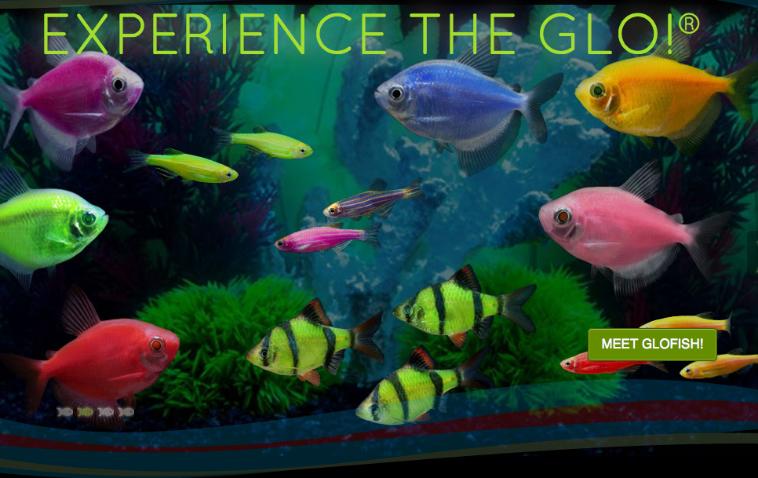
Management Response: Release of Disease-Resistant Animals
Permits may be required to release animals.
Are they “genetically engineered”?
FDA regulates GE animals under New Animal Drug provisions of the federal Food, Drug, and Cosmetic Act.
  rDNA construct is the “drug”
  FDA can exercise “enforcement discretion.”

Slide 12
Management Response: Reduce Stressors
Clean Water Act
  Point sources of pollution – sewage treatment, aquaculture facilities – must obtain permits before discharging pollutants into the ocean and coastal waters.
  Effluent limitations established based on state water quality standards. Limits can be set for pathogens.
    Some Great Lakes states have used CWA authority to address risk of VHS spread via ballast water.
  Increased enforcement of permitting requirements and monitoring could help achieve management goals.

Slide 13
Scenario Planning
It’s unclear what laws would be triggered in an attempt to mount a management response to a marine disease outbreak.
Legal framework governing a response would vary based on affected species, location, and spillover risks (human health, aquaculture operations, wild stocks).
Only way to know is to run scenarios with management agencies. Develop rapid response plans before outbreak.
  Outline potential management options.
  Identify necessary authorizations and permits (if any).
  May be able to obtain some pre-approvals for certain actions.

Slide 14
Questions?
Stephanie Otts
National Sea Grant Law Center
University of Mississippi School of Law
(662) 915-7714
sshowalt@olemiss.edu
http://nsglc.olemiss.edu/

