Slide 1

Models of Marine
Molluscan Diseases
Trends and Challenges
Eric Powell, University of Southern Mississippi
Eileen Hofmann, Old Dominion University

Slide 2
Presentation Outline
General comments on marine diseases
Describe the general characteristics and attributes of marine disease models
  Host proliferation
  Transmission
  Genetics
Example applications of marine disease models
Summary and future directions

Slide 3
Marine versus Terrestrial
Disease
Terrestrial disease models focus on transmission, contact between infected and susceptible hosts, epizootic or epidemic development, recovery, prevention, intervention
Terrestrial disease outcomes expressed in terms of mortality or recovery – prevalence
Marine disease focus is on proliferation – what happens to pathogen once inside host as result of environmental conditions or host dynamics
Marine diseases expressed in terms of intensity with the primary metric as weighted prevalence (intensity x prevalence)

Slide 4
Characteristics of Marine Diseases
Pandemic - reach high prevalence rapidly over large geographic areas
Sustain high environmental concentrations of infective particles so that transmission does not depend upon a local source
Exert a significant influences on host population dynamics
Host can survive with high disease intensity

Slide 5
Marine Disease Models
Science issues
  Influences on host population
  Initiation and ending of epizootics
  Pathogen transmission
Management issues
  Early intervention to limit host decline
  Measures to restrain decline after started
Models developed have focused on processes controlling disease proliferation rather than transmission
Models used for projections of environmental effects and management of diseased stocks

Slide 6
Host Proliferation Models
Diseases of marine invertebrates
Caused by unicellular pathogens that proliferate to high in vivo cell density
Generate widespread and rapid transmission such that reduces importance of transmission in the population dynamics
Impact on the host population is seen by the intensity of infection and increase in mortality rate
Influenced strongly by environmental conditions which can have more of a control on the rate of pathogen proliferation than the host population dynamics

Slide 7
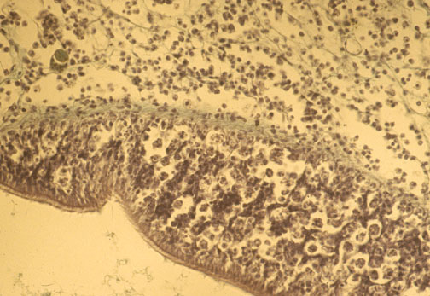
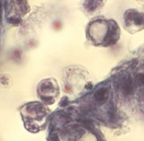
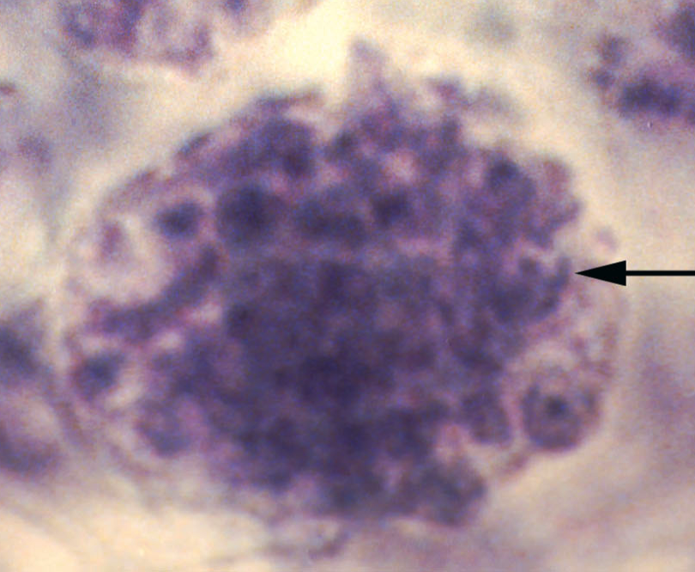
Dermo (Perkinsus marinus)
Slides from S. Ford, HSRL
water-borne protozoan
proliferates at temperatures ≥20ºC
proliferates at salinity >20
transmitted directly between oysters

Slide 8
Proliferation Models
Temperature
Salinity
Food
Environment
Infection intensity
Host mortality
Projections of environmental controls
Genetics Models
Host
Pathogen
Growth
Reproduction
Life stage
Mortality

Slide 9
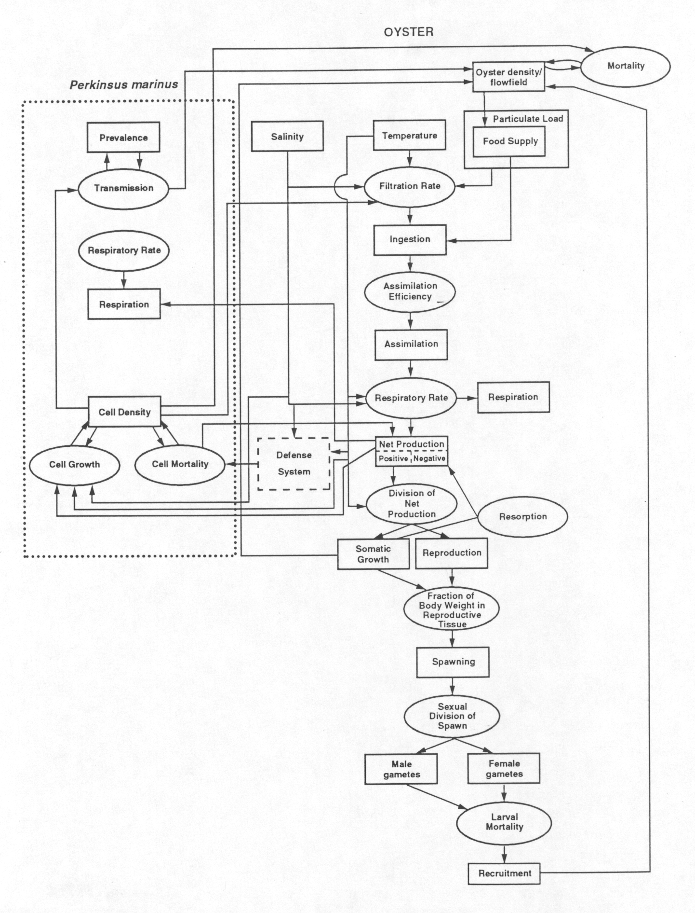
Dermo-Oyster
Model
Hofmann et al. (1995)

Slide 10
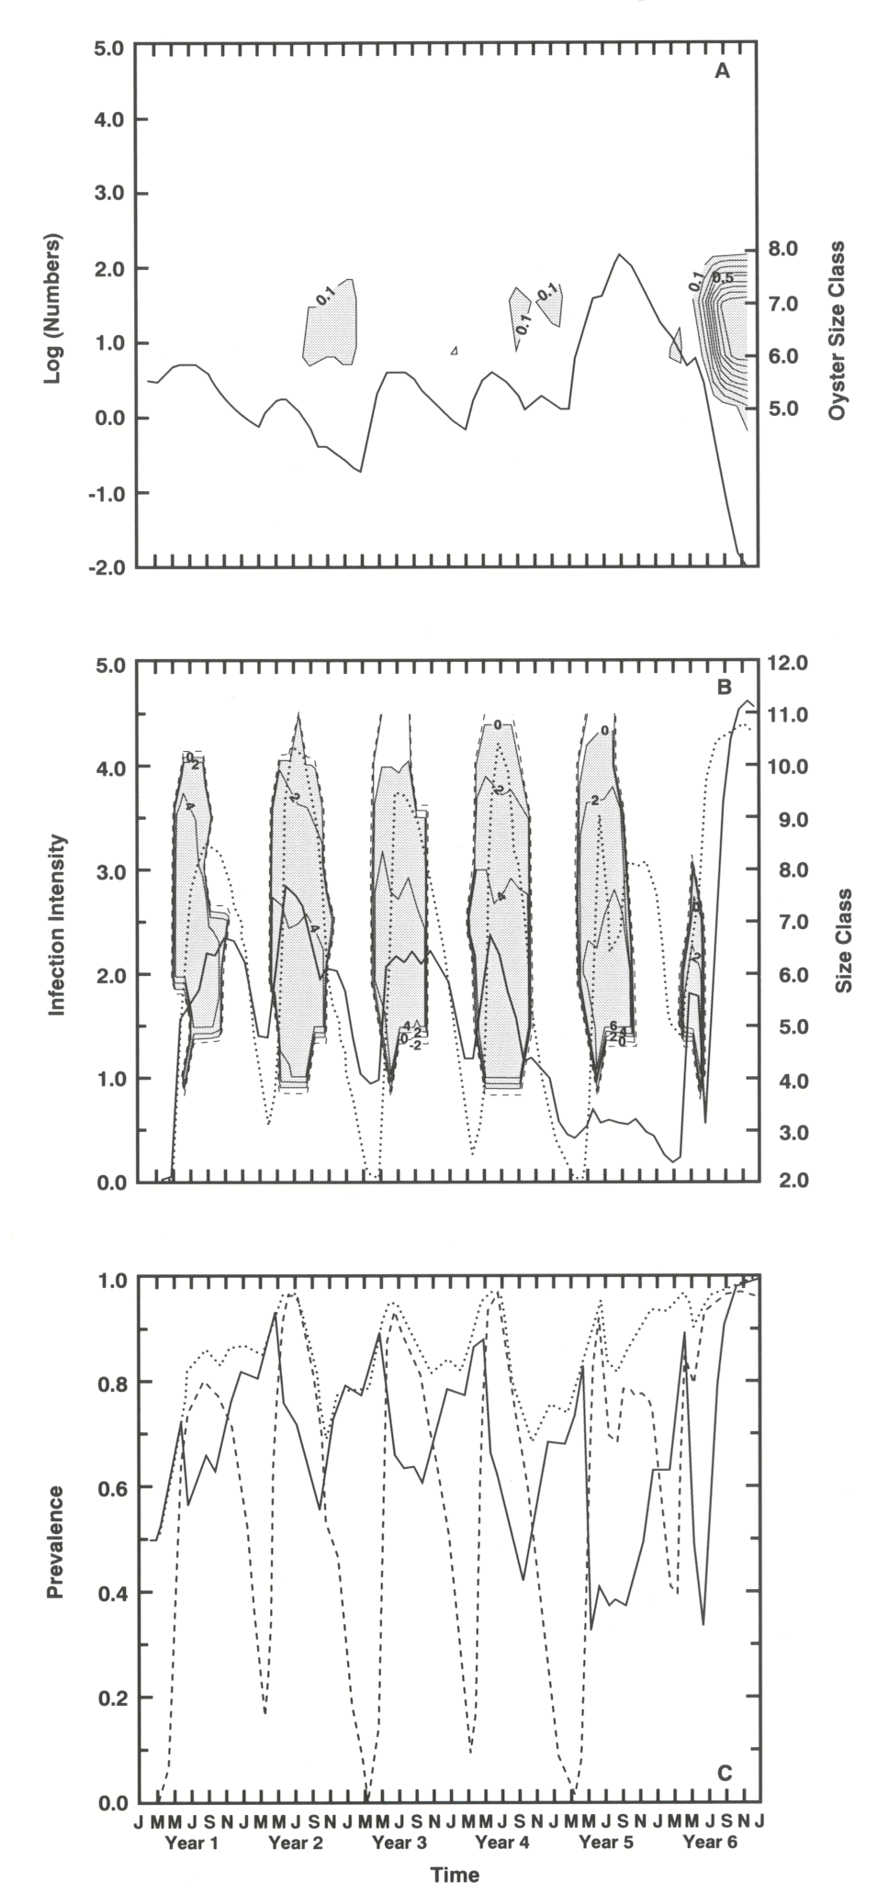
Oyster Population
Simulation

Slide 11
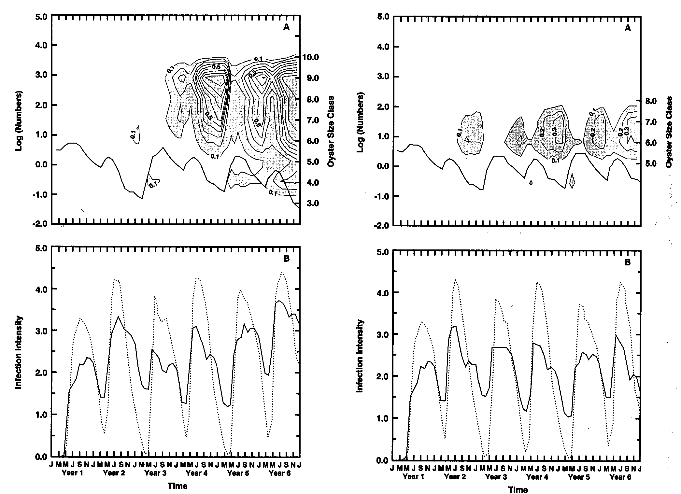
Reduced food
Warm & dry
Powell et al. (1996)
Notes:
Epizootic occurs in Year 3 – removed from triggering
Mechanism. Conditions that favor epizootics can occur 1-2 years prior to the event. Food has more effect than temperature and salinity.

Slide 12
Transmission Models
Understand mechanisms triggering epizootics
Impeding epizootic development
Controls on the rate of disease spread over the host’s range

Slide 13
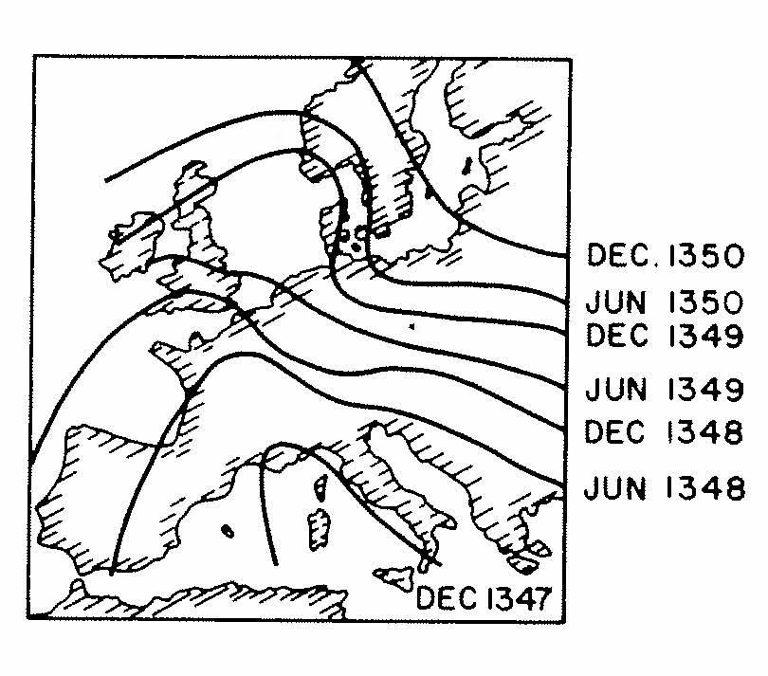
Disease Dispersal in Human Populations
Dispersal of Black Plague
in Europe
Modeled as interacting populations with diffusion
Traveling wave solution
Speed is determined by the interaction of infective and susceptible populations
Figure from Okubo (1980)

Slide 14
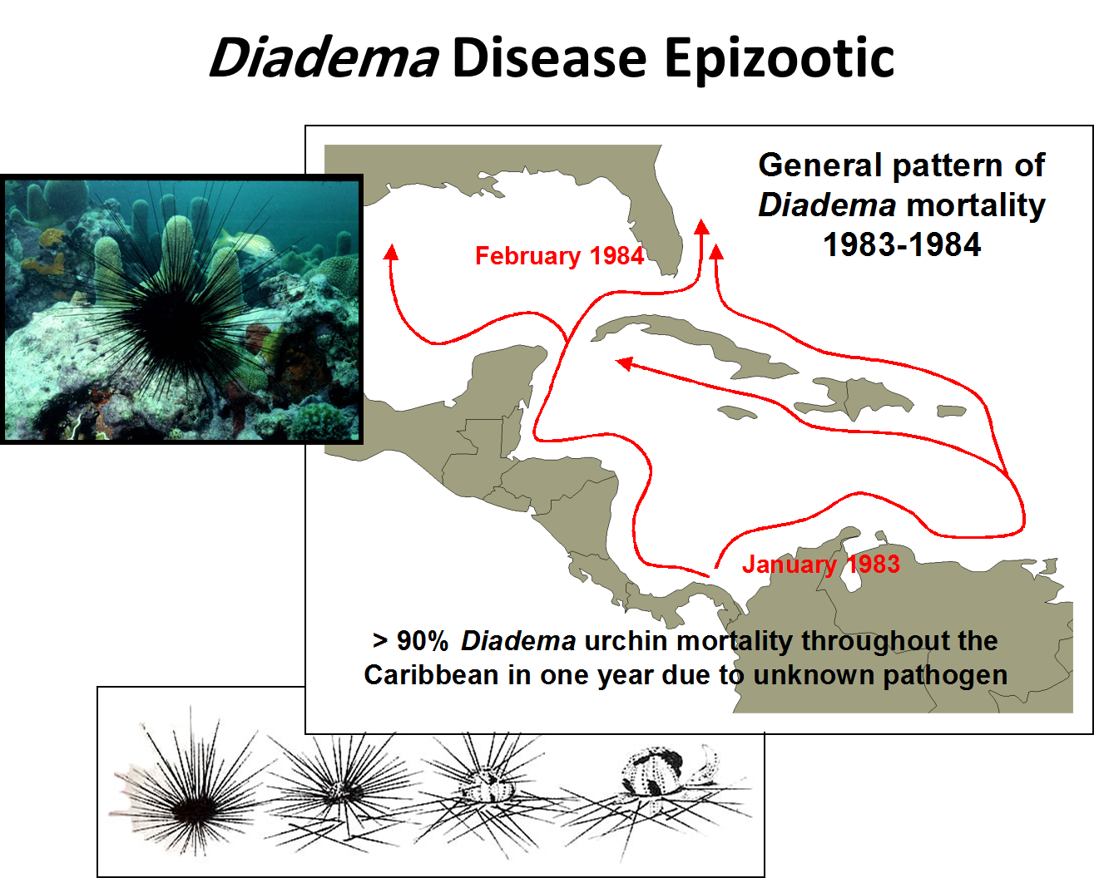
Figure from M. Butler, ODU

Slide 15
Rate of Spread of Marine Diseases
1 m/yr
1 km/yr
1000 km/yr
Terrestrial
Marine diseases
move faster
over larger
areas
Marine
McCallum et al. (2003)

Slide 16
Transmission Models
Temperature
Salinity
Food
Circulation
Environment
Projections of environmental controls
on pathogens
Release of pathogens
Genetics Models
Host
Pathogen
Host Density
Filtration
Pathogen release
Pathogen mortality

Slide 17
Infected Hosts
Dead Hosts
Waterborne transmission
The Filtration Barrier?
Local Contact
Pandemic Transmission
Local Contact
Susceptible Hosts
Dead Hosts
Pandemic Transmission
Notes:
Flow chart of transmission models

Slide 18
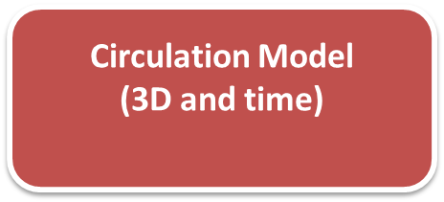
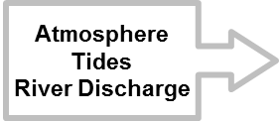


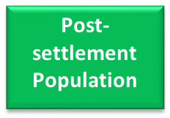

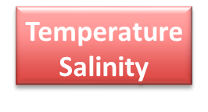


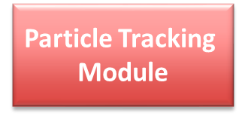
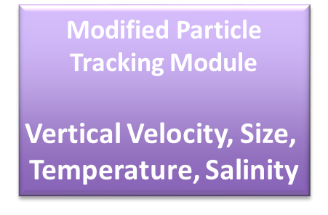
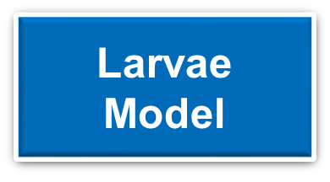
Transmission Model Framework
Pathogen Dynamics

Slide 19
Host Resistance Models
Use host population dynamics formulations with approach similar to disease proliferation models
Goals are similar to transmission models - achieve a state of minimal impact on the host population
Consider either natural selection or genetic modification of the host population
Include explicit genetics
Approach mechanistic understanding

Slide 20

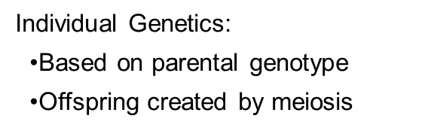

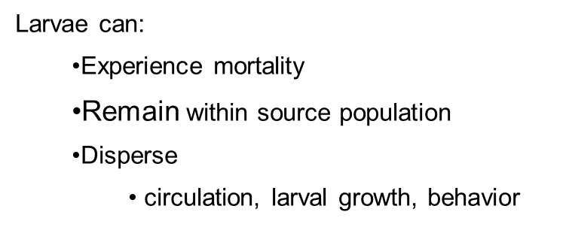
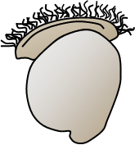
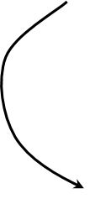
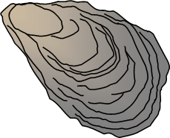
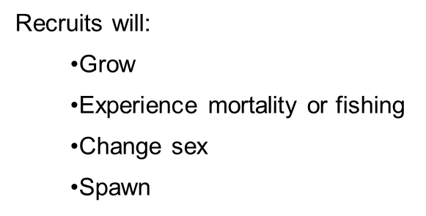
Example from
Oysters
Frequency of traits in population
determined by surviving individuals

Slide 21
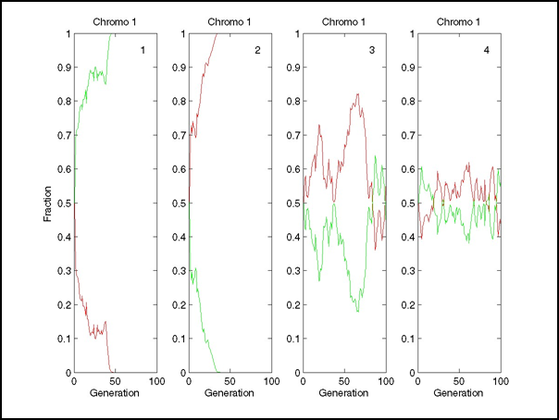
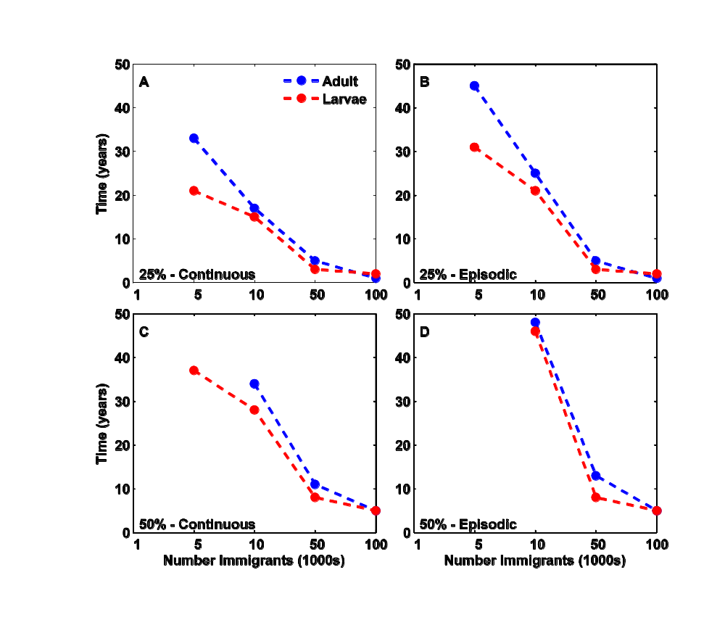
Frequency of
alleles in a
population
Simulate time to
introduce a trait such
as disease resistance
track specific genes

Slide 22
Mortality
Temperature
Salinity
Food
Environment
Restoration
Estuarine Planning
Fisheries Assessment
Habitat Integrity
Area Management
Management Models
Proliferation Models
Notes:
Strategy of proliferation models as applied to management. The dotted arrow shows cases that utilize full environmental and population dynamics features to determine outcomes rather than simply imposing mortality as a surrogate for disease.

Slide 23
Temperature
Host
Management
Salinity
Food
Environment
Proliferation Models
Genetics Models
Genetics Models
Pathogen Mortality
Transmission Models
Circulation
Filtration
Environment
Host Density
Disease
Management
Notes:
The relationship of models to management. Dotted circles and hatched arrows show limited present-day application. Dotted arrow shows as yet unexplored routes.

Slide 24
Perspective
Climate change and global warming are resulting in emergence of new diseases, expansion of disease ranges, and changes in infection intensity
Models provide approach for understanding and projecting these effects and potential consequences
Host proliferation models used for understanding environmental change and host population dynamics and can inform management of diseased stocks (mortality)

Slide 25
Perspective
Management of disease necessitates focus on transmission (fire breaks, area management)
Transmission models are limited by need to represent fluid flow - dispersion in marine systems is complex
Genetics models allow investigation of establishment of disease resistance, expression of phenotype from genotype
Require individual-based modeling approach and techniques for scaling individual to population

Slide 26
Summary
Majority of models for marine disease are proliferation models – manage diseased host
Want management of disease – transmission models
Development of viable approaches and capacity for disease transmission modeling needs to be a priority
Development of coupled modeling frameworks for marine diseases that include proliferation, genetics and transmission components
Coupled with resource economics, policy and regulatory models

Slide 27
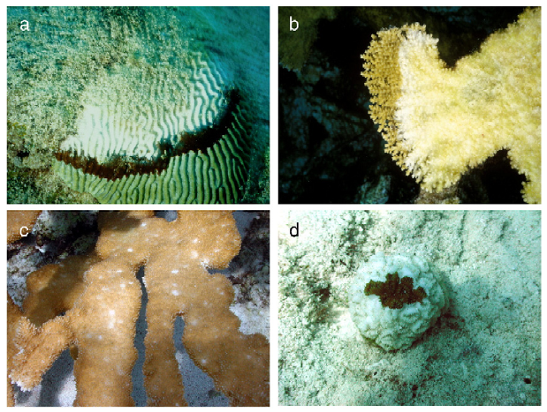
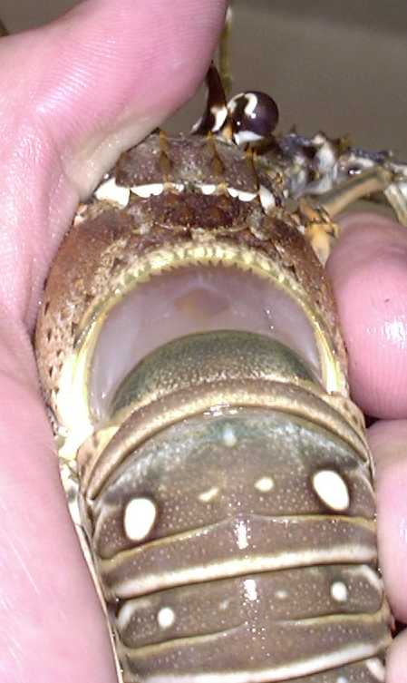
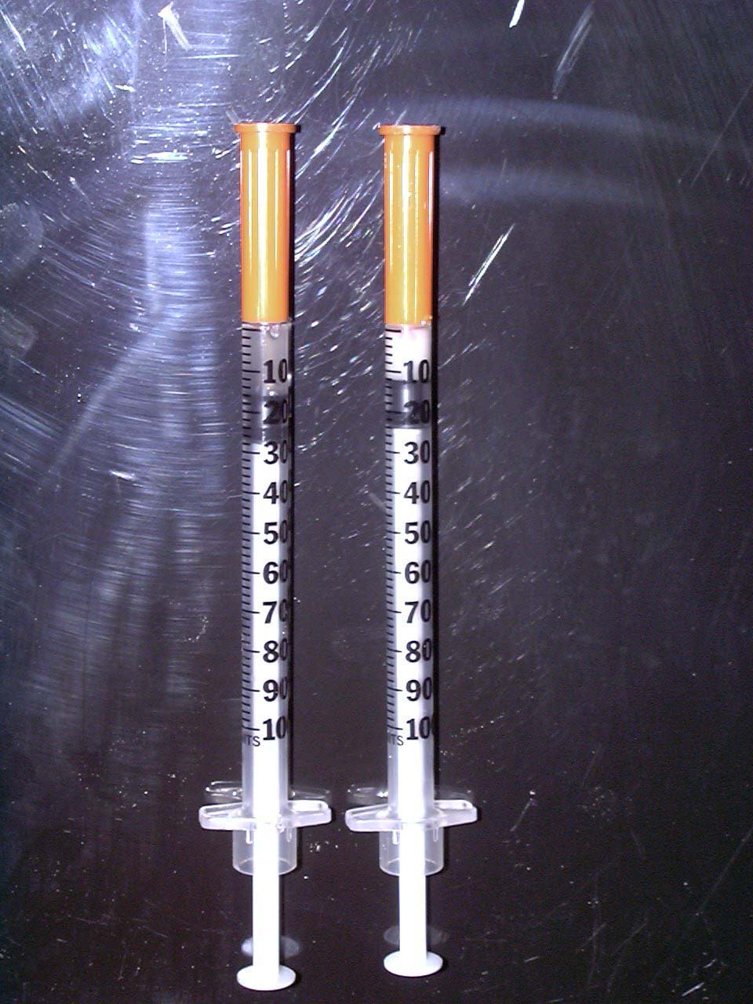
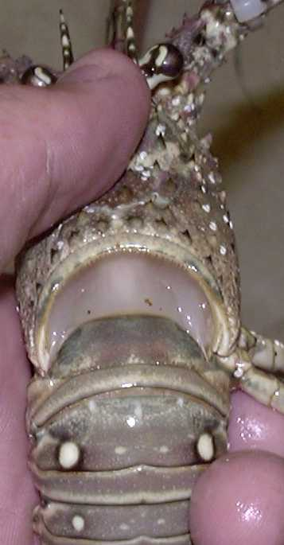
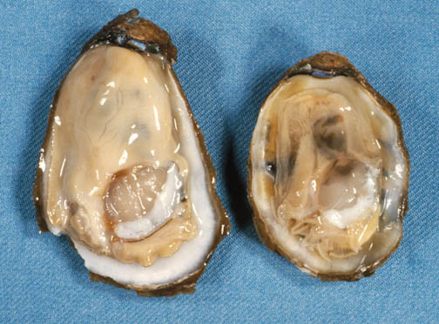
Thanks
Questions?
Sick
Healthy
Healthy
Infected

