Slide 1
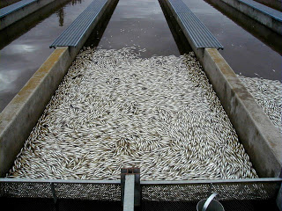
Impacts of Disease Management Practices on the Virulence Evolution and Transmission of a Salmonid Virus
Andrew Wargo
Virginia Institute of Marine Science
College of William and Mary
arwargo@vims.edu
http://wmpeople.wm.edu/arwargo
Notes:
Give you idea of trajectory towards answering. Since this is my first seminar since I arrived just over a year ago and I haven’t had the chance to meet all you yet, I thought I would start by giving a brief introduction of myself and the types of things I’m interested in. I will then move into a discussion of some of the specific projects I have been involved in in the last couple of years.

Slide 2
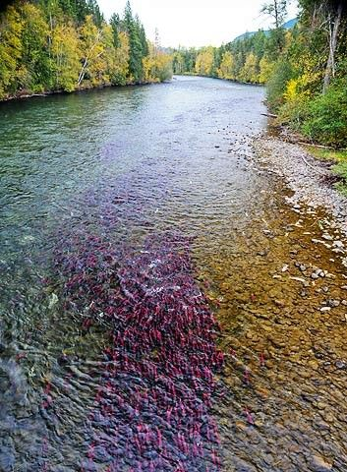
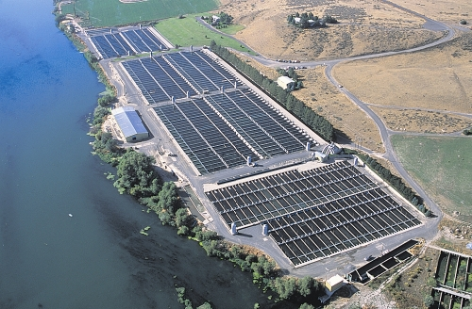
Notes:
A major theme of my research is investigating the processes that shape infectious disease ecology and evolution in wild environments such as these and determining how the processes that shape disease ecology and evolution differ in agricultural and human impacted environments such as these.
I am particularly interested in topics related to disease severity and what management strategies will be most effective at alleviating disease severity in both wild and aquaculture populations.

Slide 3
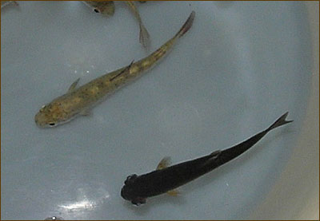
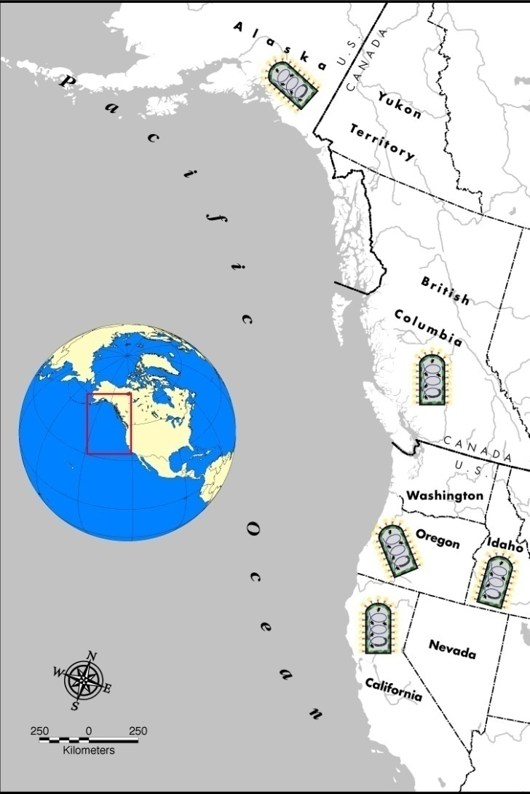
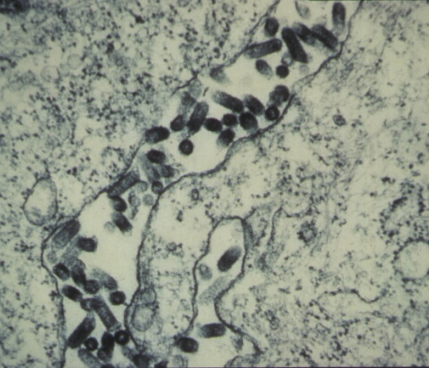
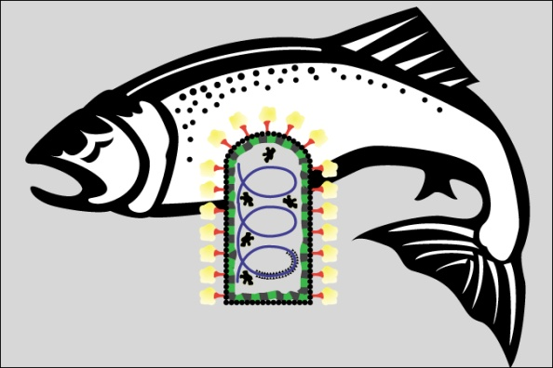
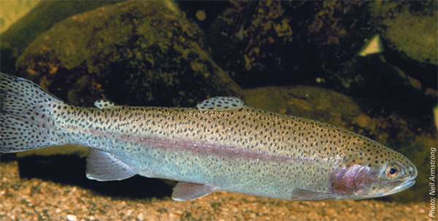
Infectious Hematopoietic Necrosis Virus
System
Negative-sense single-stranded RNA virus
Endemic salmonid fishes Pacific Coast
Acute disease
Family - Rhabdoviridae
Occurs in wild and cultured fish
Waterborne Transmission
Primary disease trout farming
IHNV

Slide 4
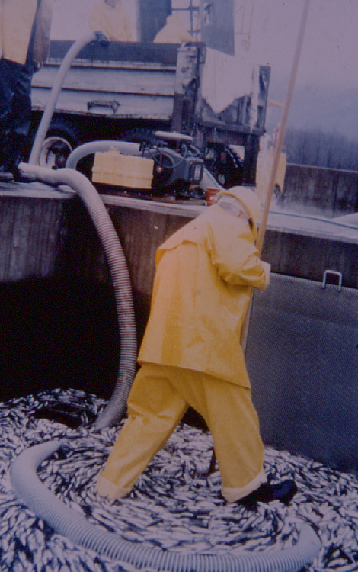
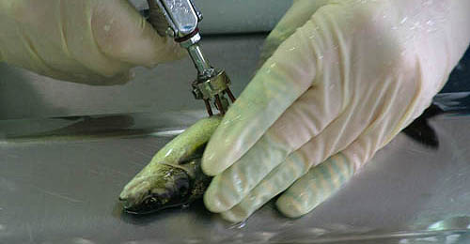
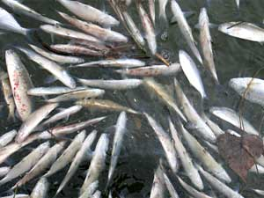
Disease Management Practices
Vaccination
Culling
Virulence and Transmission?
Notes:
When it boils down to it, host the ecology of aquatic species is fundamentally different in aquaculture compared to natural environments. One of the main differences about aquaculture is. The question is how are these practices hypothesized to impact pathogen virulence evolution. I would like to briefly discusses the hypothesized impact of each of these practices on virulence evolution.

Slide 5
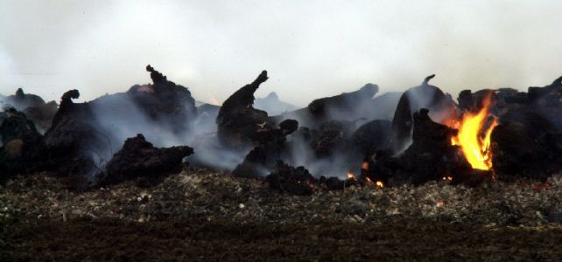
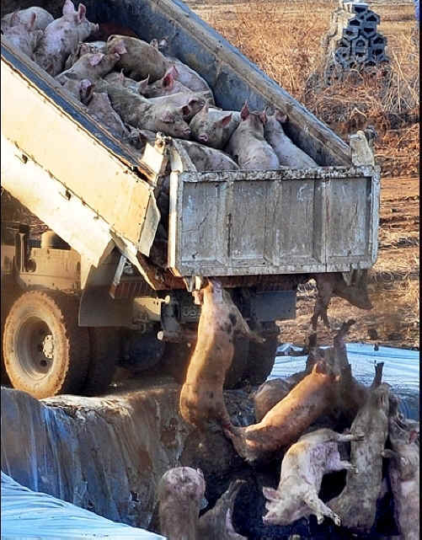
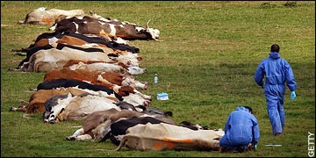
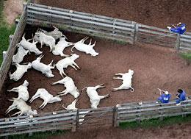
What is Culling?
Euthanize entire host population when mortality reaches certain threshold
Notes:
When we think about the term culling many different images and definitions may come to mind. In my talk I’m going to define the term culling as… The reason I have underlined the word entire is to emphasize that under this definition both infected and non-infected individuals will be culled when a disease outbreak is suspected. This practices of culling occurs quite widely across agriculture. Do not differentiate between infected and non-infected individuals. Usually a trigger by mortality when know pathogen is present.
The photo is from the Makah National Fish Hatchery in Northwest Washington. It was taken in February 1989 by Ray Brunson (who oversaw the effort) following the first finding of VHSV in North America in coho brood stock returning in the fall of 1988. About 4.5 million coho (shown), Chinook and steelhead fish and eggs were killed, buried in a lime pit and the facility disinfected.

Slide 6
Culling and Virulence?
Low Virulence
High Virulence

Slide 7

Culling and Virulence?
Low Virulence
High Virulence
Culling Threshold = 30% total population
20 % Die
80 % Die
Notes:
Fewer infected but lower percentage infected also die.

Slide 8
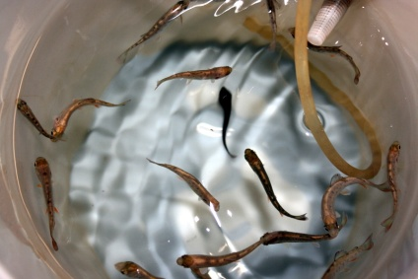
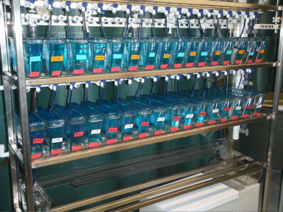
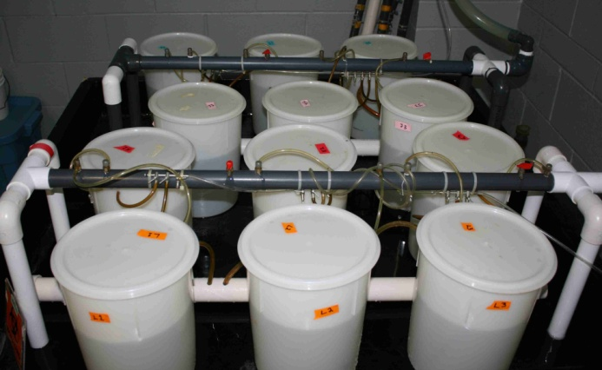
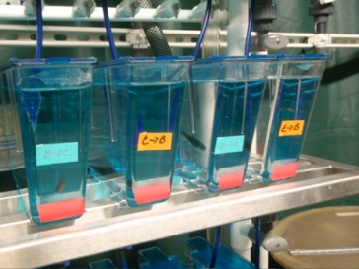
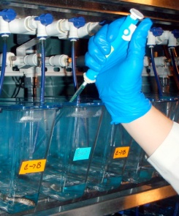
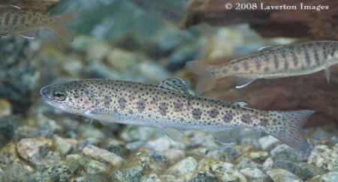
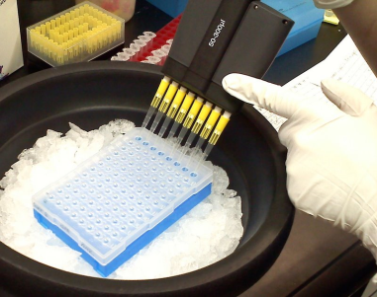
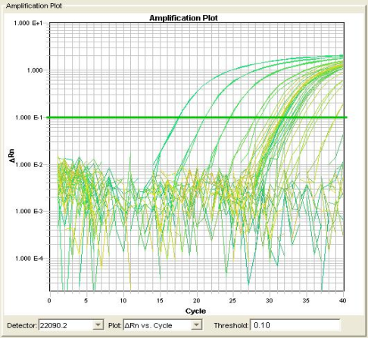
IHNV Experiments
Exposure: Batch immersion
Isolate fish in individual tanks
Allow for water flow each tank
Treatments – (20 fish ea.)
Sample water daily (30 days)
High Virulence Genotype: HV
Flush virus after sampling
Quantify viral RNA
Genotype specific qPCR
Low Virulence Genotype: LV

Slide 9
IHNV Data
Culling
Threshold
HV WINS!
Day post-exposure
Total Virus Shed
Log(Virus/ml H₂O)
Day post-exposure
Notes:
Lets imagine two host populations, one infected with genotype HV and the other with genotype LV. Culling is typically based on some sort of observed mortality threshold. Assume that we set our culling threshold to 30% mortality. We can see that we would cull the HV population around day 7, whereas the LV population would not be culled till day 28. What impact would this have on the dynamics of shedding. Well culling HV at day 7 would prevent all transmission of HV from day 7 forward, allowing LV to have the shedding advantage in the late stage of infection.

Slide 10
IHNV Data
WHO WINS?
Culling
Threshold
Day post-exposure
Total Virus Shed
Log(Virus/ml H₂O)
Day post-exposure
Notes:
Lets imagine two host populations, one infected with genotype HV and the other with genotype LV. Culling is typically based on some sort of observed mortality threshold. Assume that we set our culling threshold to 30% mortality. We can see that we would cull the HV population around day 7, whereas the LV population would not be culled till day 28. What impact would this have on the dynamics of shedding. Well culling HV at day 7 would prevent all transmission of HV from day 7 forward, allowing LV to have the shedding advantage in the late stage of infection.

Slide 11


Culling and Virulence
Mathematical Model
Supply Rate
σ
V =
I_{H}
I_{L}
S
I_{v}
τ_{v}
Transmission
Rate
Log(virus/ml H₂O)
Day post-exposure
Notes:
Expand the model?

Slide 12

Culling and Virulence
Mathematical Model
Supply Rate
σ
V =
I_{H}
I_{L}
S
I_{v}
R
τ_{v}
ρ_{v}
Transmission
Rate
Recovery
Rate
Number of Fish Shedding
Day post-exposure

Slide 13
Culling and Virulence
Mathematical Model
Supply Rate
σ
V =
I_{H}
I_{L}
S
I_{v}
R
τ_{v}
ρ_{v}
δ
Transmission
Rate
δ_{V}
Recovery
Rate
δ
Death Rate
Cumulative Mortality
Percent Mortality
Day post-exposure

Slide 14
Aquaculture Model
Raceway
1
2
μ
S
I
R
S
I
R
μ
μ
Migration Rate
3
4 … Z
S
I
R
S
I
R

Slide 15
Aquaculture Model
Raceway
1
2
Culling
S= 0
I= 0
R= 0
μ
S
I
R
μ
μ
Migration Rate
3
4 … Z
S
I
R
S
I
R
Notes:
Now we can extend this model to aquaculture, by imagining that a facility might have multiple, raceways, tanks, etc… There would be disease dynamics in each raceway, and some parameter that regulates pathogen migration between the raceways. When culling, clear out raceway and reset everything to zero. Migration could occur and restart raceway.

Slide 16
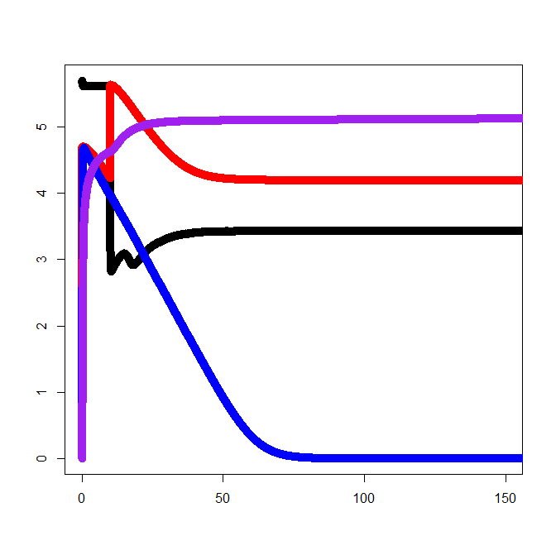
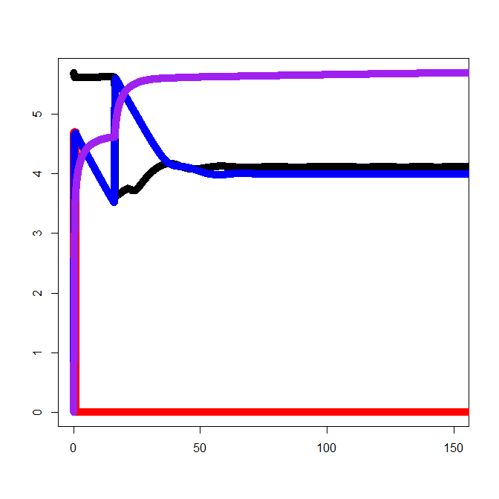
Culling Model Results
Culling
(Threshold= 30%)
No Culling
Susceptible
5
5
Recovered
4
4
Infected HV
3
3
Infected LV
Log(Number of Fish)
2
2
1
1
0
0
0
50
100
150
0
50
100
150
Day
Day
Culling selects for low virulence
Evolution of decreased virulence predicted

Slide 17
Disease Management Practices
Vaccination
Culling
Virulence and Transmission?
Notes:
When it boils down to it, host the ecology of aquatic species is fundamentally different in aquaculture compared to natural environments. One of the main differences about aquaculture is. The question is how are these practices hypothesized to impact pathogen virulence evolution. I would like to briefly discusses the hypothesized impact of each of these practices on virulence evolution.

Slide 18
Vaccination and Transmission
Vaccine protection is heterogeneous
Typical vaccine trial very homogeneous
  One host population
  One pathogen exposure dose
  Quantify protection against disease only
  Infection and transmission rarely considered
Homogeneous trials mask protection heterogeneity
The shape of protection heterogeneity may have major epidemiological impacts

Slide 19
Vaccine Protection:
Heterogeneity Distribution
50% Efficacy
“Leaky”
Proportion of Hosts
“All or Nothing”
0
0.5
1
Susceptibility

Slide 20
Vaccine Protection Heterogeneity:
Prevalence
Exposure 1
Exposure 2
All or Nothing
Leaky

Slide 21
Vaccine Protection Heterogeneity:
Prevalence
Exposure 1
Exposure 3
All or Nothing
Leaky

Slide 22
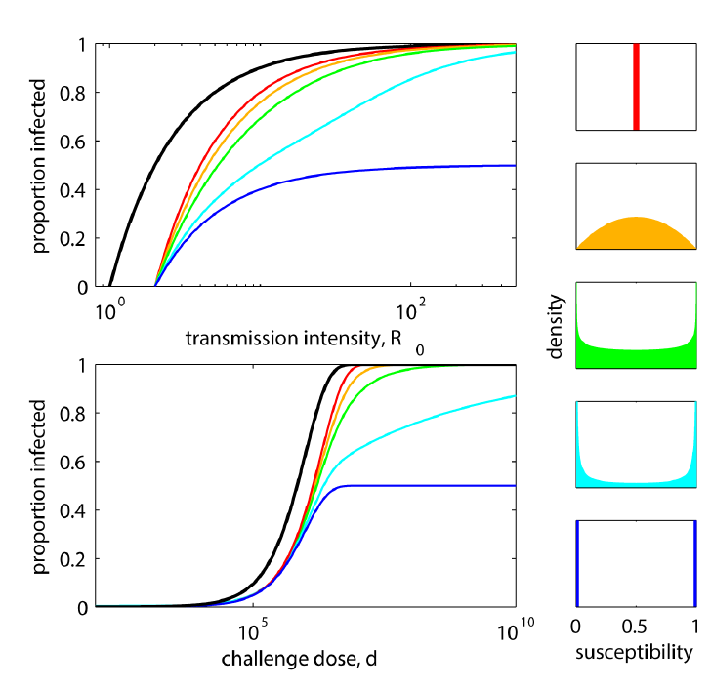
Gomes et. al., Plos Pathogens, 2014

Slide 23
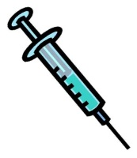
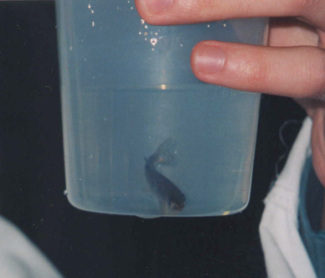
Vaccine Protection Heterogeneity:
Experiments
Vaccinated
Sham: PBS
Pathogen dosages:
0,10¹,10²,10³,10⁴,10⁵,10⁶
Isolate Fish
Measure
-Mortality
-Percent infected
-Viral shedding

Slide 24
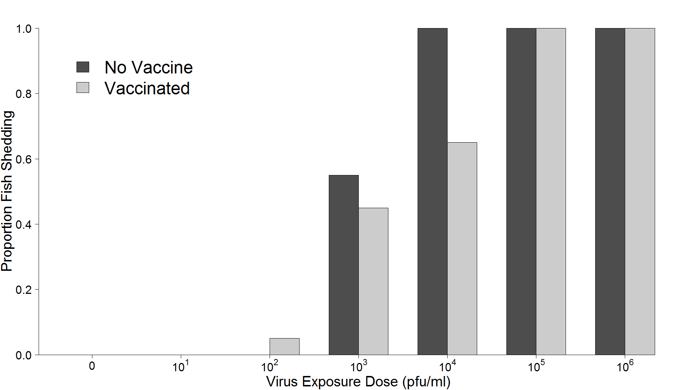
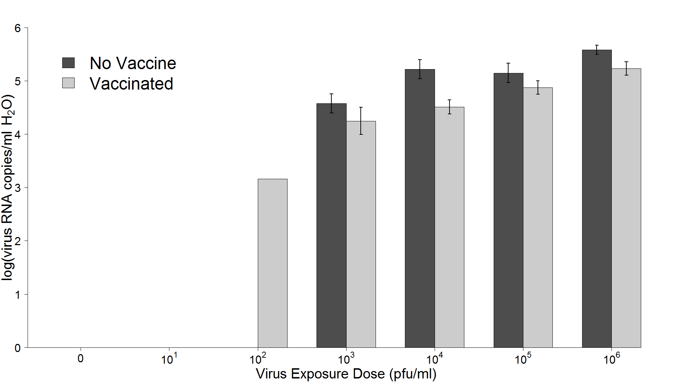
Vaccine Protection Heterogeneity:
Results
Cumulative Mortality
Proportion Shedding
0
10¹
10²
10³
10⁴
10⁵
10⁶
Virus Exposure Dose (pfu/ml)
Quantity Virus Shed

Slide 25
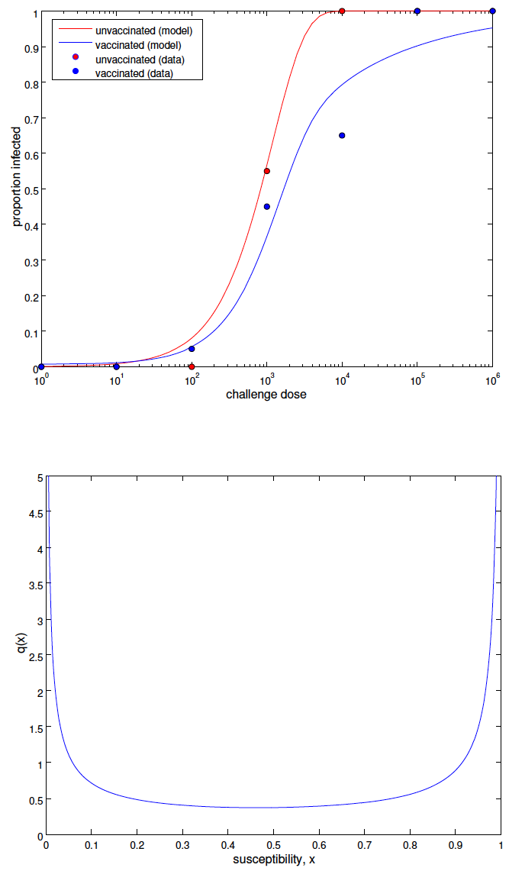
Proportion Infected
Challenge Dose
Density
Susceptibility

Slide 26
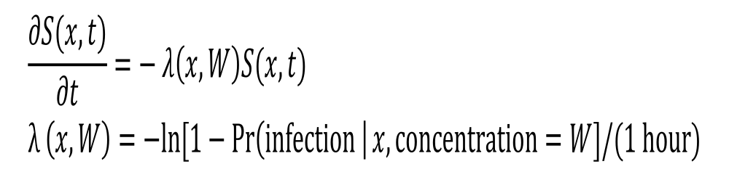
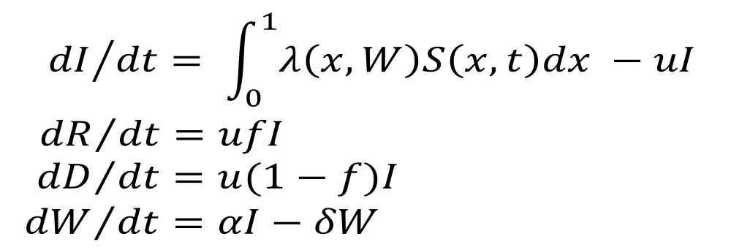
Vaccine Protection Heterogeneity:
Transmission Model Framework
S = # Susceptible
λ = transmission rate
W = virus concentration
I = # Infectious
R = # Recovered
D = # Dead
f = proportion recover
α = shedding rate
δ = virus removal rate
Notes:
W = infectious particles
Lamda = beta transmission term
Mu = recovery rate
F= proportion of infectious hosts that go to recovery or death
Alpha = shedding rate

Slide 27
Disease Management Practices
Vaccination
Culling
Virulence and Transmission?
Notes:
When it boils down to it, host the ecology of aquatic species is fundamentally different in aquaculture compared to natural environments. One of the main differences about aquaculture is. The question is how are these practices hypothesized to impact pathogen virulence evolution. I would like to briefly discusses the hypothesized impact of each of these practices on virulence evolution.

Slide 28

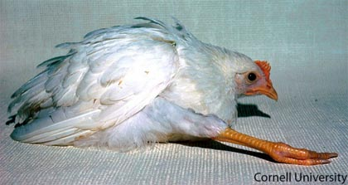
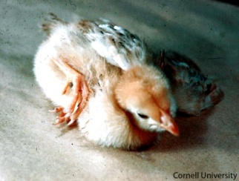
Vaccination and Virulence Evolution
No transmission
Vaccinate
Non-sterilizing
Transmission
Virulence can evolve upwards
(Gandon et. al., Nature, 2001)
(Gimeno, Vaccine, 2008)
Problematic
When vaccine allows transmission
Incomplete vaccine coverage
Notes:
Imagine a host that is infected with a highly virulent strain of a pathogen. Imagine it is so virulent that it kills the host before transmission can occur. Now imagine that you vaccinate a host…..
Now we can ask whether this hypothesis applies to aquaculture. To answer this we need to determine if there are aquaculture vaccine that reduce clinical signs but don’t block transmission.

Slide 29
Vaccination and Transmission:
IHNV Vaccine Trial
Unvaccinated Fish
Vaccinated Fish
67% Mortality
5% Mortality
(Kurath and LaPatra, unpublished)
Notes:
Here is a vaccine trial conducted by Kurath and LaPatra. They examined the viral load of IHNV in vaccinated compared to vaccinated fish. The found that although viral load was reduced in vaccinated fish it still persisted to substantial levels, indicating that transmission of the virus could still occur. Importantly, when examining mortality, they found a significant reduction in mortality. Typcially vaccine efficacy is based solely on mortality reductions and therefore this vaccine would be considered highly effective.

Slide 30
Vaccination and Virulence Evolution
No transmission
Vaccinate
Non-sterilizing
Transmission
Virulence evolves upwards
(Gandon et. al., Nature, 2001)
(Gimeno, Vaccine, 2008)
Problematic
When vaccine allows transmission
Incomplete vaccine coverage
Notes:
Imagine a host that is infected with a highly virulent strain of a pathogen. Imagine it is so virulent that it kills the host before transmission can occur. Now imagine that you vaccinate a host…..
Now we can ask whether this hypothesis applies to aquaculture. To answer this we need to determine if there are aquaculture vaccine that reduce clinical signs but don’t block transmission.

Slide 31
Incomplete Vaccine Coverage

Slide 32
Vaccine Virulence Evolution:
Laboratory Experiments
P1
P2
P1
P2
P2
P3
Single
Mix
Vaccinate
Vary: Level and timing of treatment
Quantify: Genotypic and phenotypic evolution
Notes:
Vaccine experiments would take a similar approach but in this case we passage virus through unvaccinated and vaccinated host populations. We could then regulate vaccine timing, dosage, and coverage to examine their impact on virulence.

Slide 33
Vaccine Induced Virulence Evolution:
Model Exploration
Supply Rate
σ
I_{H}
I_{L}
… N types
S
I_{v}
R
τ_{v}
ρ_{v}
δ
Transmission
Rate
δ_{V}
Recovery
Rate
δ
Death Rate
Notes:
Now onto vaccination which impacts…

Slide 34
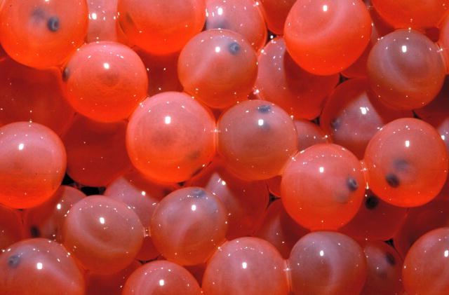
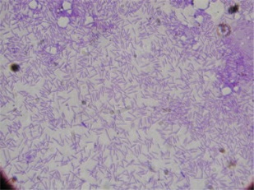
Harnessing Evolution to
Manage Disease?
Selective Breeding
Virulence
IHNV
BCWD
Co-Infection
Notes:
When it boils down to it, host the ecology of aquatic species is fundamentally different in aquaculture compared to natural environments. One of the main differences about aquaculture is. The question is how are these practices hypothesized to impact pathogen virulence evolution. I would like to briefly discusses the hypothesized impact of each of these practices on virulence evolution.

Slide 35
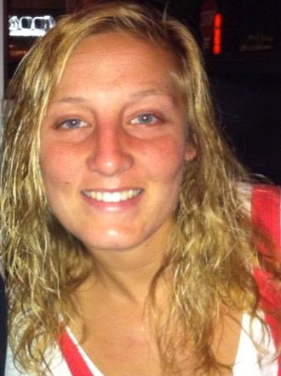




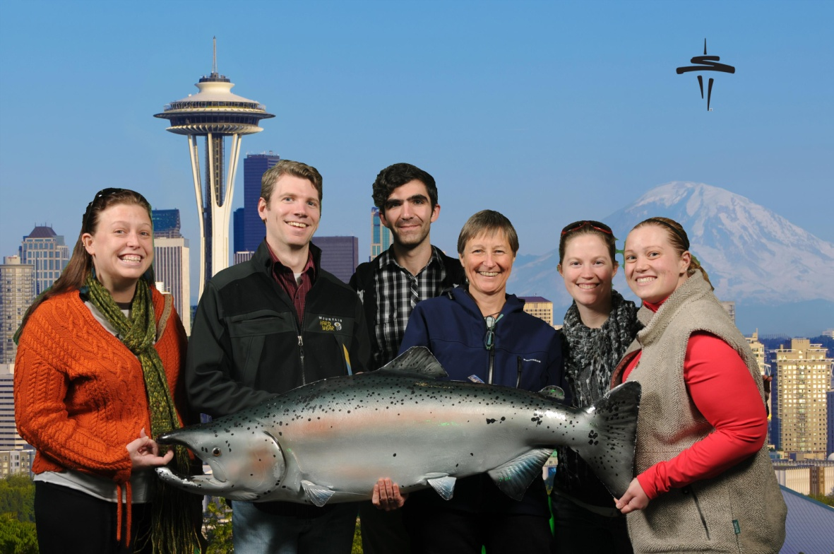
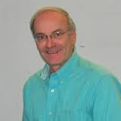

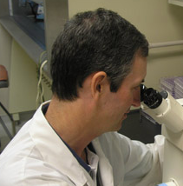
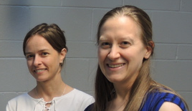
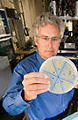
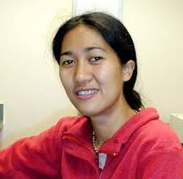
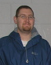
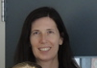
THANKS!
Darbi Jones
Barb Rutan
Doug McKenney
Jessie Viss
Ben Kerr
Gabriella Gomes
Rachel Breyta
Jim Winton
Gael Kurath
Alison Kell
Tarin Thompson
Bill Batts
Marc Lipsitch
Michelle
Penaranda
Shannon LaDeau
Paige Barlow
Maureen Purcell
Jake Scott
Greg Wiens
Funding: NIH EEID, USDA NIFA, NSF, USGS, UW, VIMS

Slide 36
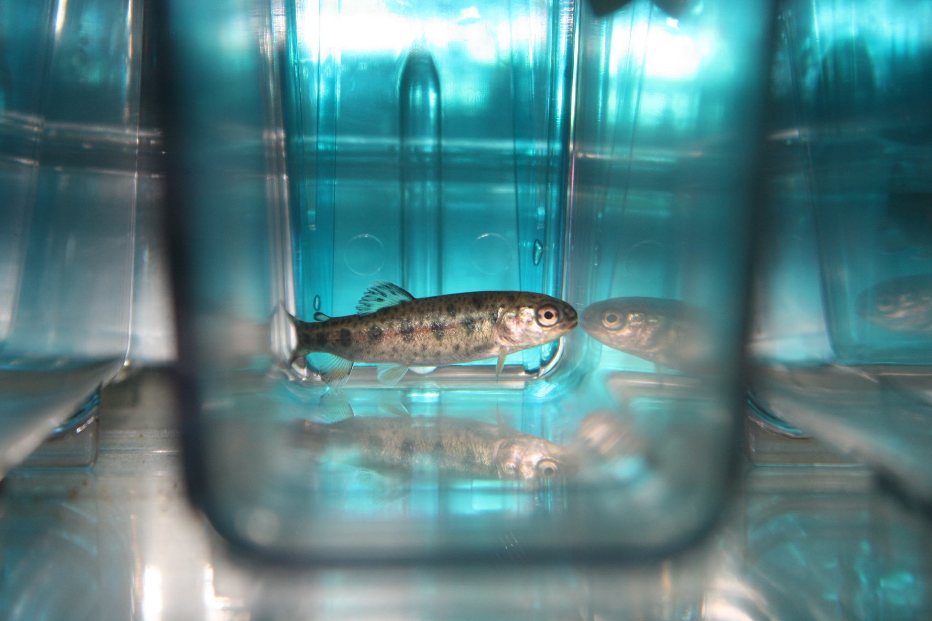
Questions?

Slide 37
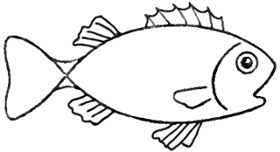
Culling Model Explorations
Impact of virus migration rates (biosecurity)
Impact of culling threshold
Timing of strain invasion
μ
S
I
R
S
I
R
Culling
Threshold

Slide 38
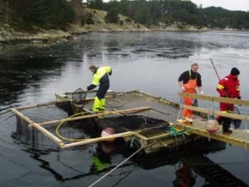
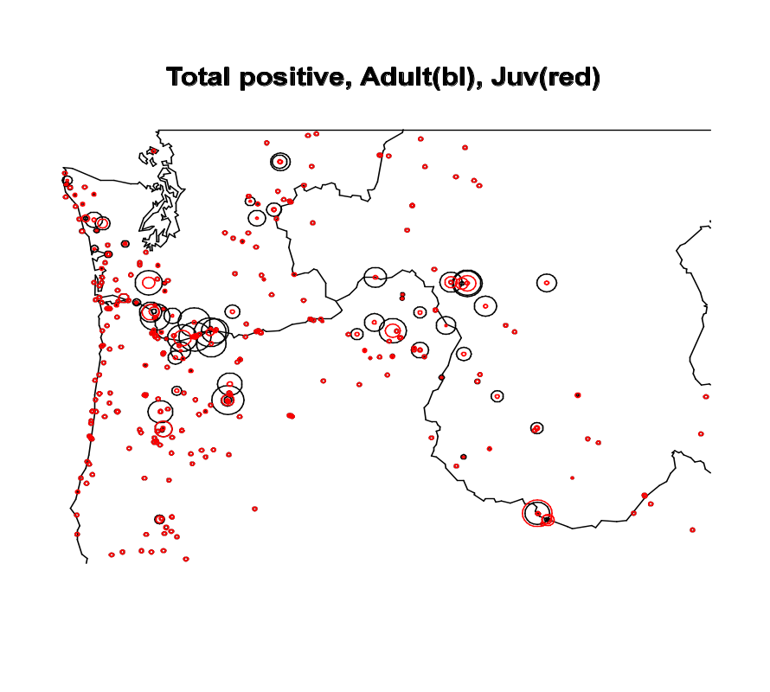
Virulence Evolution in the Field
IHNV Database (WFRC)
Genomic and Epidemiological data
Investigations
Virulence
Fitness
Ecological Drivers
Notes:
Cut this slide?

Slide 39
Individual Fish Variation
(Mixed Infections)
Immersion
Injection
Viral load in host
Viral load in host
Log(virus/g fish)
Log(virus/g fish)
Fish
Fish
Shed
Viral load in water
High levels fish-to-fish variation
Mimic natural infections in the field
Log(virus/ml H₂O)
Fish
(Wargo and Kurath, Virus Res., 2012)
Notes:
Here we are looking at the results from individual fish

Slide 40
Drivers of Variation
Immersion
Isogenic
Immersion
Injection

Slide 41
Transmission
Log(virus/ml H₂O)
P1
P2
P1
Notes:
I am gearing up to examine the transmission of virus from infected to nieve hosts at multiple time points over the course of infection.

Slide 42
Correlation Virus Shed and Virus Within Fish
Shed Viral load
Within Host Viral load
Positive correlation in-host viral load and shedding (R² = 0.76)
HV more efficient at Shedding
Notes:
I was also very interested to understand the relationship between the amount of virus in the host and the quantity of virus shed. I found a strong positive correlation between within host viral load and

Slide 43
ID 50 Results
Peak Viral Load
Infected Fish Only
Log(virus/g fish)
All negative
Virus Dosage (pfu/ml)
Exposure dosage does not impact peak viral load

Slide 44


ID50 & LD50
Experimental Design
1 Hour Exposure
Day 3
Viral Load Quantification (ID50)
Vary Dosage
Track Mortality 30 days (LD50)

Slide 45
ID50 Results
% Fish Infected
% Fish Infected
Virus Dosage (pfu/ml)
ID50 HV: ~900 pfu/ml
ID50 LV: ~7500 pfu/ml
Notes:
So now looking at the ID50 results from these expereimtns.
So what this says is you are going to need a lower virus dosage to infect the same number of fish with genotype HV compared to LV

Slide 46
LD50 Results
% Mortality
10³
10⁴
10⁵
Virus Dosage (pfu/ml)
HV LD50: ~10³ pfu/ml
LV LD50: ~ 10⁵ pfu/ml
Notes:
So to kill the same number of fish you are going to need a lower dosage with genotype HV compared to LV
Or is it that given the same number of infected fish, is HV killing a larger proportion of those fish.

Slide 47
Percent of Infected Fish That Die
% Mortality
10 ⁴
10 ⁵
Virus Dosage (pfu/ml)
HV kills more fish that it infects

Slide 48
LD50/ID50 and Tradeoff Hypothesis?
?
Transmission
Duration
Infectivity
Virulence
Virulence
Virulence comes with infectivity benefit
More virulent genotypes kill larger proportion hosts, but mortality occurs after shedding subsides,
so cost is minimal
Notes:
Work on this

Slide 49
Virulence and Other Fitness Traits
Dosage to kill & infect 50% of fish – LD 50 & ID 50 (Undergraduate Doug McKenney)
  Superinfection
  (Grad student Alison Kell)

Slide 50
Superinfection
Ability of virus genotype to establish infection in host with a prior established infection by another genotype
Notes:
So what is superinfection

Slide 51

Superinfection Experiments
1° exposure
Interval
2° exposure
3 days
Harvest
1° exposure
2° exposure
HV
LV
Superinfection
groups
Mixed
LV
HV
HV
mock
Primary exposure
control
LV
mock
Single
mock
LV
Secondary exposure
control
mock
HV
mock
mock
Uninfected Control
Intervals
12 hours
24 hours
48 hours
96 hours
168 hours

Slide 52
Percent Fish Superinfected
Kell, AM, et. al., Journal of Virology, 2013

Slide 53
Viral Load in Fish
24 Hour Delay Time
*
LV
*
HV
Log(virus/g fish)
LV Mock
LV HV
Mock HV
HV Mock
HV LV
Mock LV
Kell, AM, et. al., Journal of Virology, 2013
Notes:
Superinfection suppression and level of suppression same regardless of which genotype.

Slide 54
Superinfection and Virulence Tradeoff?
First virus genotype infecting host has advantage
Virulence not associated with superinfection fitness
Could explain field maintenance of low virulence
Notes:
So whether you the high virulent or low virulent ability to exclude secondary genotype is equal

Slide 55
Virulence and Other Fitness Traits
Dosage to infect 50% of fish –ID 50
(Undergraduate Doug McKenney)
% Fish Infected
Virus Dosage (pfu/ml)
ID50 HV: ~900 pfu/ml
ID50 LV: ~7500 pfu/ml
Notes:
So I am going to talk about the research of two individuals I worked with that have continued looking at virulence fitness associations

Slide 56
Virulence and Other Fitness Traits
  Superinfection
  (Grad student Alison Kell)
0
12
24
48
96
168
Could explain field maintenance of low virulence
Notes:
So I am going to talk about the research of two individuals I worked with that have continued looking at virulence fitness associations

Slide 57
Log(MX Fold
Change)
Log(Viral Load)
Day

Slide 58
Exposure Dosage Data:
Mortality
Percent Mortality
Virus Exposure Dosage (pfu/ml)
Notes:
cut

Slide 59
Preliminary Results
Percent Mortality
10⁰
10¹
10²
10³
10⁴
10⁵
10⁶
Virus Exposure Dosage (pfu/ml)

Slide 60

Vaccine impacts epidemiology non-target pathogen?
IHNV
BCWD
Heterogeneity in protection correlated?

Slide 61
Infection Classes
“Acute”
Log(virus/ml H₂O)
“Chronic”
Day post-exposure
Notes:
Use transmission rate figure

Slide 62

Aquaculture Model Effects
Supply Rate
σ
I_{H}
I_{L}
… N types
S
I_{v}
R
τ_{v}
ρ_{v}
δ
Transmission
Rate
δ_{V}
Recovery
Rate
δ
Death Rate
Density
Notes:
And finally density and supply which impacts…

Slide 63



Other Developing Projects
Virulence Evolution after Pathogen Emergence?
IHNV
O. mykiss
Crossostrea virginica
Haplosporidium
nelsoni
Perkinsus
marinus

Slide 64










Notes:
A major theme of my research is investigating the processes that shape infectious disease ecology and evolution in wild environments such as these and determining how the processes that shape disease ecology and evolution differ in agricultural and human impacted environments such as these.
I am particularly interested in topics related to disease severity and what management strategies will be most effective at alleviating disease severity in both wild and aquaculture populations.

Slide 65



Notes:
A major theme of my research is investigating the processes that shape infectious disease ecology and evolution in wild environments such as these and determining how the processes that shape disease ecology and evolution differ in agricultural and human impacted environments such as these.
I am particularly interested in topics related to virulence epidemiology and how we can harness the ecology and evolution of wild and agricultural systems to manage virulence epidemiology.
I am

Slide 66



Topics
Evolutionary Drivers of Virulence Epidemiology
Animal Husbandry Impacts on Virulence Epidemiology
Notes:
Given this framework the research I would like to discuss with you today can be broken into three main topics. Firstly I’ll present some of my previous research on…. Secondly I’ll discuss some of my future plans to look at.. And finally I present my long term goals to look at…

Slide 67

Virulence Evolution
Theory
Morbidity and mortality due to infection
Transmission Duration
(Opportunities)
Infected Host lifespan
Virulence
Infected Host lifespan
Pathogens should evolve towards benign coexistence with host
    Conventional Wisdom (May and Anderson, In: Coevolution, 1983)
Multitude virulent pathogens
Notes:
To set the foundation for this work I like to begin with..

Slide 68
Virulence Associated with
Pathogen Fitness Traits
Virulence
Transmission Rate
Competitive Fitness
Replication
Replication
Replication
(Virulence)
(Virulence)
Contradicts conventional wisdom
Competitive Fitness: Relative ability of co-infecting genotypes to produce infectious progeny in a given environment (Domingo et. al., Rev. Med. Virol., 1997)
(Alizon et. al., J. Evol. Biol., 2009)
Notes:
There are many factors which are hypothesized to regulate pathogen virulence, one of those is replication such that… Replication is also hypothesized to offer other fitness advantages to the pathogen.

Slide 69
Current Paradigm
The Virulence-Tradeoff
(Host lifespan)
(Replication)
Transmission Rate
Transmission Duration
Virulence
Virulence
Few in vivo studies on the nature of virulence-fitness trait associations and tradeoffs

Slide 70
Objective
Determine if virulence is associated with pathogen fitness traits in vivo:
Entry
Replication
Competitive Fitness
Shedding

Slide 71

IHNV Genotype Diversity
Over 240 genetic variants N. America
U
M
M
L
U
L
(R. Breyta, unpublished)
Notes:
As shown by this phylogenetic three IHNV is also known to have a substantial level of genetic diversity. Over 240 genetic types have been detected in N. America. No I don’t expect you to memorize every feature of this tree but what I do want to illustrate is that the virus falls in to three clades in N. America where are associated with specific geographical regions… M-clade believed to have evolved in trout farming and the primary clade in Idaho, Washington, and Oregon. Lots of other really interesting things we are exploring about this tree that I don’t have time to go into day, such as evolved host specificity. I simply use it here to illustrate the breadth of viral diversity.

Slide 72

IHNV Virulence Diversity
Cumulative Percent Mortality (Fish)
Notes:
Now that we see this phylogenetic diversity we can begin to ask whether there is also virulence diversity. Mention that these are virus isolates.

Slide 73

Characterize Virulence-Fitness Association
Cumulative Mortality
Percent
Notes:
Now that we know there is genetic and virulence variation we can assess whether or not they are associated. I decide to examine this association in two IHNV genotypes labeled HV and LV. These genotypes are naturally occuring field isolates that were obtained from epidemics in the trout farming region of Idaho.

Slide 74


Experimental Design
Host:
Rainbow trout - Oncorhynchus mykiss
Exposure type 1: Immersion
Exposure type 2: Injection
12 hr
2
3
1
Sample day 3
Viral load quantification:
Genotype specific qPCR
4
3
4
5
6
as before
5
6
Notes:
To test this I conducted the following experiment.

Slide 75
Experimental Design - Continued
Treatments – (14-28 fish)
HV alone
LV alone
HV + LV 1:1 ratio
Notes:
To test this I conducted the following experiment.

Slide 76

Infection Cycle Fitness
Injection bypasses host entry
Notes:
To test this I conducted the following experiment.

Slide 77
Testing Virulence-Fitness Associations
Virulence
Transmission Rate
Competitive Fitness
Replication OR Entry
Virulence
Virulence
Notes:
REMOVE OR MERGE THIS SLIDE?

Slide 78
Results: Mean Viral Load
Immersion
HV always produces more virus than LV
Log(virus copies/g fish)
Virulence
Competitive Fitness
Replication
Or
Entry
Virulence
(Wargo, et. al., J. Virology, 2011)
Notes:
78

Slide 79
Results: Mean Viral Load
Immersion
HV always produces more virus than LV
Log(virus copies/g fish)
Injection
Viral load differences?
Replication?
Entry?
Log(virus copies/g fish)
(Wargo, et. al., J. Virology, 2011)
Notes:
79

Slide 80
Importance of Host Entry
Proportion of HV reduced when bypass entry (P<0.05)
Advantage of HV partially due to more efficient entry
HV has replication advantage

Slide 81
Mean Viral Load
Immersion
Log(virus copies/g fish)
Virulence
Injection
Replication
AND
Entry
Log(virus copies/g fish)
(Wargo, et. al., J. Virology, 2011)
Notes:
81

Slide 82
Mean Viral Load
Immersion
Shed
Log(virus copies/g fish)
Log(virus copies/ml H₂O)
Injection
Transmission
Rate
Log(virus copies/g fish)
Virulence
(Wargo, et. al., J. Virology, 2011)
Notes:
82

Slide 83
Summary: Experimental Observations
The more virulent genotype (HV) had an advantage in each fitness trait examined:
Suggests virulent genotype has overall fitness advantage
However, fitness is ultimately driven by lifetime transmission
  Examined traits at peak viral load
  Lifetime shedding kinetics important
Transmission rate
Competitive Fitness
Virulence
Entry
Replication
Competitive
Fitness
Shedding
Replication
Virulence
Virulence
(Replication)
(Replication)
Notes:
We’ve conducted these experiments in 4 genotype pairs and two host types and results hold up.

Slide 84
Trade-off Hypothesis?
Demonstrated
Benefit
Hypothesis
Cost
Transmission
Duration
Transmission rate
Virulence
Virulence
(Host lifespan reduction)
Shed
High Virulence Type
Transmission
Low Virulence Type
Log(virus copies/ml H₂O)
Time

Slide 85
Tradeoff Prediction Vs. Data
High Virulence Type
Transmission
Duration
Transmission
Low Virulence Type
Virulence
(Host lifespan reduction)
Time
Total Virus Shed

Slide 86
Shedding Kinetics – Second Genotype Pair
Cumulative Mortality
Number of Fish
Shedding
Percent Mortality
Day post-exposure
Day post-exposure
Total Virus Shed
Same conclusions
More virulent type (LR80) sheds at higher quantities for longer
Log(Virus/ml H₂O)

Slide 87
Conclusions
The more virulent genotype had shedding advantage over infection period examined
Virulence correlated with lifetime transmission potential
Conventional
Wisdom
Transmission
Duration
Lifetime Transmission
Potential
Virulence
Virulence
(Host lifespan reduction)
(Replication)

Slide 88
Conclusions
The more virulent genotype had shedding advantage over infection period examined
Virulence correlated with lifetime transmission potential
Transmission
Duration
Lifetime Transmission
Potential
Virulence
Virulence
(Replication)
No cost to virulence

Slide 89
Lack of Virulence-Tradeoff?
Isolates don’t represent spectrum of virulence
In a trait not measured
  Environmental stability
  Super-infection fitness
  Minimum Infectious Dose
No cost to virulence
  Investigate field patterns
Fitness
Fitness
Virulence
Virulence
Graduate
Undergrad
Alison
Kell
Doug
McKinney
Notes:
Expand this

Slide 90
Culling Creates Virulence Tradeoff
Benefit
Cost
Transmission Rate
Likelihood Culled
Transmission Duration
Virulence
Virulence
Virulence
Notes:
Virulence = pathogen induced mortality
Cut slide?

Slide 91


