Slide 1
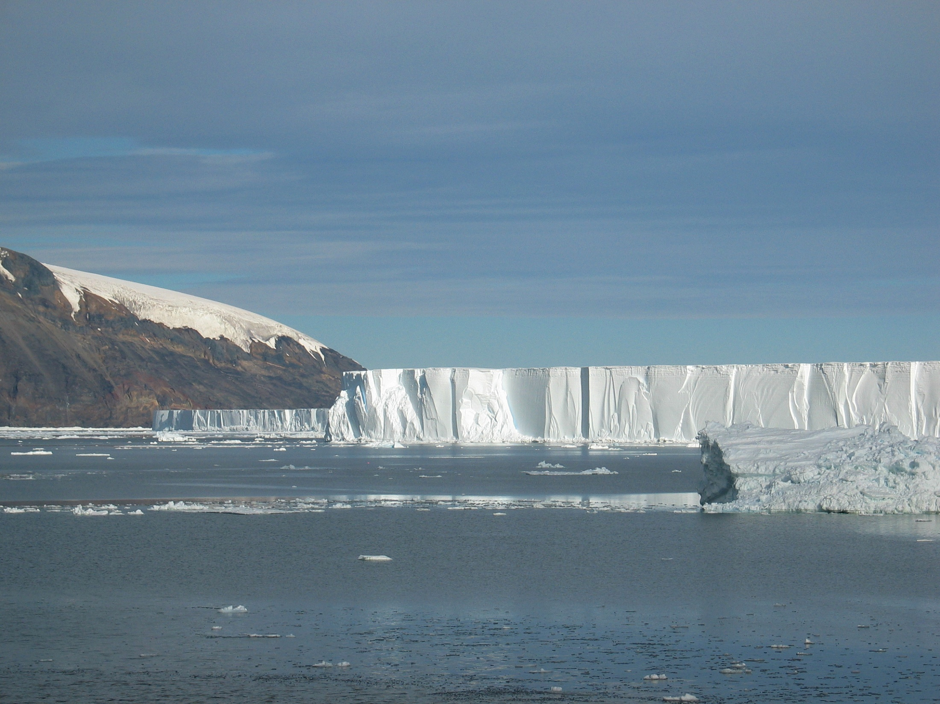

Regional Ocean Circulation Model for the west Antarctic Peninsula (including the area around Palmer Deep)
Mike Dinniman
Center for Coastal Physical Oceanography
Old Dominion University
August 13, 2019

Slide 2
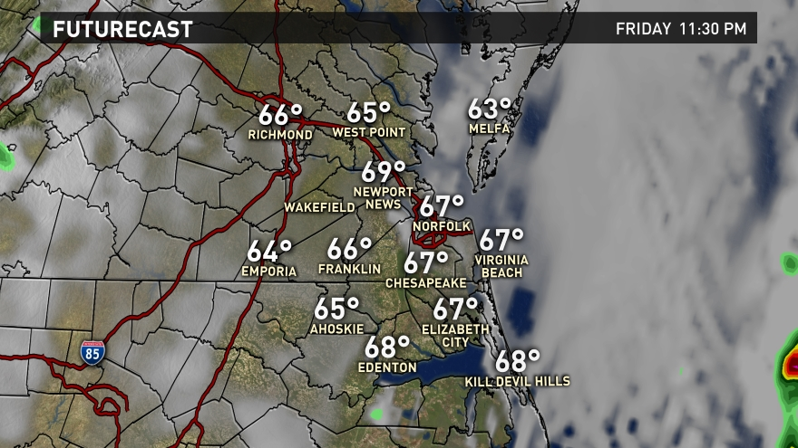
Computer Models of “Weather”
Hear about computer models of the atmospheric weather all the time…
(from WVEC)

Slide 3
Computer Models of “Weather”
However, we can also make the same kind of computer models of the “weather” of the ocean:
  Both the atmosphere and the ocean are fluids moving around on a rotating ellipsoid (Earth)
  Both follow the same laws of physics
  Granted, there are many differences (for example, water is much denser than air), but both can be studied with some of the same mathematical equations
Notes:
Explain “weather” of the ocean and ocean eddies vs. low pressure systems.

Slide 4
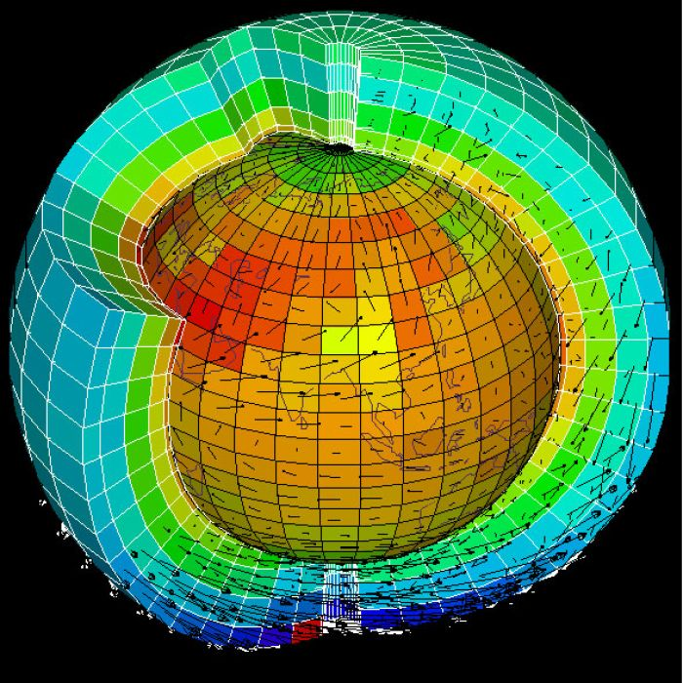
First, divide up the atmosphere and/or ocean into “lots” of little boxes, the more the better:
(model I’m going to show later has ~ 26,700,000 boxes)

Slide 5
In each box, you can use Newton’s Law (F = ma) to predict changes in the current/wind speed if you add up all the forces:
For the ocean:
Change in ocean current = horizontal transport +
vertical transport +
rotation (Coriolis force) +
horizontal pressure force +
wind force +
frictional forces
Change in sea level = add up all the velocities into and out
of a grid box (“incompressibility”)
Notes:
Also, one difference in atmosphere and ocean is how “squeezable” the water is.

Slide 6
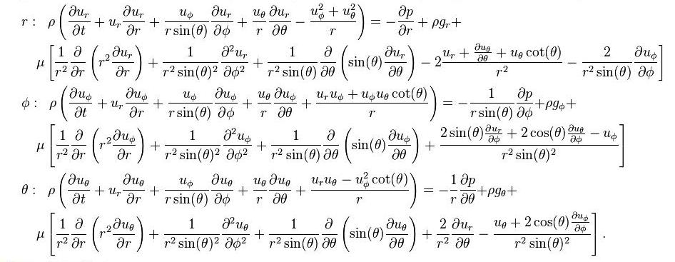
Navier – Stokes Equations: The full equations can get a little complicated…
…but are used for not only ocean and atmosphere models, but anywhere you study fluid motion (aircraft and car design, blood flow in a heart, movie special effects).

Slide 7
Antarctic Peninsula Regional Model
Originally created to study the transport of Circumpolar Deep Water (and heat) onto the Antarctic Peninsula continental shelf
Being used for several studies
  Interactions between current and krill
  Transport on and off the continental shelf by currents and eddies
  Ocean melting of glaciers
  This project

Slide 8
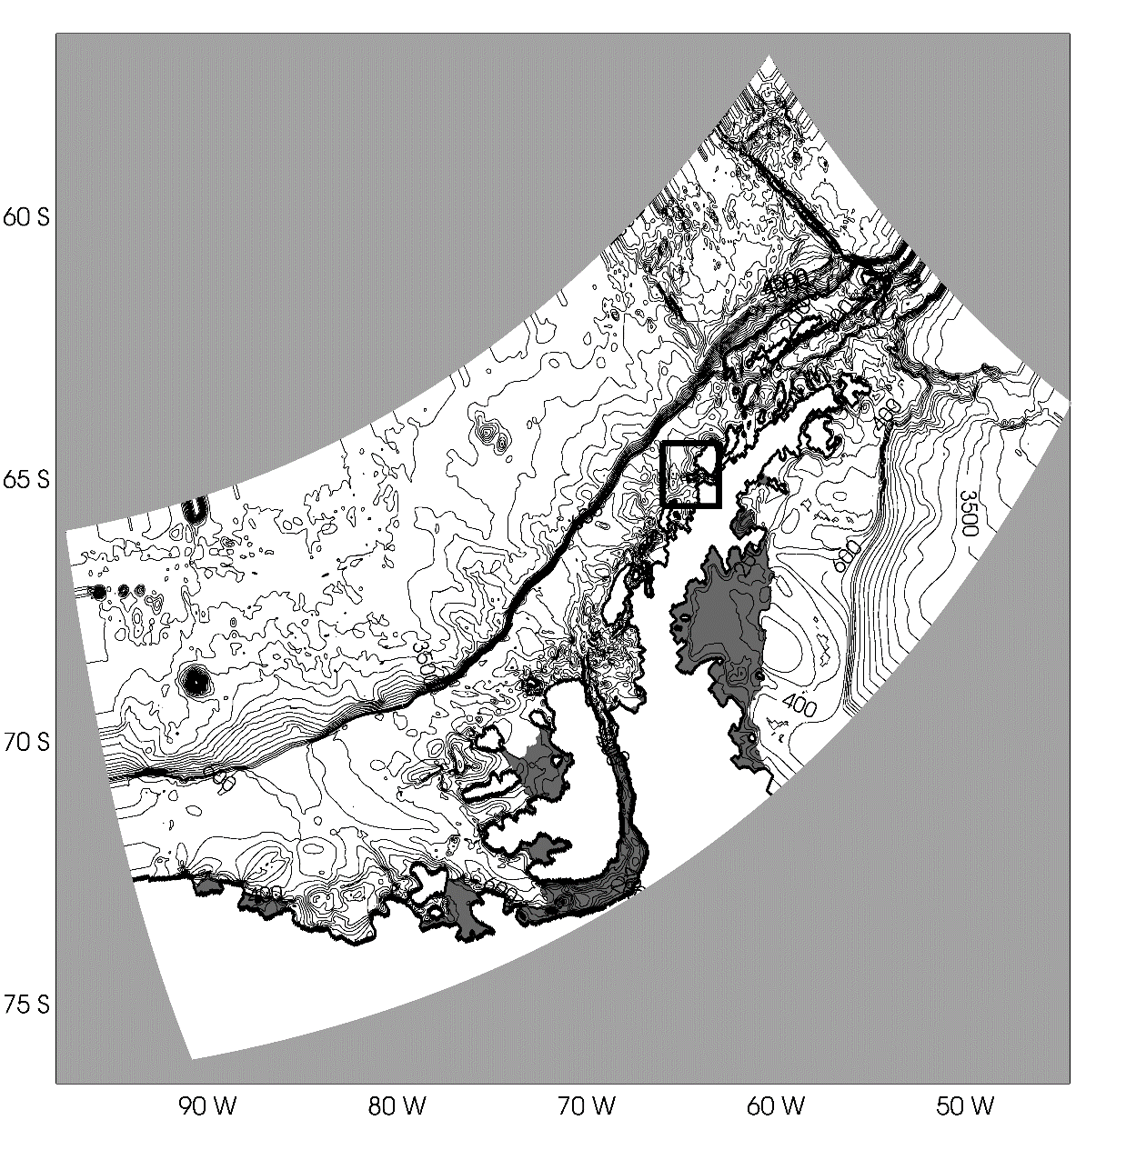
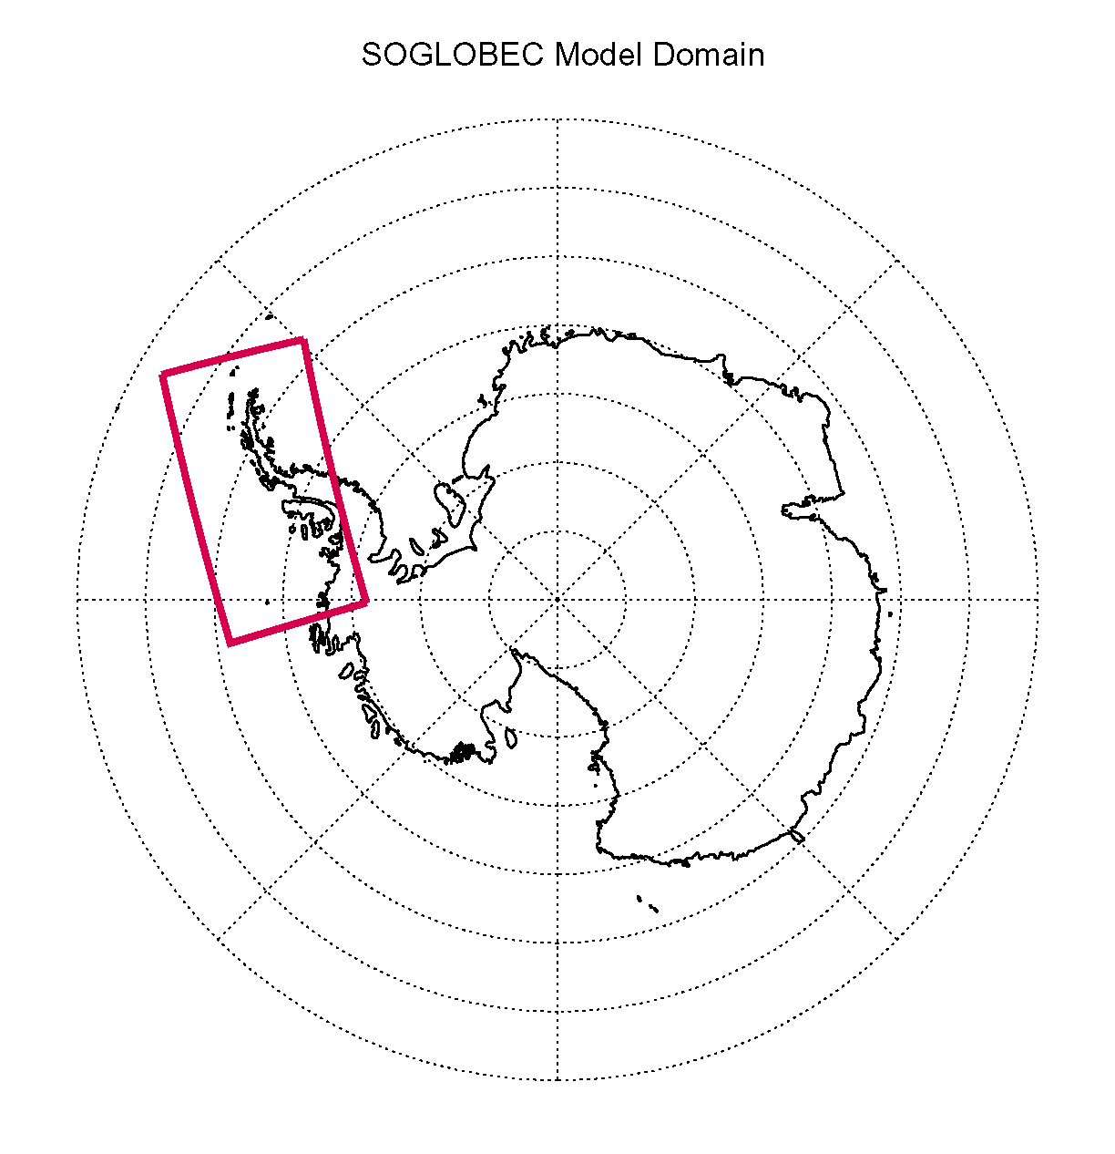
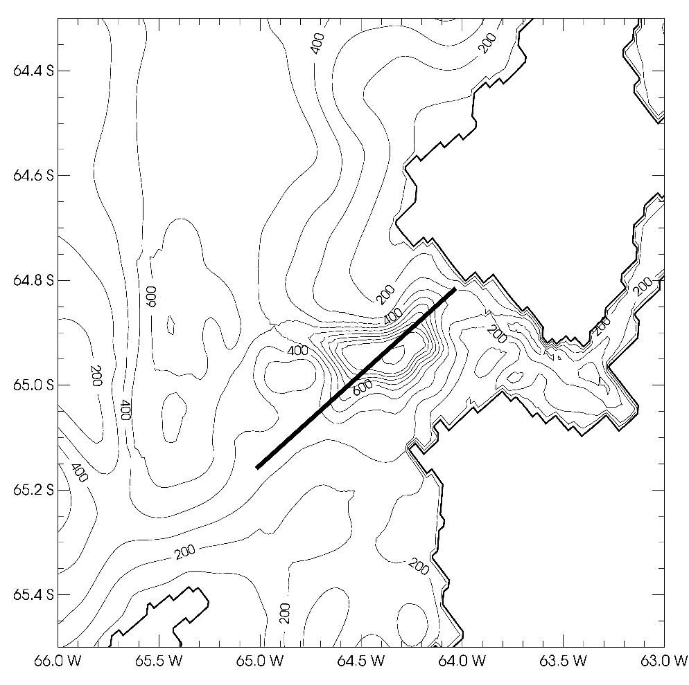
West Antarctic Peninsula (WAP) regional model
Notes:
Mention ice shelves including calving of A-68 off of Larsen C. Cross section is 60km (40 grid points).

Slide 9
Antarctic Peninsula Model (cont.)
Regional Ocean Modeling System: 1.5 km horizontal resolution, 24 vertical (terrain following) levels
Need atmospheric forcing (winds, air temperature, humidity, clouds, rain/snow, air pressure)
  Hindcast mode (what we have…uses past atmospheric forcing)
  Forecast mode (we don’t, but we could…uses forecasted future atmospheric conditions)
Also need lateral ocean boundary conditions (currents, sea level, temperature, salinity)

Slide 10
Antarctic Peninsula Model (cont.)
Simulates ocean 3D velocity, temperature, and salinity at every model grid point
Also simulates sea ice (thickness, extent, 2D ice velocity) and interactions between floating land/glacial ice (ice shelves) and the ocean
Can simulate the spread of tracer dyes
  Will show a dye representing the transport of Circumpolar Deep Water (CDW) onto the continental shelf
Can also load the model with passive floats and simulated where they are driven by the current

Slide 11
Antarctic Peninsula Model (cont.)
Most of the following examples are from 1 day averaged fields covering austral summer 2008-2009 (12/1/2008 – 2/28/2009)

Slide 12
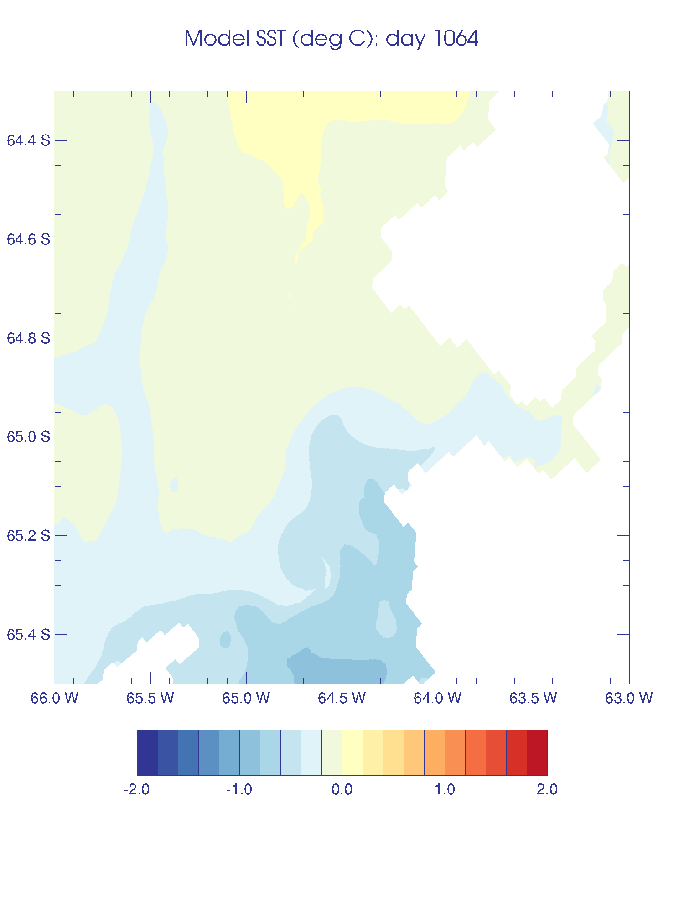
Model 1-day average sea surface temperature (SST) for the region around Palmer Deep
(12/1/2008)

Slide 13
Model sea surface temperature (SST) for the region around Palmer Deep
Summer 2008-2009
Note generally increasing SST over the summer
Notes:
Note cold coastal water coming in from the south early on and generally increasing SST over the course of the summer.

Slide 14
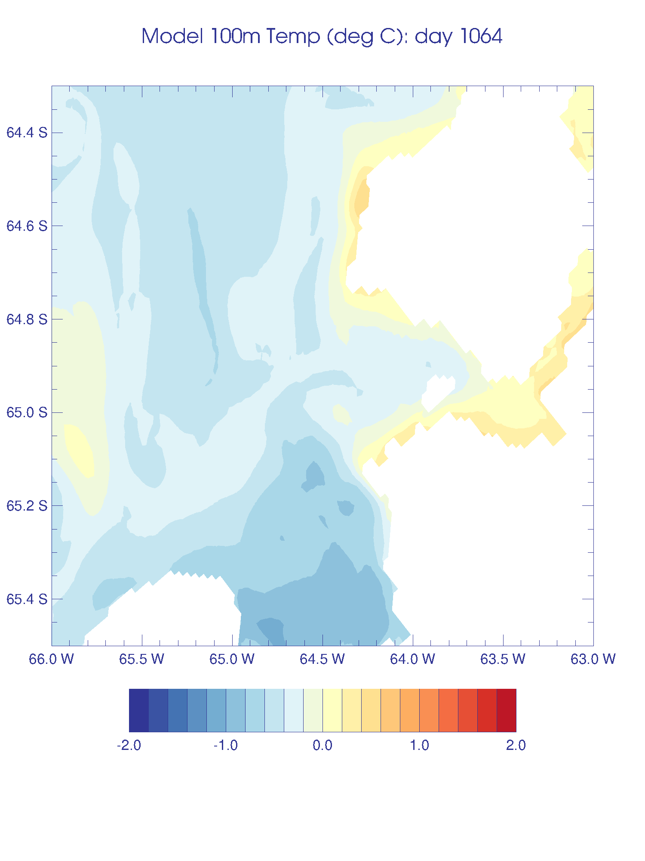
Model temperature at 100 m for the region around Palmer Deep
Summer 2008-2009
Cooler temperatures than at surface
Note increasing temperature at this depth over the summer
Notes:
Note generally cooler temperatures at this depth but increasing temperature at 100 m over the summer. Can also see some evidence of eddies spinning off the coast and around Palmer Deep canyon.

Slide 15
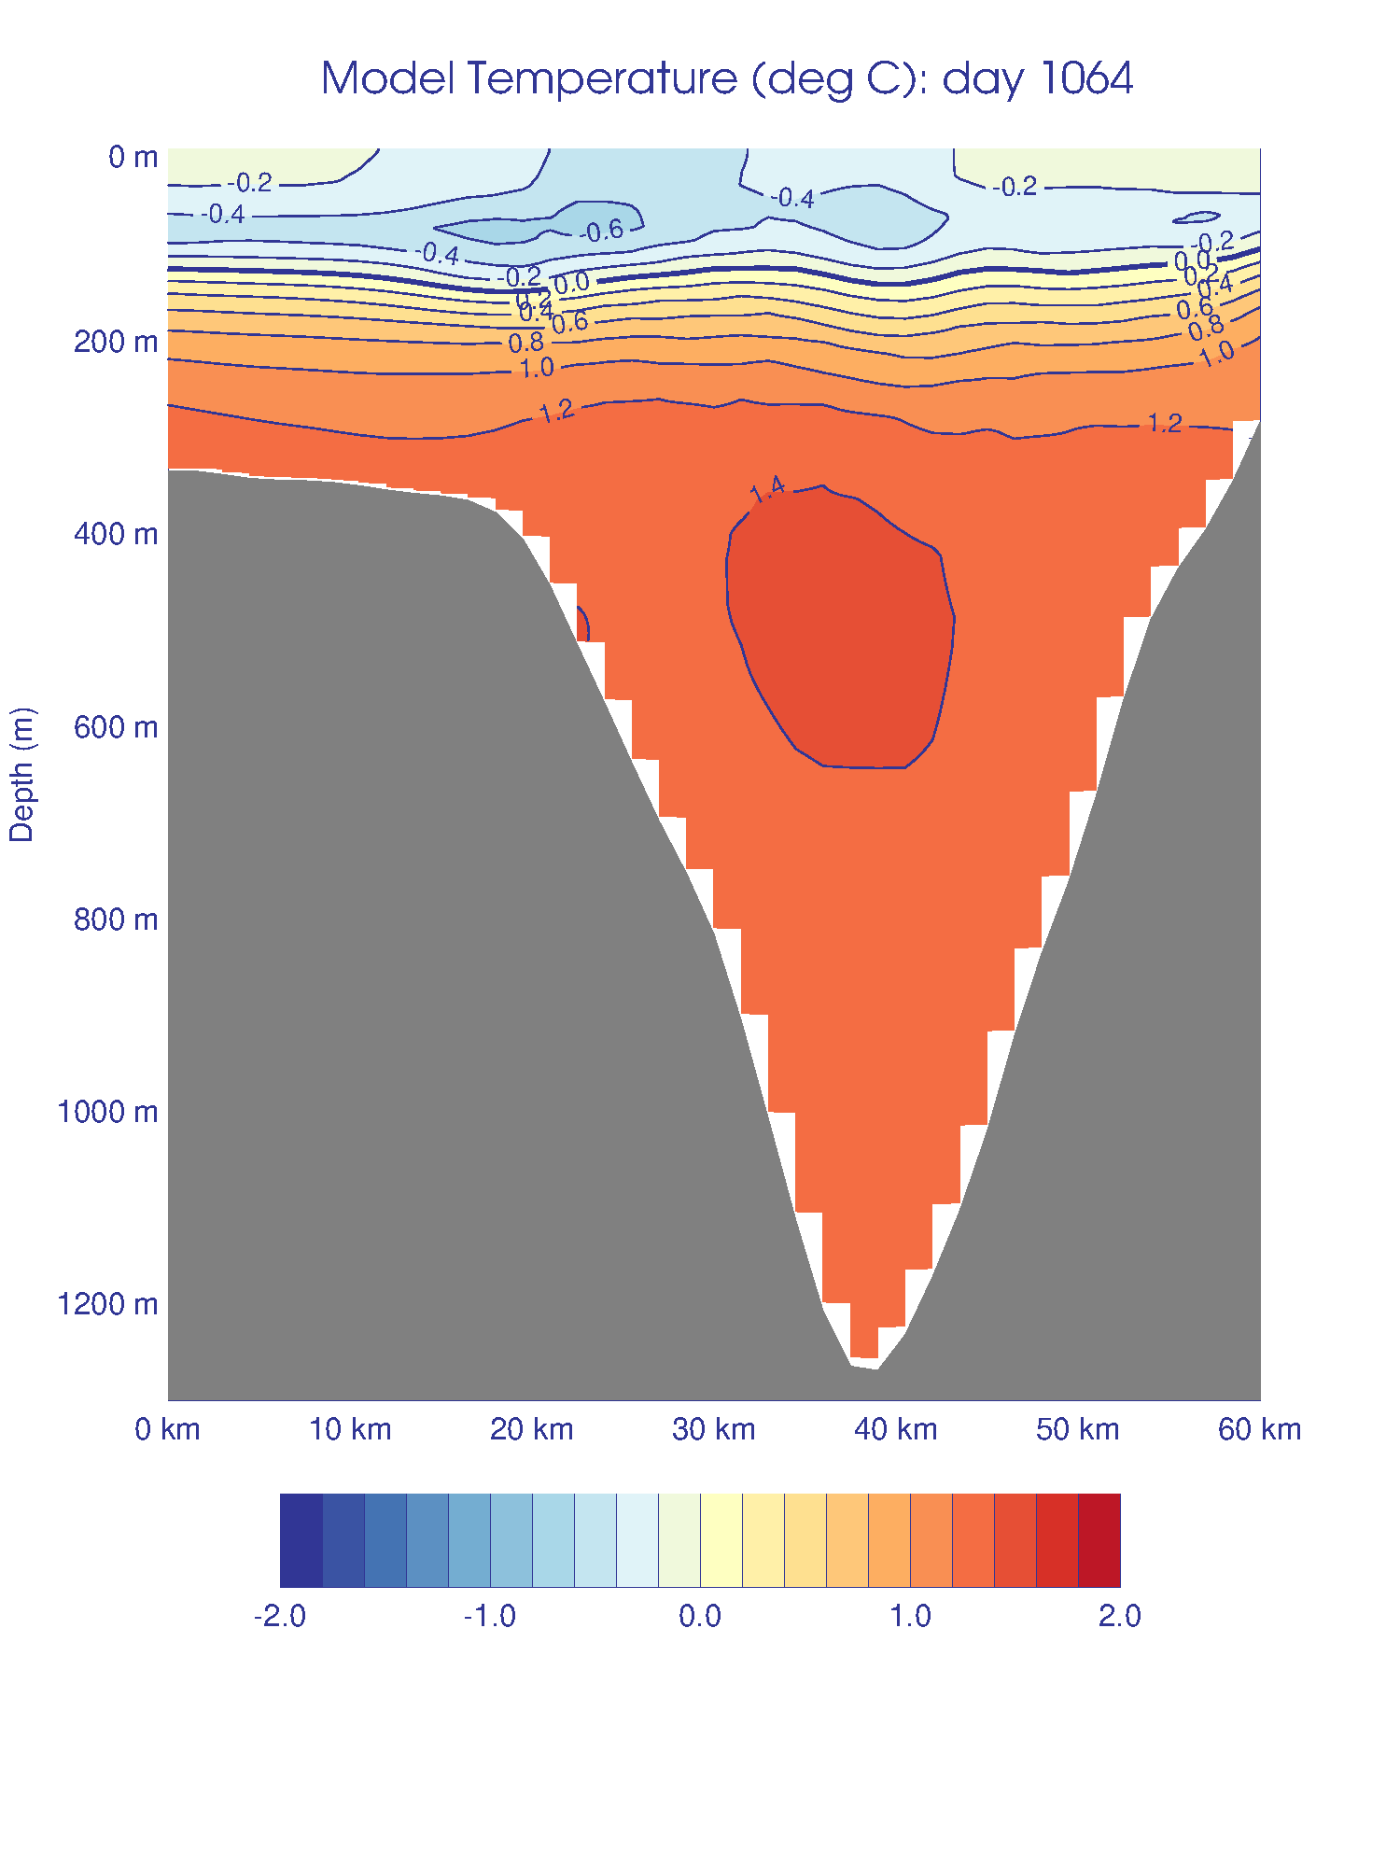
Model temperature along cross section through Palmer Deep
Summer 2008-2009
Note warmer water near surface, cooler water below that, and warmest water at depth
Warming surface and near surface waters over the summer
Notes:
Note surface water gets warmer over time, cold winter water layer goes away, deeper water just above rim gets a little colder, deep water in canyon doesn’t change temperature much.

Slide 16
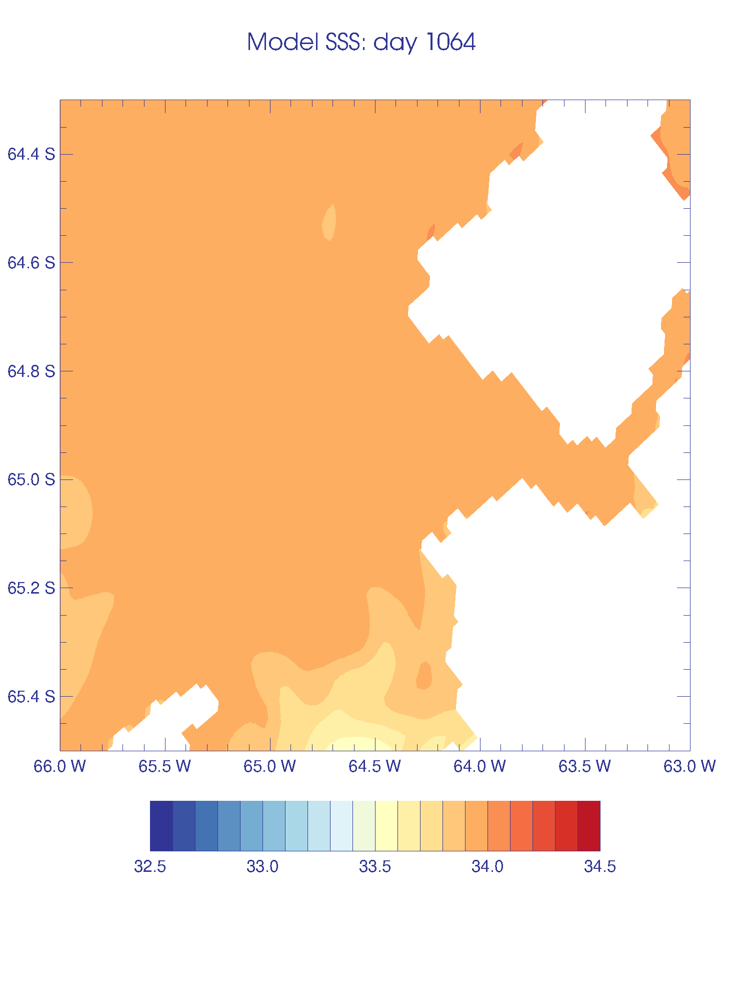
Model sea surface salinity (SSS) for the region around Palmer Deep
Summer 2008-2009
Note surface is getting fresher over the summer
Notes:
Early on can see cold (look at SST movie) fresh water from the south. Probably sea ice melt (sea ice has already melted out here long before 12/1). Generally getting fresher over the course of the summer.

Slide 17
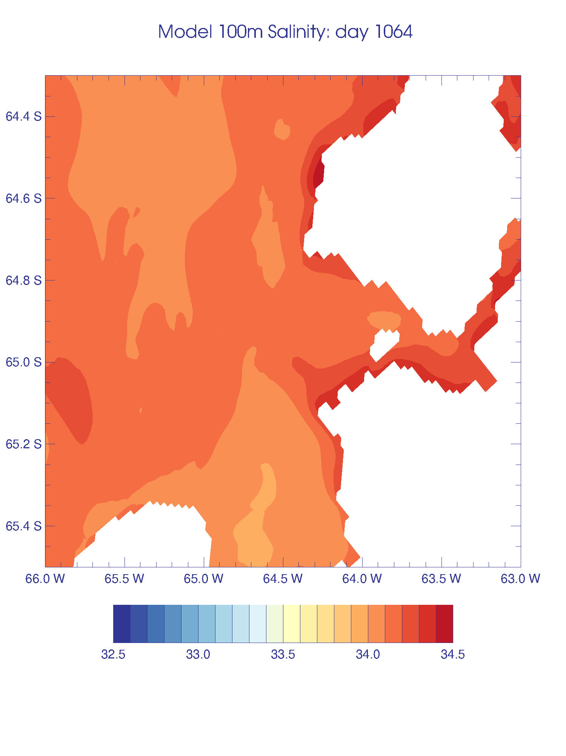
Model salinity at 100 m for the region around Palmer Deep
Summer 2008-2009
Saltier at this depth than surface
Getting even saltier over the summer
Notes:
Note higher salinity here vs. surface and getting saltier over the summer at this depth. Also note that you can see some eddies spinning off from near the coast and going over Palmer Deep. Also, no fresher water at this depth from the south early on (fresh signal is confined to surface).

Slide 18
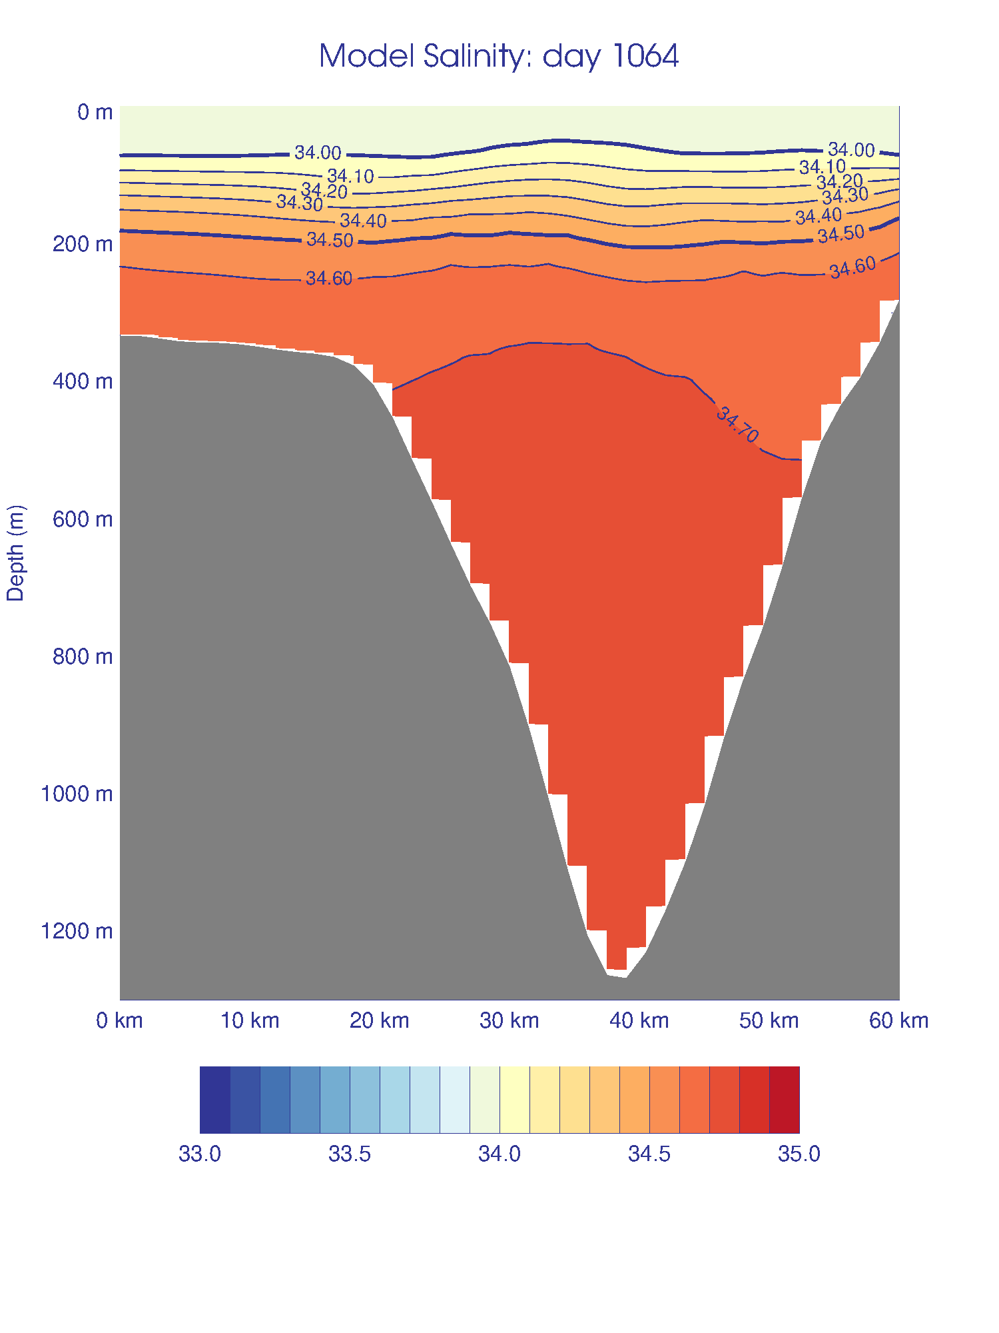
Model salinity along cross section through Palmer Deep
Summer 2008-2009
Note that salinity change with depth is only in one direction (different from temperature)…density is set more by salinity than temperature in cold water
Surface gets fresher over the summer
Notes:
Fresher at surface and saltier at depth. Can see the surface get fresher over the summer.

Slide 19
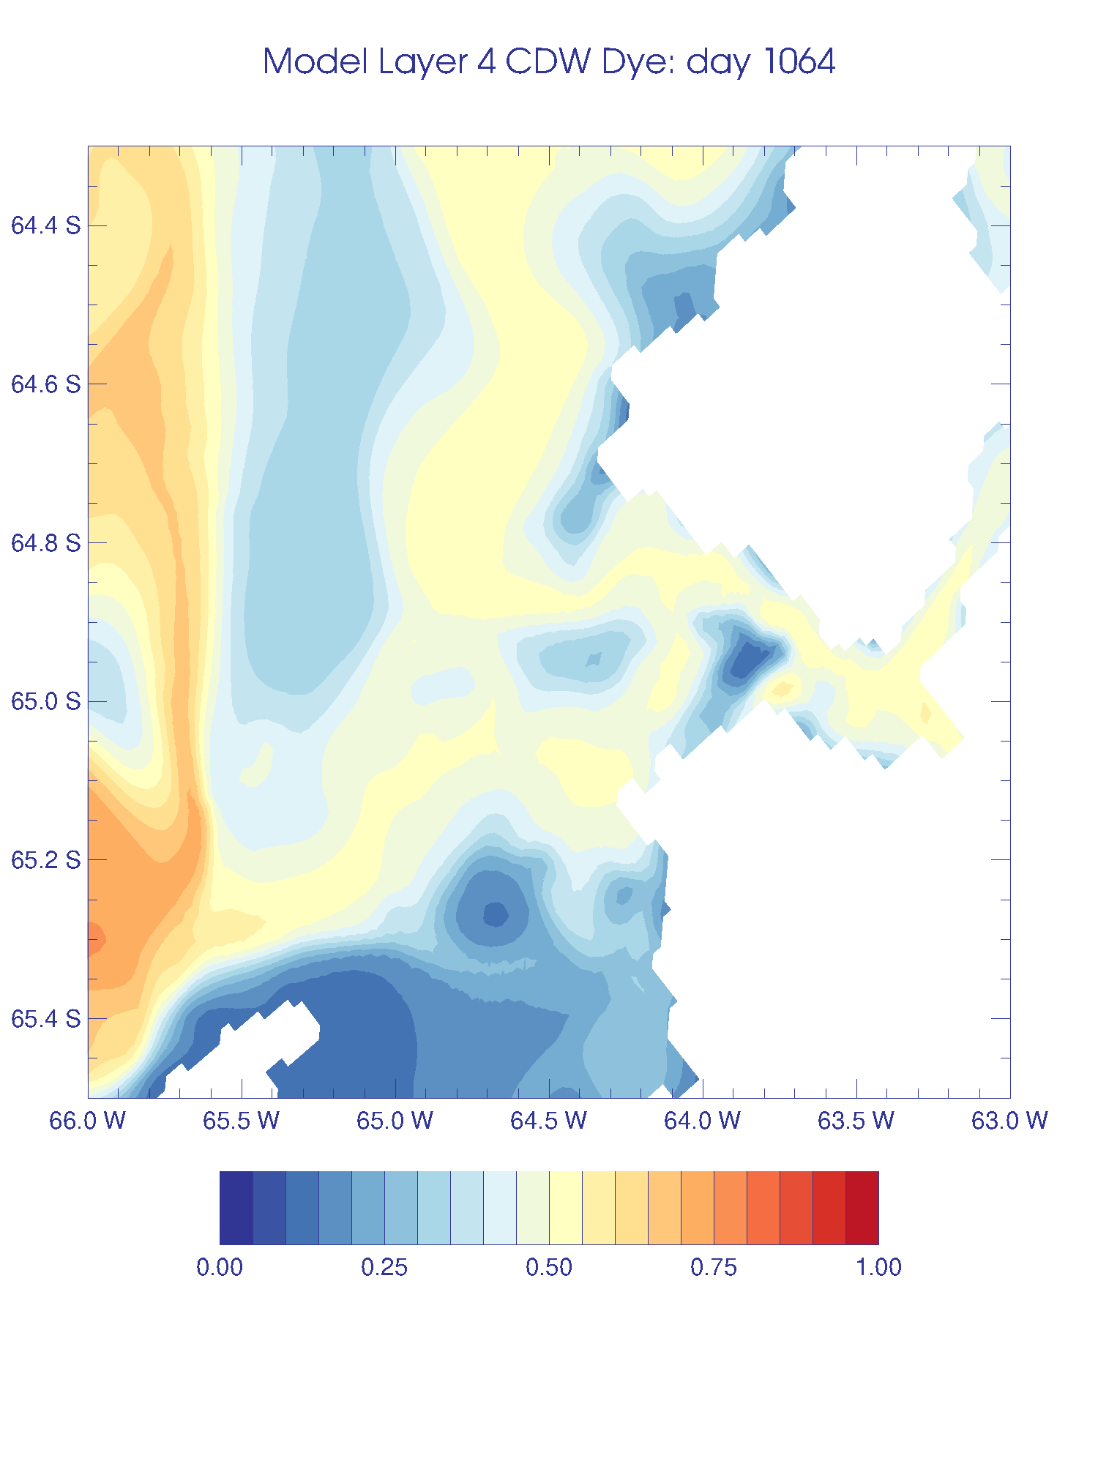
Model CDW dye at the 4th model layer from the bottom (out of 24 layers…actual depth varies) for the region around Palmer Deep
Summer 2008-2009
Note that dye getting to Palmer Deep is primarily coming from the north just west of Anvers Island
Notes:
Most of the CDW getting to Palmer Deep seems to be coming from the north from just west of Anvers Island. Note values getting larger over time. Again, this is not at a fixed depth, so the low values over Palmer Deep are at a much greater depth that will take longer to fill in.

Slide 20
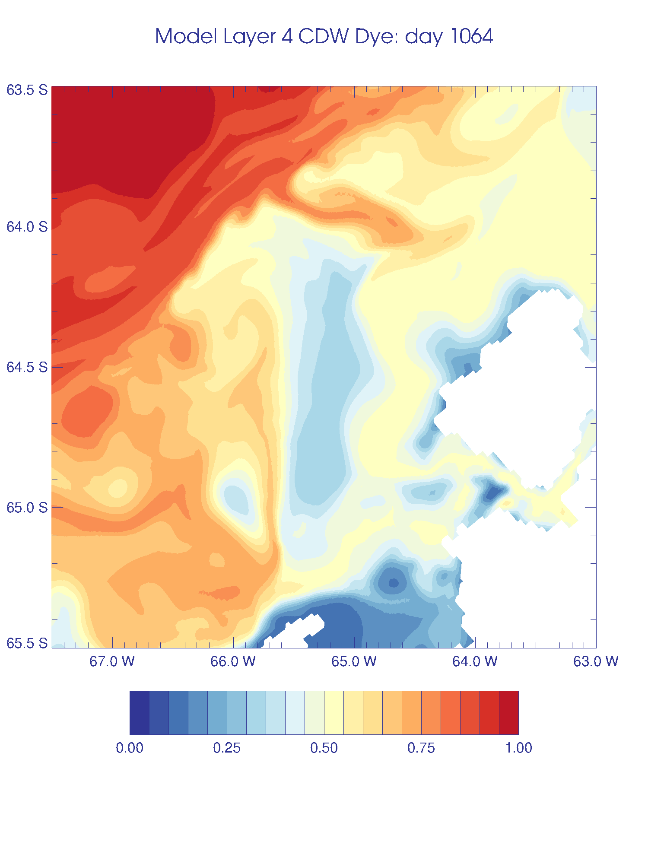
Model CDW dye at the 4th model layer from the bottom (out of 24 layers…actual depth varies) for a larger region around Palmer Deep to show the pathway from the shelf break
Summer 2008-2009
Notes:
Most of the CDW getting to Palmer Deep seems to be coming from the north from just west of Anvers Island. Note most of the CDW from the northern canyon not going towards Palmer Deep. Same pathway of heat as found by observations. Note values getting larger over time. Again, this is not at a fixed depth, so the low values over Palmer Deep are at a much greater depth that will take longer to fill in.

Slide 21
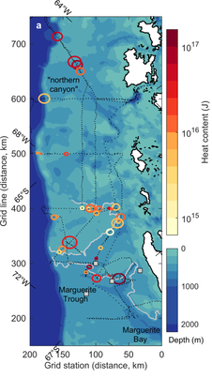
(Couto et al., 2017)
Shows gliders tracks of warm eddies of CDW through the “northern canyon”
Notes:
Most of the CDW getting to Palmer Deep seems to be coming from the north from just west of Anvers Island. Note most of the CDW from the northern canyon not going towards Palmer Deep. Same pathway of heat as found by observations. Note values getting larger over time. Again, this is not at a fixed depth, so the low values over Palmer Deep are at a much greater depth that will take longer to fill in.

Slide 22
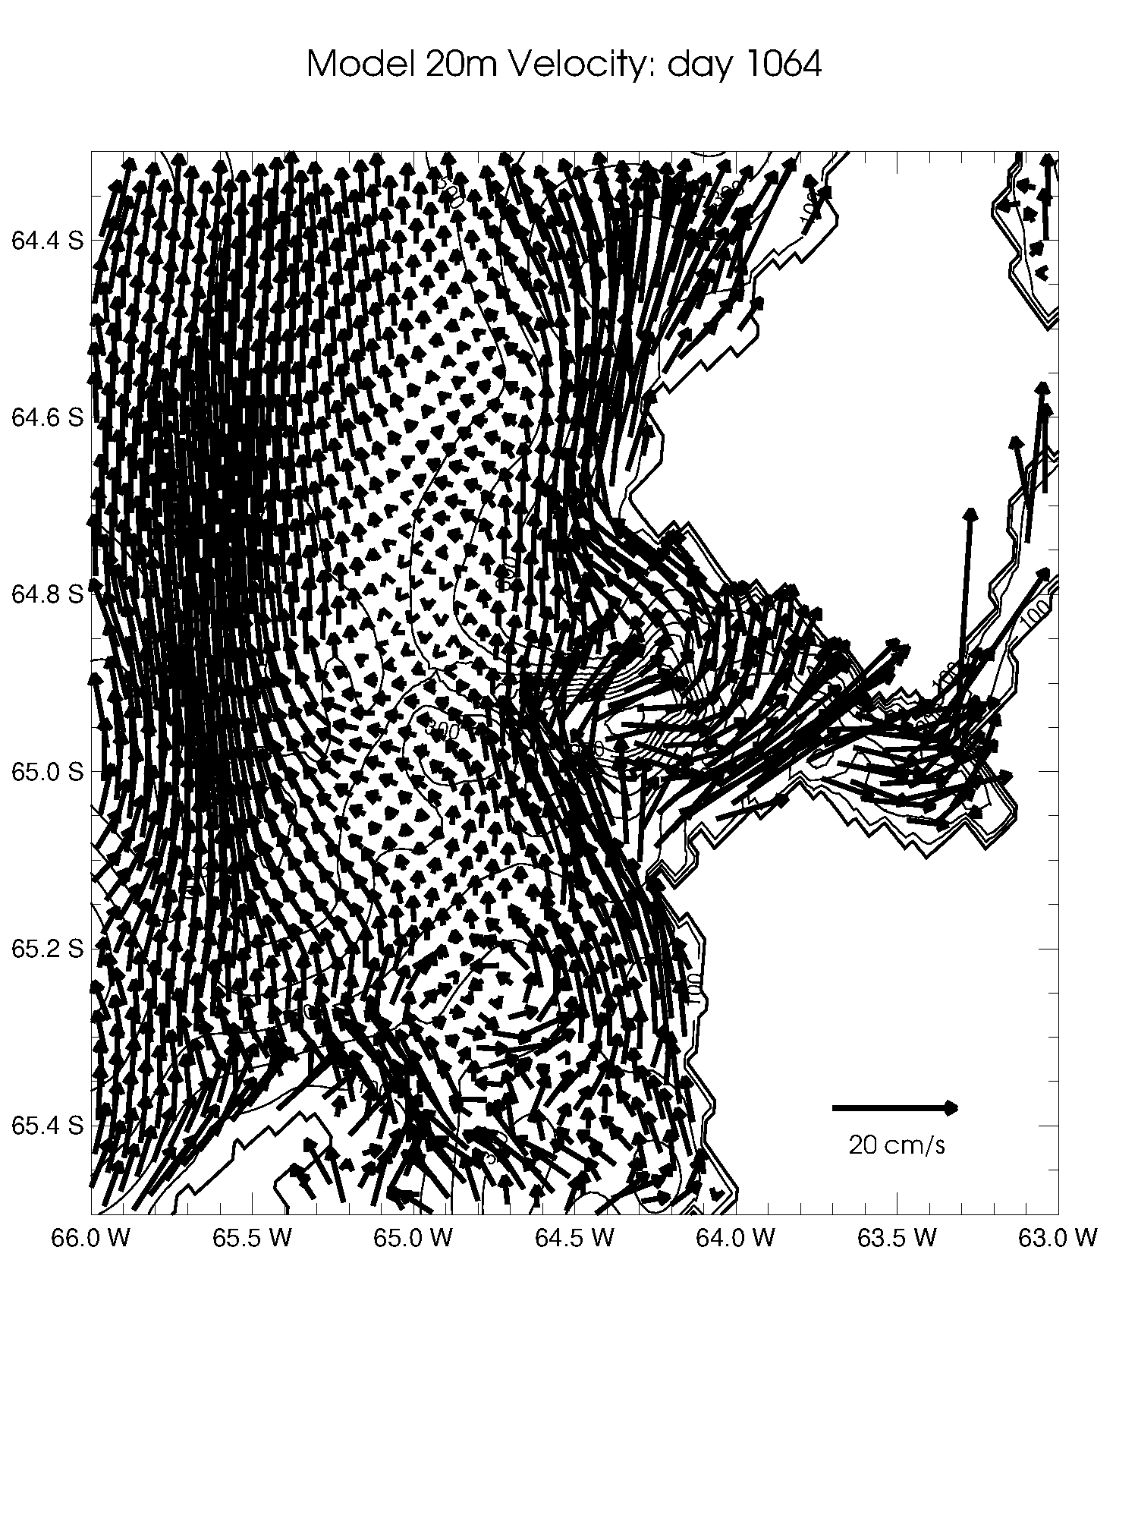
Model 1-day average velocity vectors at 20 m for the region around Palmer Deep
(12/1/2008)
Note that this is not showing every model velocity vector (showing every 4th)
Notes:
Note that this is not showing every model velocity vector (would be too busy), but instead is every 4th vector (1/2 in x, ½ in y).

Slide 23
Model velocity vectors at 20 m for the region around Palmer Deep
Summer 2008-2009
Not showing every model velocity vector, but every 4th
Note the cyclonic (CW) flow over Palmer Deep
Flow varies greatly (response to changing winds)
Notes:
Note the generally cyclonic flow over Palmer Deep. Can also see the flow varies a lot at this depth and can see (sort of) some eddies forming.

Slide 24
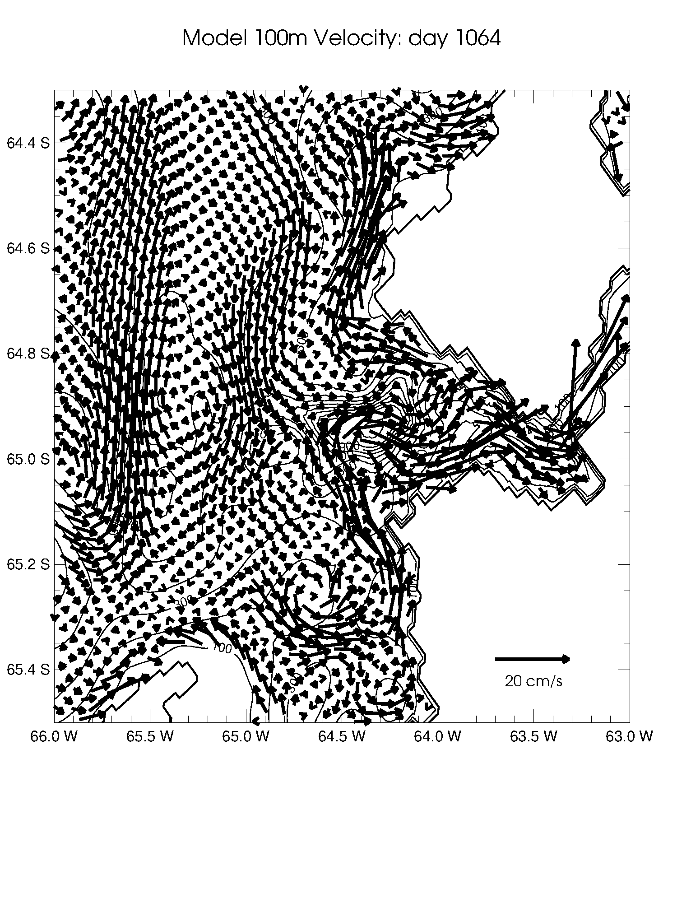
Model velocity vectors at 100 m for the region around Palmer Deep
Summer 2008-2009
Can see the CW flow over Palmer Deep better
Flow is less variable at this depth and can better see generation of eddies
Notes:
Can see the cyclonic flow over Palmer Deep better at this depth. Flow is less variable and can see some cool eddies.

Slide 25
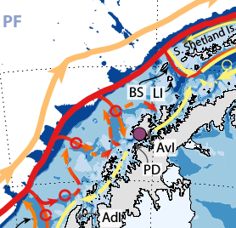

(Moffat and Meredith, 2018)
Notes:
Schematic currents vs. model.

Slide 26
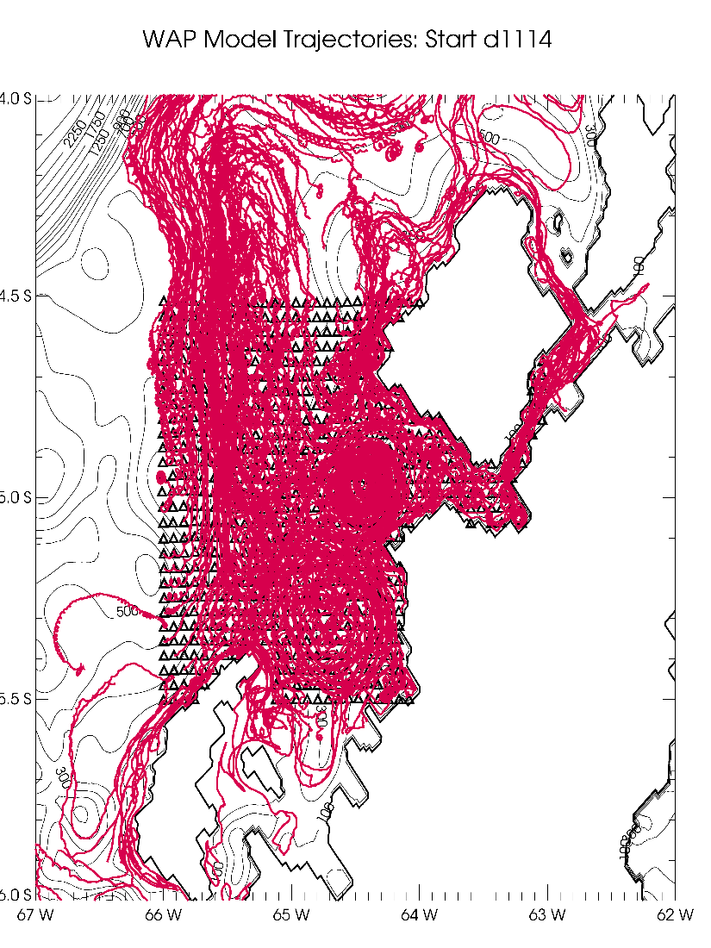
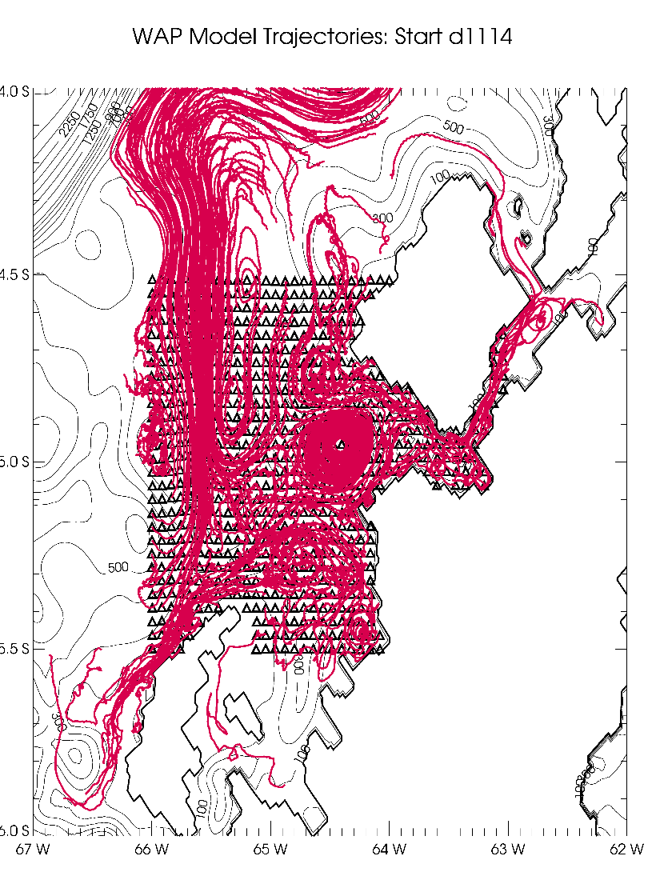
Can release drifters in the model to track pathways
Drifters released around Palmer Deep at two different depths in mid-January 2009 and tracked for 30 days
20 m 120 m
Note that deeper particles seem to be held more strongly around Palmer Deep
Notes:
Triangles are start positions. Only plotted every third pathway (red lines). Note that more of the drifters are locked around Palmer Deep at 120m…looks like particles are held more strongly around Palmer Deep at depth…implications for biology.

Slide 27
Model is good at filling in gaps between observations and helping place the observations in a broader context
All these animations, as well as this PowerPoint, will be available at: www.ccpo.odu.edu/~msd/TUCKERTON
  Any interest in the individual frames of the animation?
Full data sets of model values of any variables (temperature, salinity, velocity, etc.) are available, but you probably don’t want everything (it’s TB of data)
  I can make subsets (in space and in time)
  Just ask and we’ll figure out something
Some of the drifter tracks are available as well
Questions?

Slide 29
Model 1-day average temperature at 100 m for the region around Palmer Deep
(12/1/2008)

Slide 30
Model 1-day average temperature along cross section through Palmer Deep
(12/1/2008)
Note warmer water near surface, cooler water below that, and warmest water at depth

Slide 31
Model 1-day average sea surface salinity (SSS) for the region around Palmer Deep
(12/1/2008)

Slide 32
Model 1-day average salinity at 100 m for the region around Palmer Deep
(12/1/2008)

Slide 33
Model 1-day average salinity along cross section through Palmer Deep
(12/1/2008)

Slide 34
Model 1-day average CDW dye at the 4th model layer from the bottom (out of 24…so varying depth) for the region around Palmer Deep
(12/1/2008)
Notes:
Note that model starts off with zero dye concentration on shelf, 1.0 off shelf. This shows pathways CDW takes on the way to Palmer Deep. Again, this is not at a fixed depth, so the low values over Palmer Deep are at a much greater depth that will take longer to fill in.

Slide 35
Model 1-day average CDW dye at the 4th model layer from the bottom (out of 24…so varying depth) for a larger around Palmer Deep to show the pathway from the shelf break
(12/1/2008)
Notes:
Note that model starts off with zero dye concentration on shelf, 1.0 off shelf. This shows pathways CDW takes on the way to Palmer Deep. Note path from the north. Again, this is not at a fixed depth, so the low values over Palmer Deep are at a much greater depth that will take longer to fill in.

Slide 36
Model 1-day average velocity vectors at 100 m for the region around Palmer Deep
(12/1/2008)

Slide 37
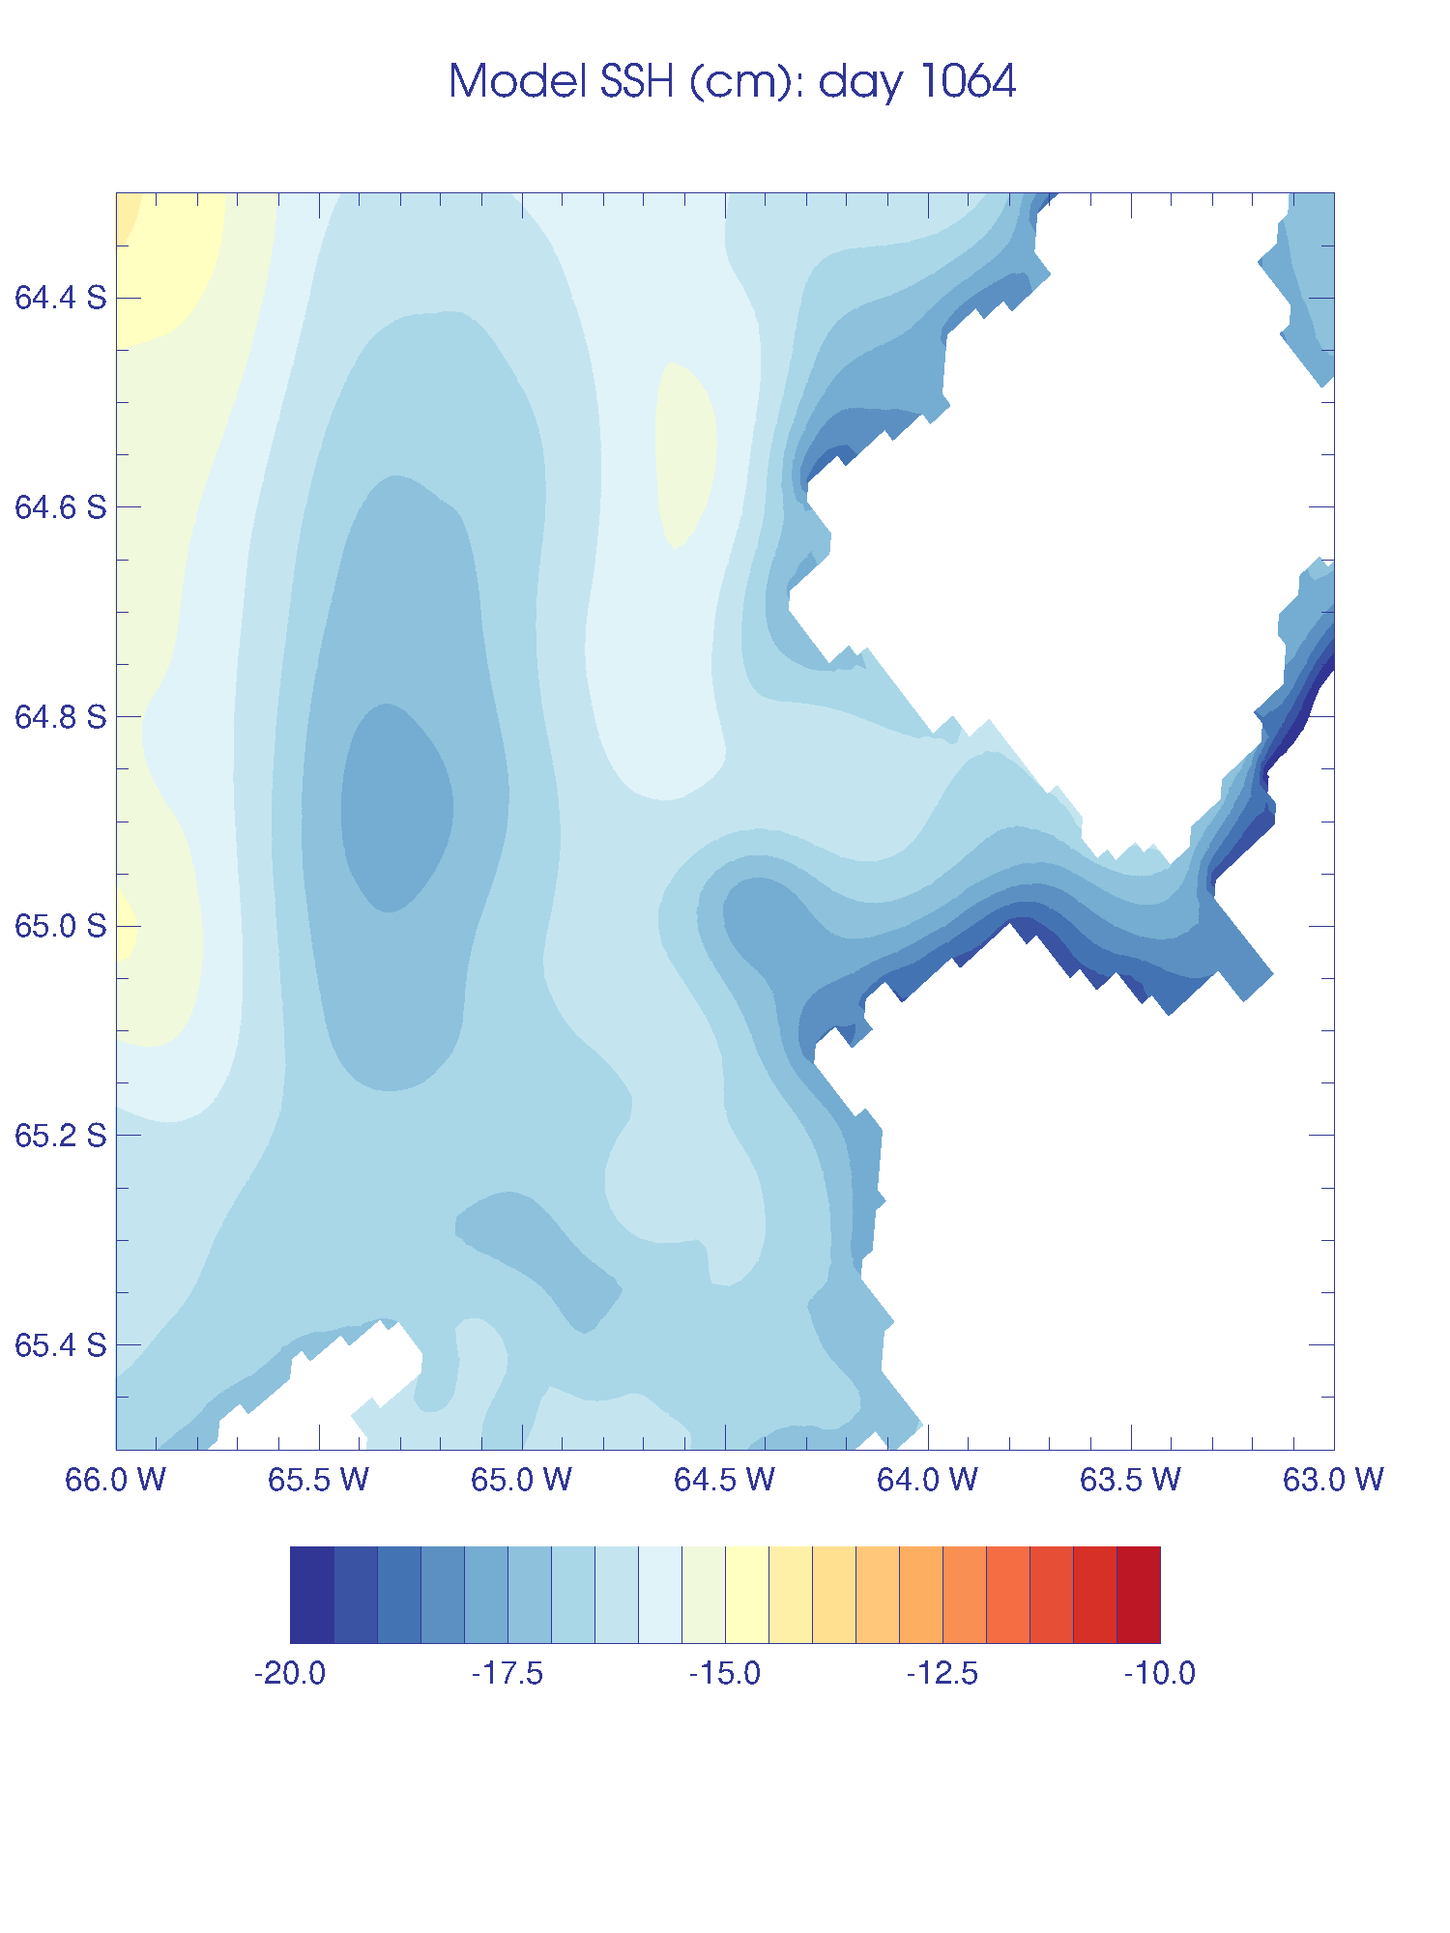
Model sea surface height (SSH) for the region around Palmer Deep
Broad scale up/down movement in response to the wind, but can see some eddies
Summer 2008-2009
Notes:
Explain height like pressure in atmosphere, which way water will move in SH, eddies are like storms/surface lows in atmosphere.

