Slide 1
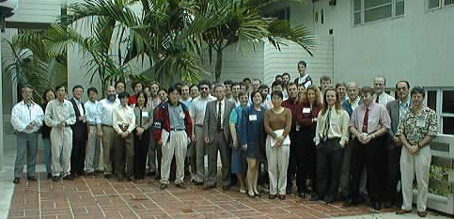
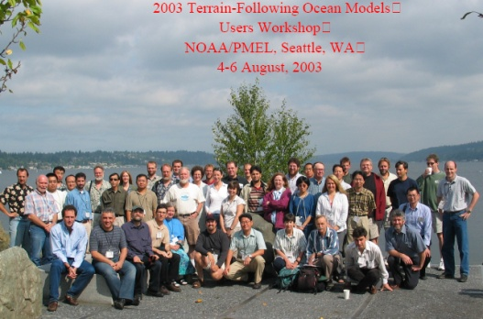
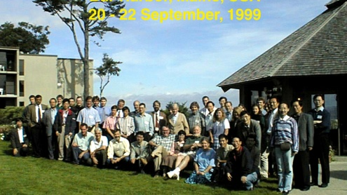
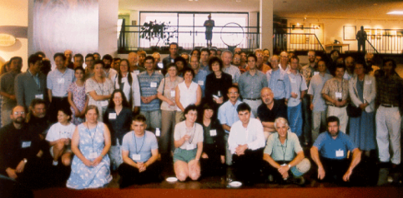
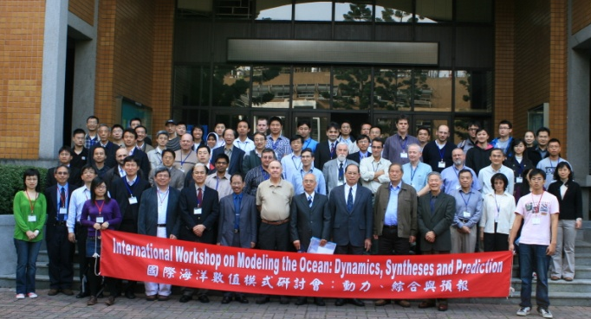
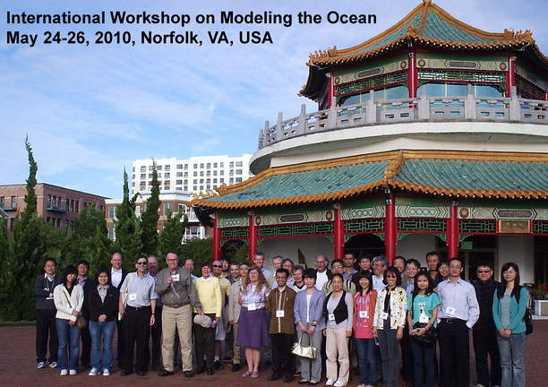
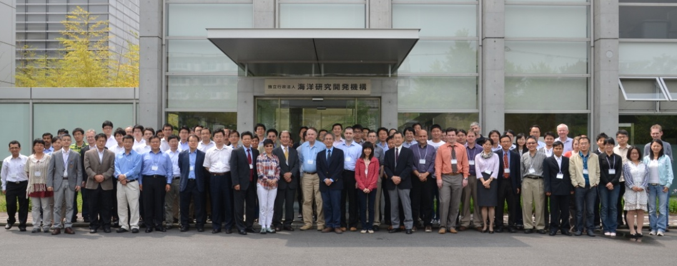
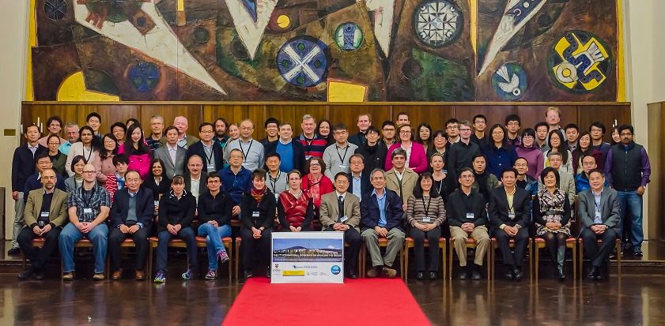
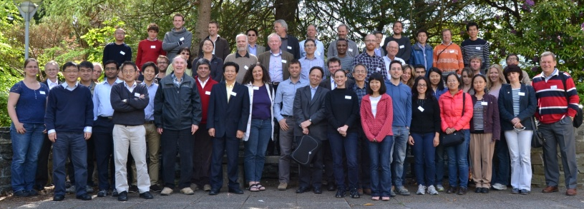
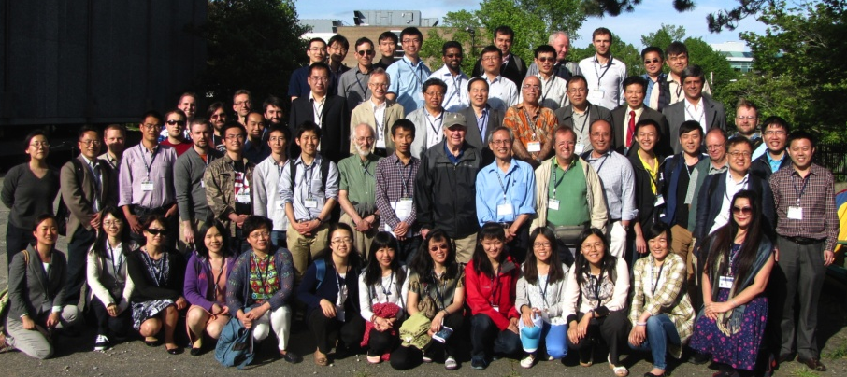
From POM-1996 to IWMO-2016:
An overview of 20 years of ocean modeling and users participation
Tal Ezer
Center for Coastal Physical Oceanography, ODU, Norfolk, VA, USA
1998
1999
2001
2003
2009
2012
2010
2015
2013
2014

Slide 2
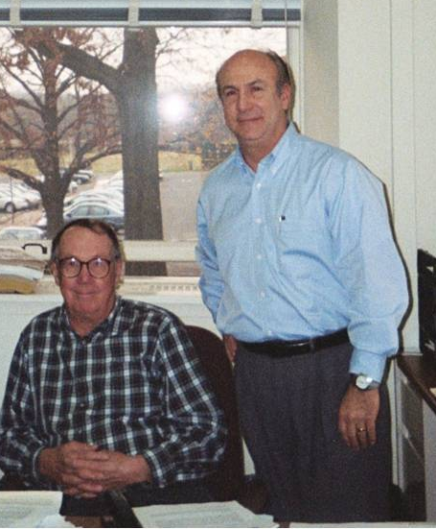
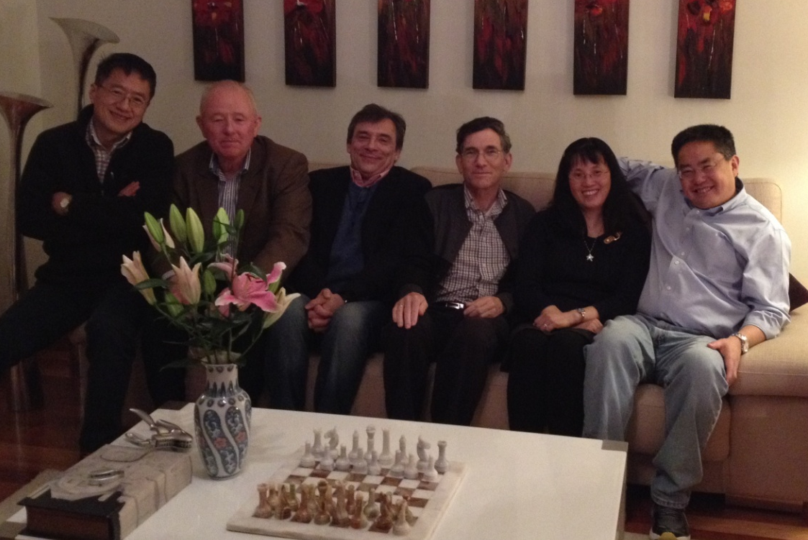
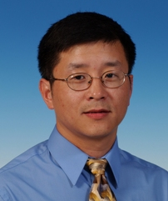
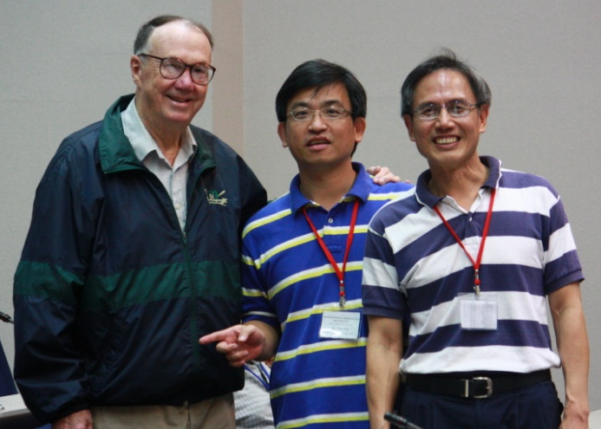
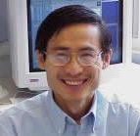
Some of the people who attended both
POM-1996 (Princeton) and IWMO-2016 (Bologna)
Also in the pictures:
Chau-Ron Wu: hosted the first IWMO meeting (2009)
Jarle Berntsen: hosted the first European IWMO meeting (2013)
Mellor Blumberg
J. Gan
J. Wang
H. Wang Berntsen Zavatarelli Ezer Xue Fei
Mellor C-R Wu L-Y Oey

Slide 3
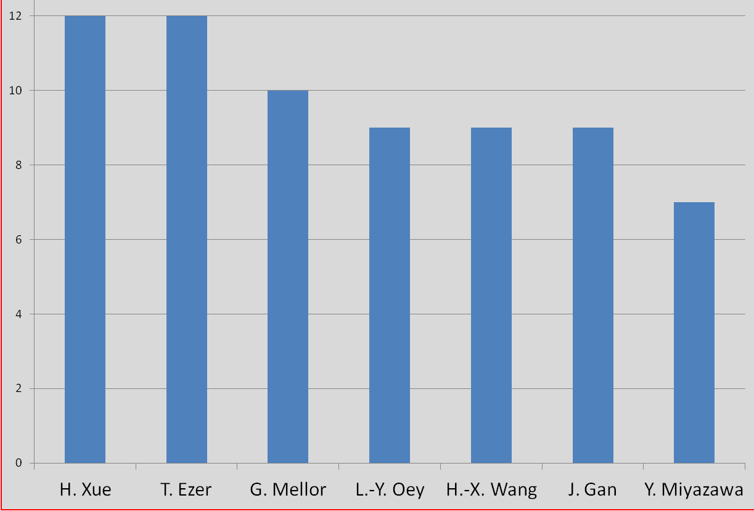
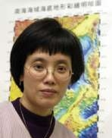
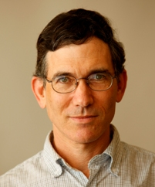
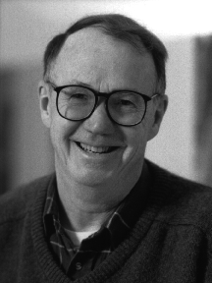
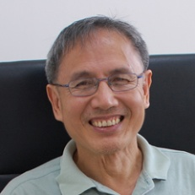
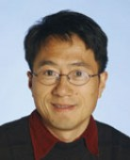
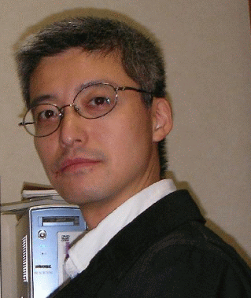
The most dedicated attendees…
(number of users meeting attended 1996-2015)

Slide 4
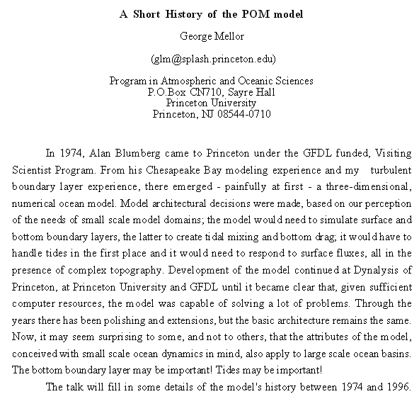
Princeton
June 1996

Slide 5
Some milestones in the development of POM (1974-2016):
(some developments later adapted by other models…)
Mellor & Yamada (1974, 1982): M-Y turbulence model
Blumberg & Mellor (1983, 1987): “Blumberg-Mellor” model
commercial versions: “Dynalysis of Princeton model”, “ECOM model”
since the 1990s known as POM
Galperin, Kantha, Mellor, others (1990- ): improved turbulence scheme
Hakkinen, Kantha, Mellor (1990- ): Sea-Ice model
Mellor (1991): new Equation of State
Mellor&Ezer (1991): Data assimilation scheme
Blumberg, Jewell, Wang, others (1993- ): Sediment transport model
Ezer & Mellor (1995): POMnb, Non-Boussinesq version of POM
POM98.f (all CAPITAL)
J. Hunter (2001): “Australian POM” OzPOM → pom2k (netCDF output)
Mellor et al. (2002): POMgcs, Generalized-coordinate POM
Oey (2005): POMwad, Wetting and Drying scheme
Parallel versions (2000-2016), latest sbPOM (Jordi & Wang, 2012)
Mellor (2003-2015): Surface wave-current coupling
contributors:
Blumberg, Ezer, Galpering, Hakkinen, Herring, Hunter, Kantha, Mellor, Oey, Patchen, Wang, Xue, Yamada,

Slide 6
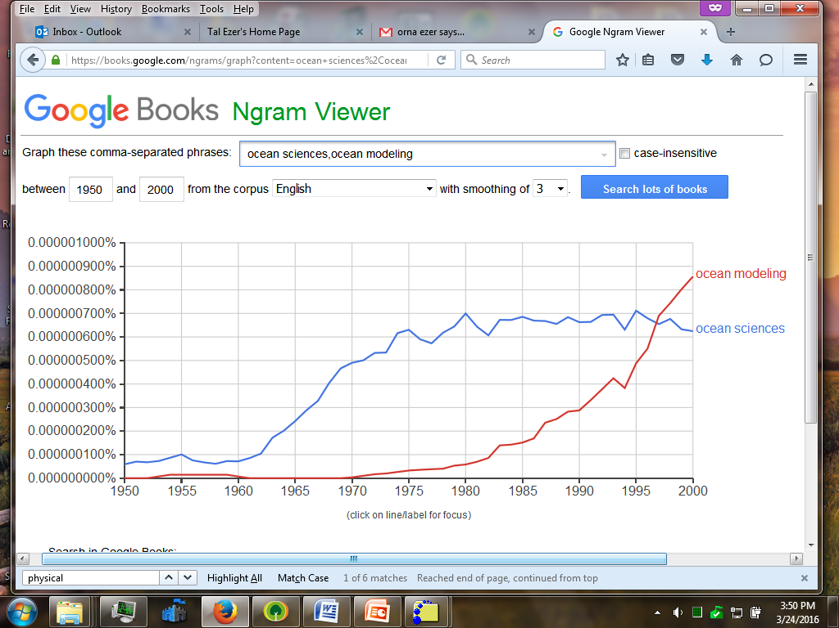
Numerical ocean modeling is a relatively new field
1993: 1st web browser Mosaic →
1994: POM
on web
Mellor&Yamada (1974)
GOM, Atlantic coast, estuaries
Sea-ice coupled model
operational forecast systems, & data assimilation
basin-scale and climate models
Examples of some of the milestones in the development of POM

Slide 7
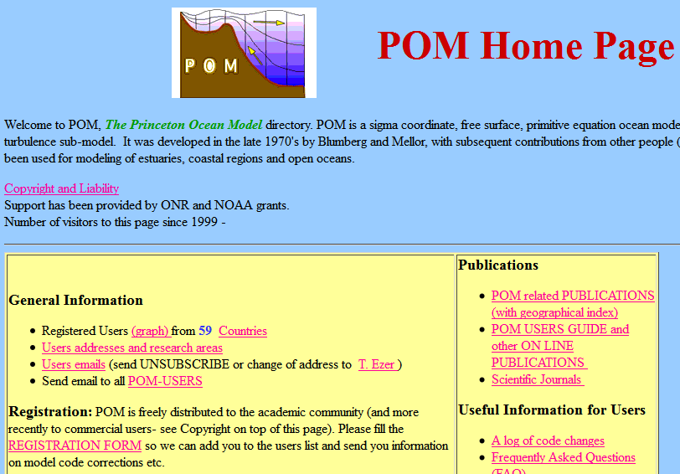
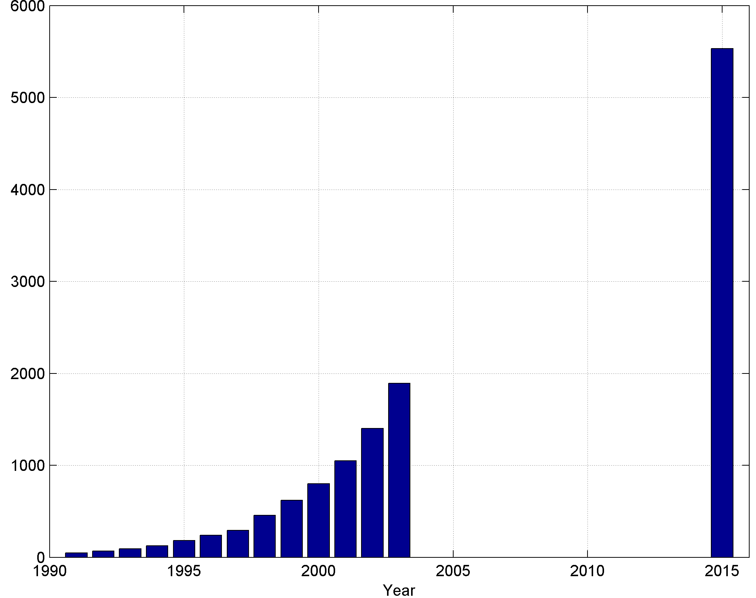
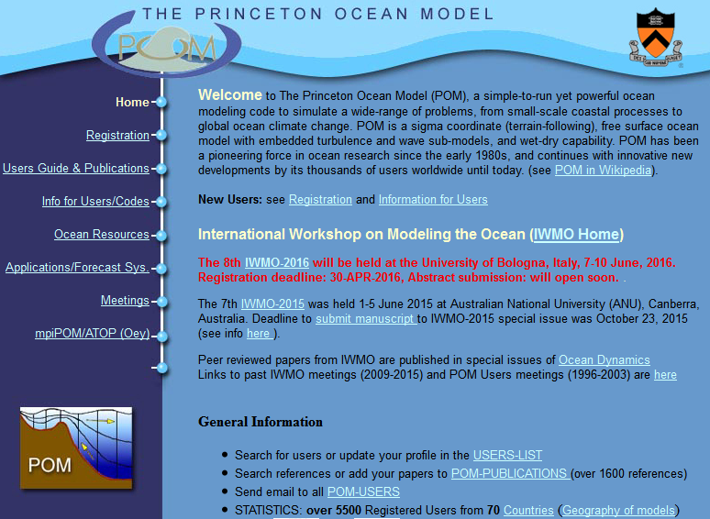
1991: POM Users Group established
(~ 20 users)
1994: First POM web site was set
(www.aos.princeton.edu)
(~ 60 users)
[one of the first community ocean model codes to be freely available to all users and provided online]
POM registered users
2016 (~6000 current & past users)
(http://www.ccpo.odu.edu/POMWEB/)

Slide 8
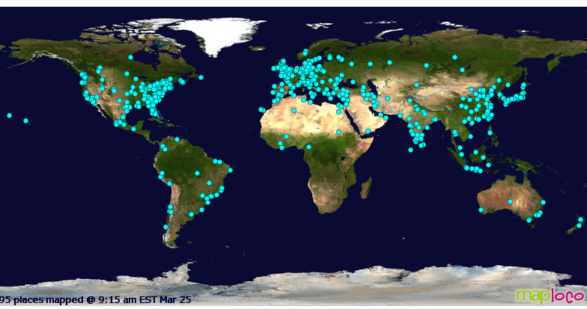
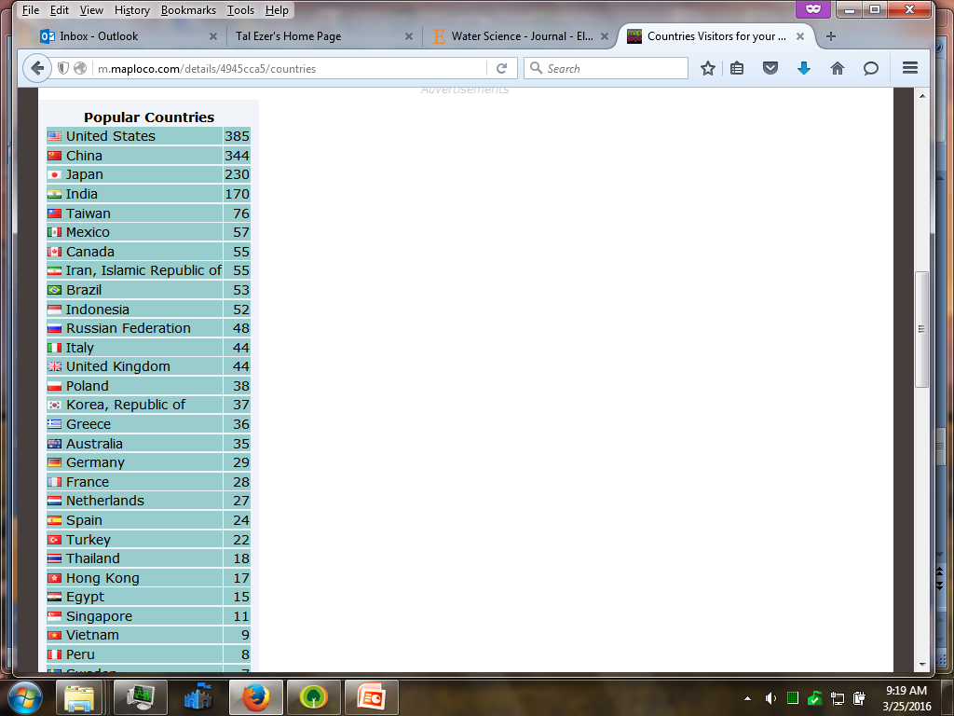
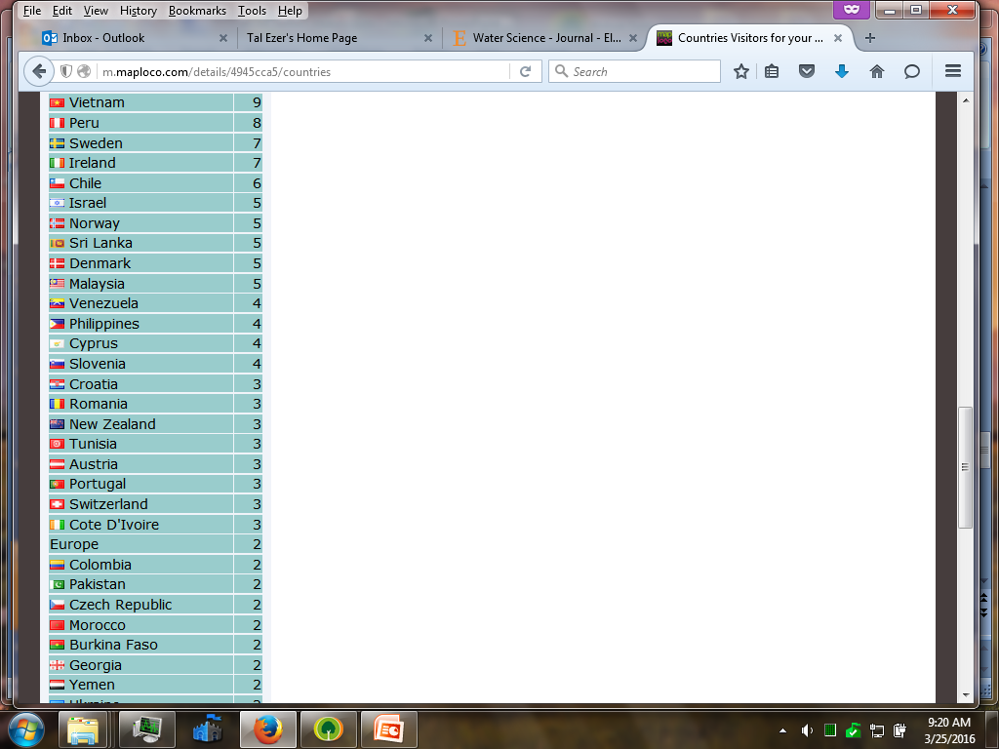
Recent viewers of the POM web site (http://www.ccpo.odu.edu/POMWEB/)

Slide 9
Until the 1980s: very few models (POM/Princeton, MOM/GFDL, HOPS/Harvard)
Development and Expansion of ocean models:
Sigma coord models
POM (POMnb, POMgcs, mpiPOM) → CUPOM → ECOM → NCOM → FVCOM
SPEM → SCRUM → TOMS → ROMS
Isopycnal models
MICOM → HYCOM ; HIM → GOLD
Z-level models
MOM → POP → OPA → NEMO
Now: many generalized-coordinates or hybrid models
that combine different grids in a single code

Slide 10
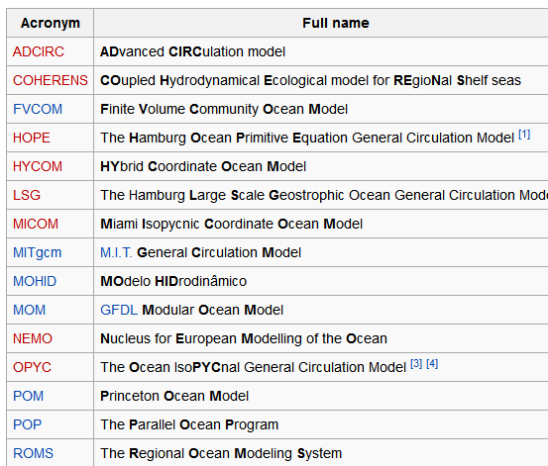
(incomplete) List of Ocean Circulation Models

Slide 11
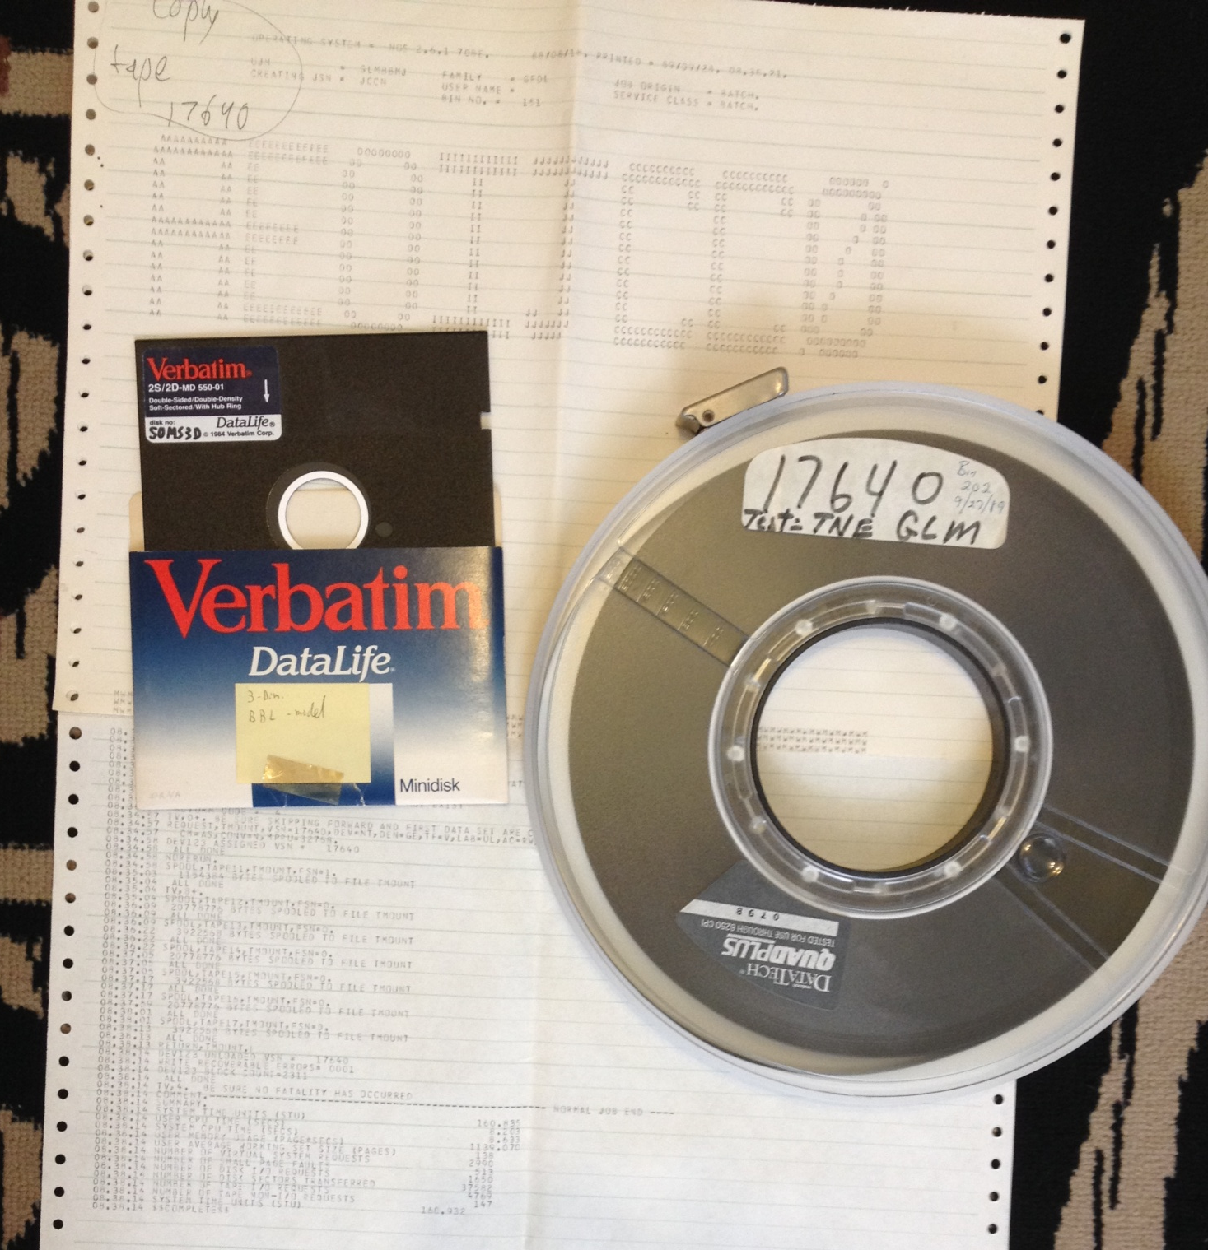
Technology had changed …....
Remember these?....
George L. Mellor
code at GFDL
model code saved on a “floppy” →
1989:
Model output saved on GFDL ← computer
1989

Slide 12
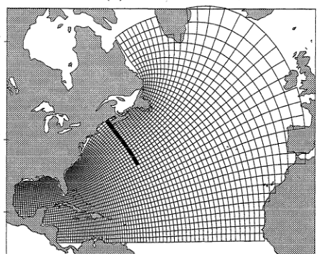
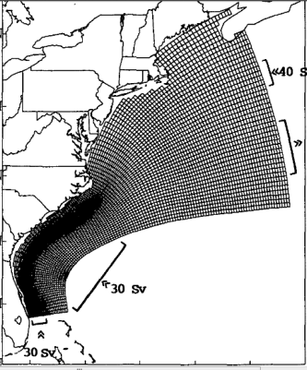
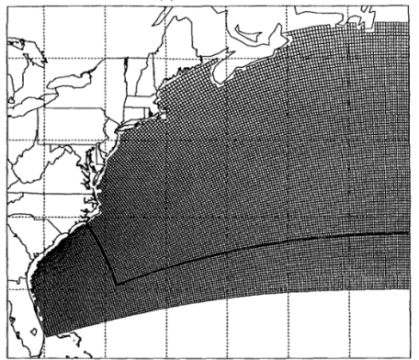
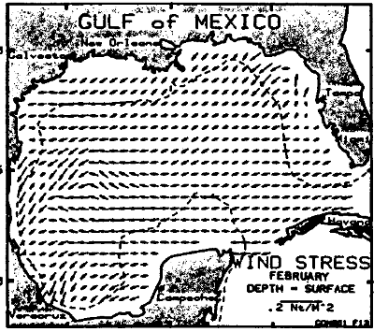
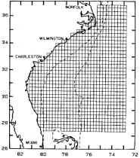
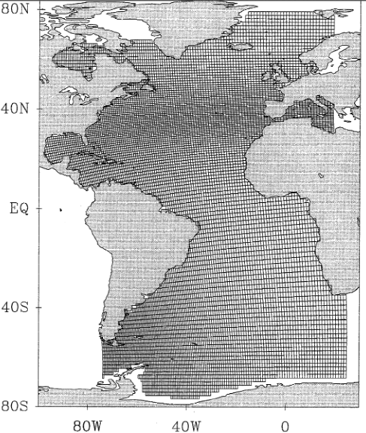
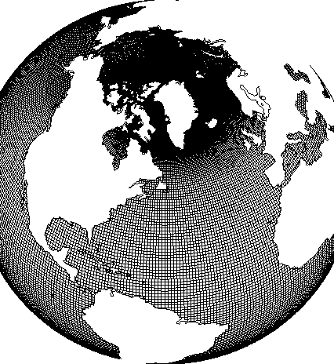
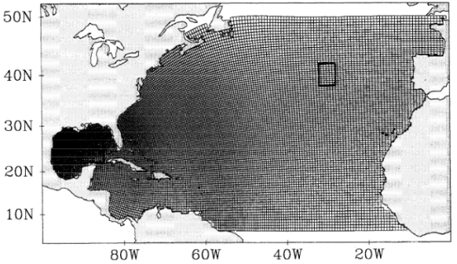
Improved computation capabilities allows expanding models to finer grids and larger scale problems
(examples from few applications of POM to Atlantic Ocean)
1994
1991
1994
1985
1983
1997
1992-2016
2000

Slide 13
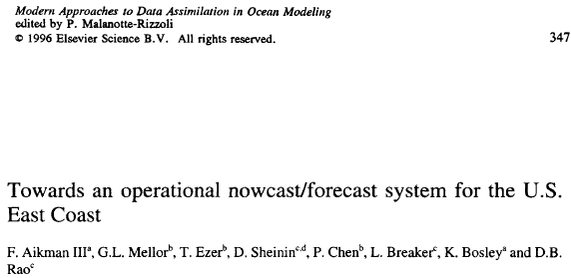
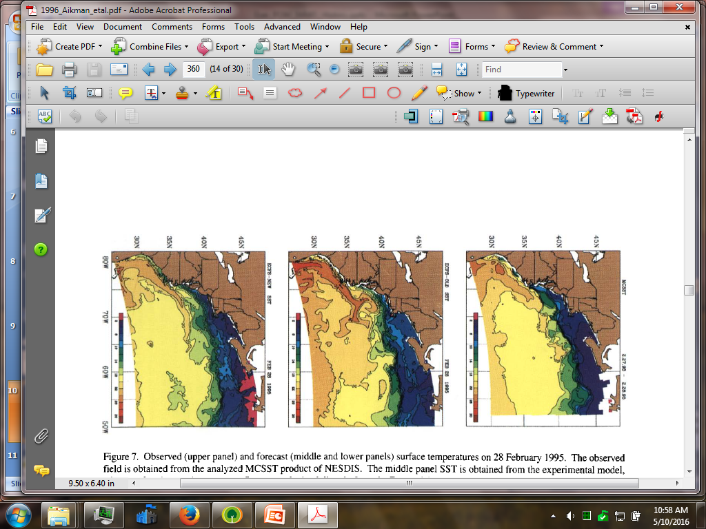
1996: one of the first operational ocean forecast systems (developed at Princeton and operated at NOAA/NMC, now NCEP)
Observed SST on 28-Feb-1995
Predicted SST on 28-Feb-1995

Slide 14
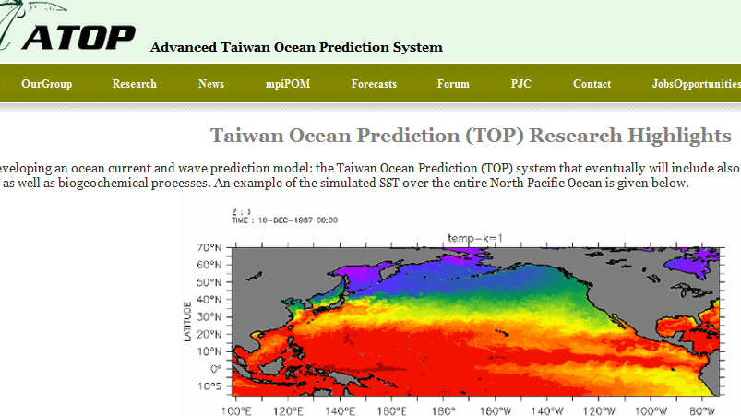
Today: many basin-scale and global ocean forecast systems…
(Oey et al.)

Slide 15
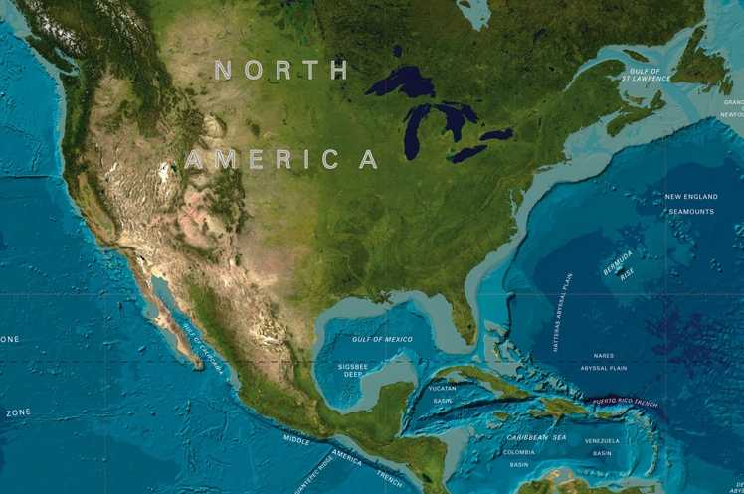
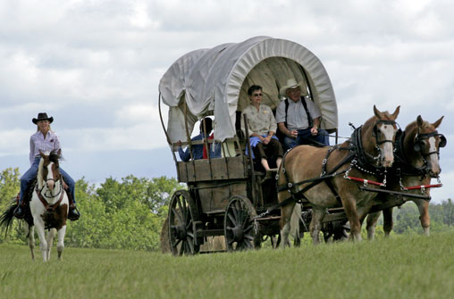
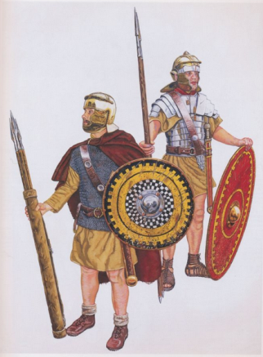
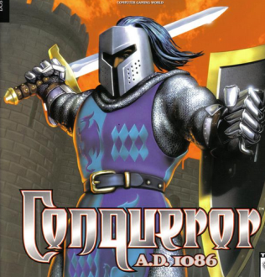
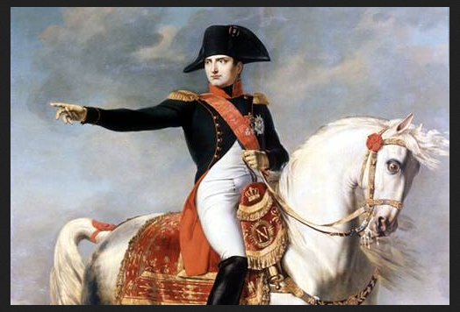
20 Years History of Ocean Modeling Meetings:
POM /Sigma-Coord Users’ Group Meetings
Westward Expansion
3. SIG-1999
Bar Harbor, ME, USA
5. SIG-2003
Seattle, WA, USA
1. POM-1996, Princeton, NJ, USA
4. SIG-2001 Boulder, CO, USA
As ocean modeling became more international, why not conquer the rest of the world?...
2. POM-1998 Miami, FL, USA

Slide 16

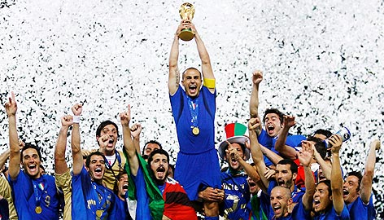
20 Years History of Ocean Modeling Meetings:
International Workshop on Modeling the Ocean (IWMO)
10. IWMO-2013
Bergen, Norway
5. 2003
13. IWMO-2016
Bologna, Italy
11. IWMO-2014
Halifax, Canada
9. IWMO-2012, Yokohama, Japan
4. 2001
3. 1999
1. 1996
8. IWMO-2011, Qingdao, China
7. IWMO-2010
Norfolk, VA, USA
6. IWMO-2009, Taipei, Taiwan
2. 1998
12. IWMO-2015, Canberra, Australia
IWMO Score:
Asia: 3, N. America: 2, Europe: 2, Australia: 1

Slide 17
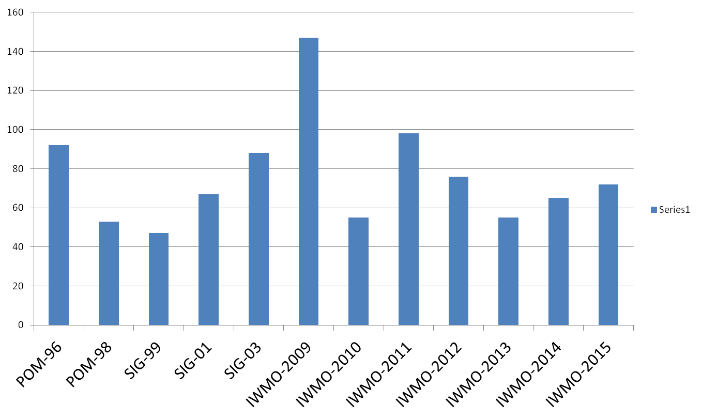
Number of attendees (estimated)
N. AMERICA
ASIA
EUROPE
Australia
Bologna
Italy
Taipei
Taiwan
Princeton
NJ, USA
Seattle
WA, USA
Qingdao
China
Canberra
Australia
Miami
FL, USA
Boulder
CO, USA
Yokohama
Japan
Halifax
Canada
Norfolk
VA, USA
Bergen
Norway
Bar Harbor
ME, USA
2016

Slide 18

International nature of ocean modeling
POM-1996 (~10 countries)
Australia, Brazil, Canada, Denmark, Germany, Greece, Korea, Japan, Norway, US.
IWMO- (~50 countries)
Australia, Belgium, Brazil, Canada, Chile, China, Cuba, Denmark, Estonia, France, Germany, Greece, Hong Kong, India, Indonesia, Ireland, Israel, Italy, Japan, Korea, Malaysia, Mexico, Norway, Peru, Poland, Russia, Singapore, Slovenia, Spain, Sri Lanka, Sweden, Taiwan, Thailand, Turkey, UK, US, Vietnam.

Slide 19
Presentation’s topics during users’ meetings reflect the ocean modeling evolution
Presentation topics in POM-1996:
~20 estuarine and coastal simulations
(NY Bight, submarine canyon, Gibraltar St., Tampa Bay, Great Lakes, South China Sea, etc.)
~7 basic model development issues
(Open BCs, pressure gradient errors, grid comparisons, advection scheme, etc.)
~4 development of forecast systems
~3 developing basin-scale models
(Arctic/Atlantic, Kuroshio, Gulf of Mexico)
~1 ecological model
Presentation topics in IWMO-2015:
~20 estuarine and coastal processes
~2 model development
~5 data assim. & forecast systems
~25 basin-scale to global simulations and climate change
~8 phys-biol/ecosystem models
~10 waves, tides and sediment
~10 process studies, eddies, etc.

Slide 20


IWMO meetings resulted in 6 published special issues (and 2, 2014/2015, still in progress…)
~80 peer-reviewed papers in
Ocean Dynamics

Slide 21

This talk is dedicated to George Mellor
Thank You

